Slide 1
Fully Homomorphic Encryption and the Future of Trustworthy AI
César Soto Valero
Notes:
And that’s precisely the title of this talk.
So let’s get started

Slide 2
Fully Homomorphic Encryption and the Future of Trustworthy AI
César Soto Valero
Notes:
And that’s precisely the title of this talk.
So let’s get started

Slide 3
Fully Homomorphic Encryption and the Future of Trustworthy AI
César Soto Valero
Notes:
And that’s precisely the title of this talk.
So let’s get started

Slide 4
Fully Homomorphic Encryption and the Future of Trustworthy AI
César Soto Valero
Notes:
And that’s precisely the title of this talk.
So let’s get started

Slide 5
Trust
Notes:
But first, before the technical exciting part.
I wanna mention one very important thing.
That our entire society, and all of us rely on.
Trust.
Because, if you think about about it, it’s just impossible to verify everything.

Slide 6
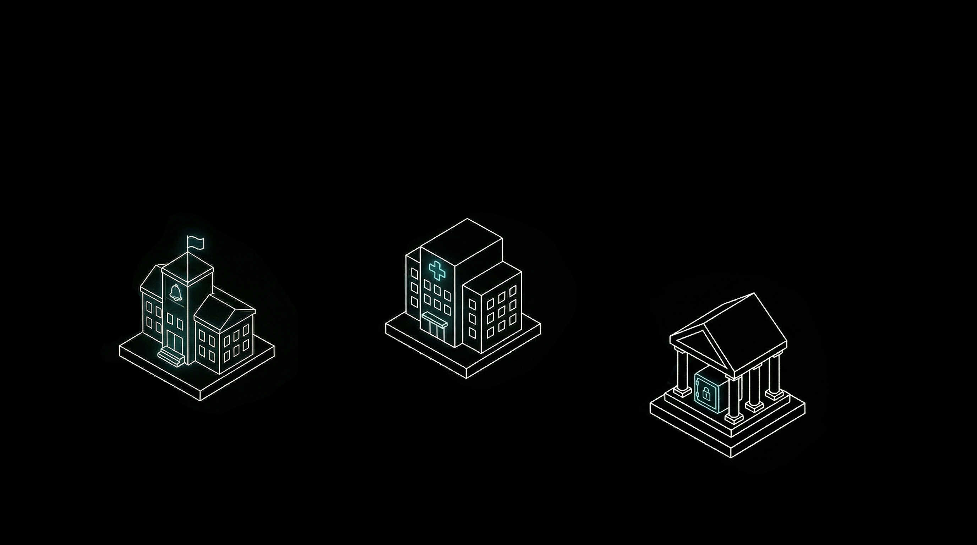
Trust
Healthcare
Notes:
For example
- We trust the skills of doctors when we get sick.
- We trust the knownledge our teachers when we’re students.
- And we trust the banks, the financial system, to hold and safeguard our money.

Slide 7
Trust
Healthcare
Education
Notes:
For example
- We trust the skills of doctors when we get sick.
- We trust the knownledge our teachers when we’re students.
- And we trust the banks, the financial system, to hold and safeguard our money.

Slide 8
Trust
Healthcare
Education
Finance
Notes:
For example
- We trust the skills of doctors when we get sick.
- We trust the knownledge our teachers when we’re students.
- And we trust the banks, the financial system, to hold and safeguard our money.

Slide 9
AI
Notes:
Exact spoken lines
“We already know how to protect data in two states. At rest, when it is stored. In transit, when it moves across the network. That part of the story is mature.” [PAUSE]
Build order
At rest -> In transit
Visual direction
Storage icon and network icon.
Speaker notes
Matter-of-fact tone.
Visual type
Manual simple state diagram
AI image prompt
“two secure data states visualized as encrypted storage and encrypted network transmission, minimalist and balanced, black background, white line art, subtle cyan accents, ultra-clean keynote slide aesthetic, high contrast, minimalist, technical, no text, no watermark, no labels”
Manual diagram instructions
Two large boxes:
storage icon
network icon No third box yet.

Slide 10

Notes:
For example
- We trust the skills of doctors when we get sick.
- We trust the knownledge our teachers when we’re students.
- And we trust the banks, the financial system, to hold and safeguard our money.

Slide 11

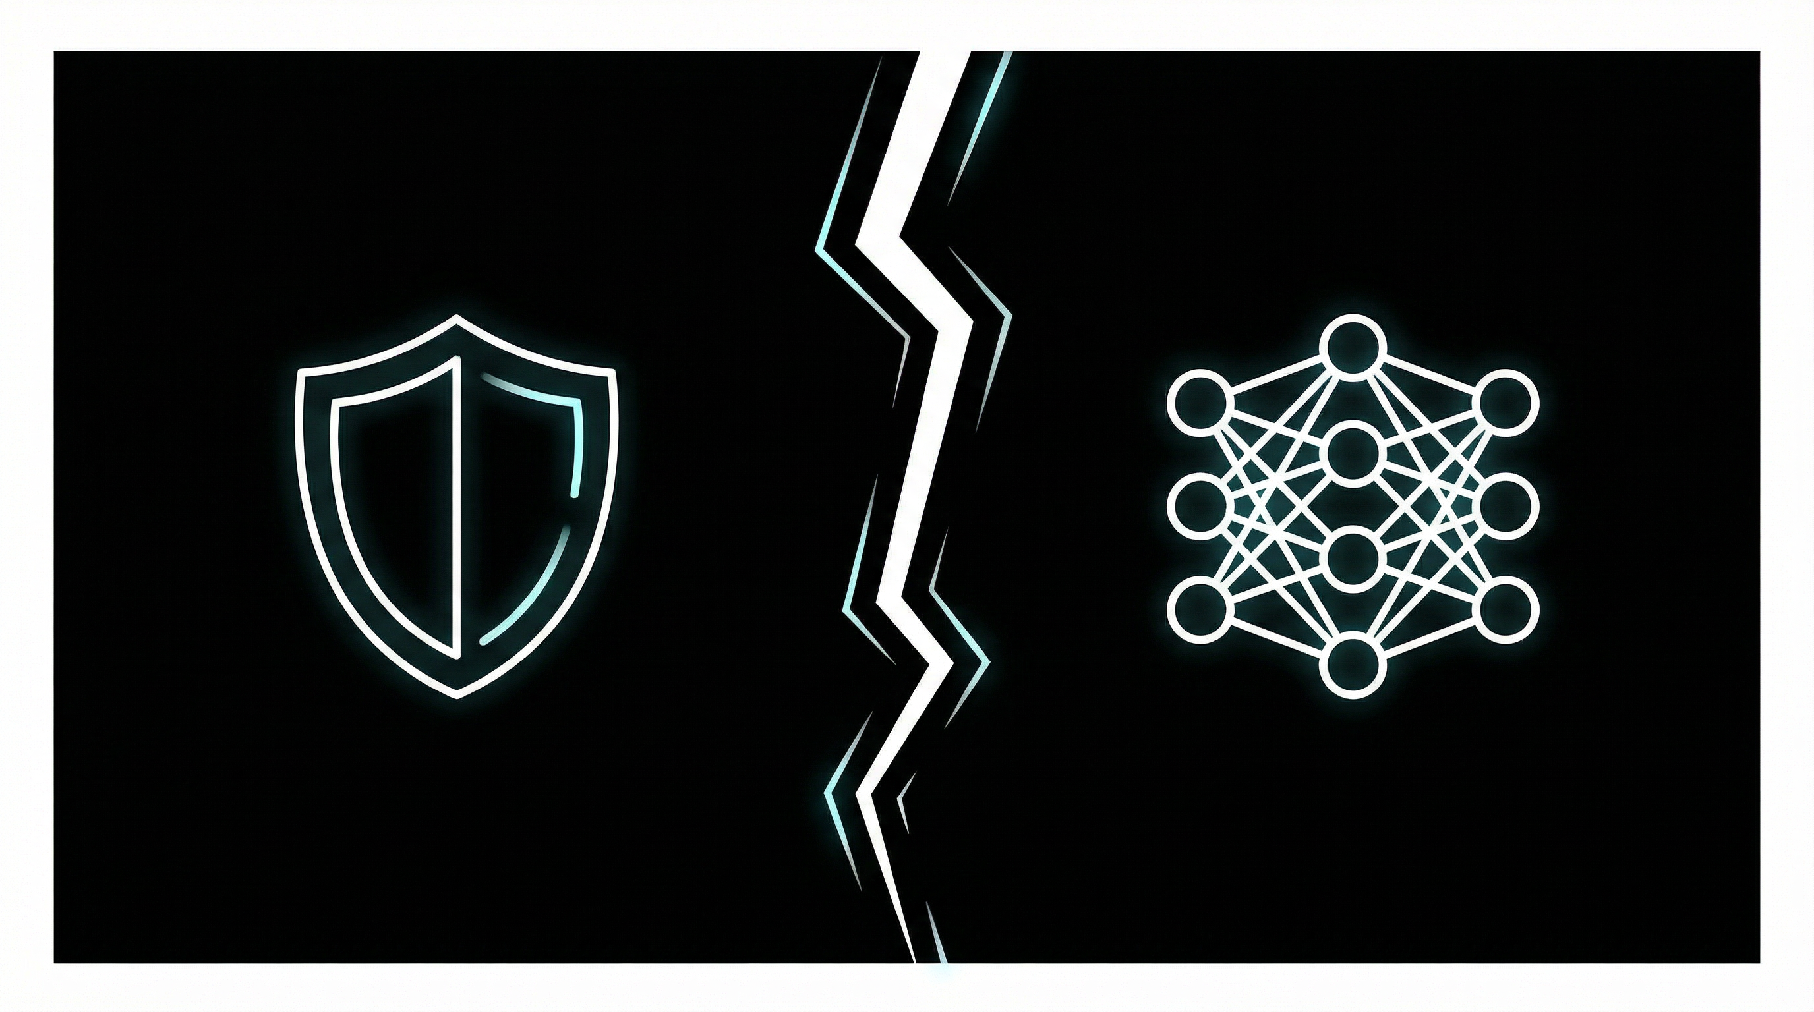
Notes:
For example
- We trust the skills of doctors when we get sick.
- We trust the knownledge our teachers when we’re students.
- And we trust the banks, the financial system, to hold and safeguard our money.

Slide 12

Notes:
For example
- We trust the skills of doctors when we get sick.
- We trust the knownledge our teachers when we’re students.
- And we trust the banks, the financial system, to hold and safeguard our money.

Slide 13

Notes:
For example
- We trust the skills of doctors when we get sick.
- We trust the knownledge our teachers when we’re students.
- And we trust the banks, the financial system, to hold and safeguard our money.

Slide 14

Notes:
For example
- We trust the skills of doctors when we get sick.
- We trust the knownledge our teachers when we’re students.
- And we trust the banks, the financial system, to hold and safeguard our money.

Slide 15
Data States
Notes:
Exact spoken lines
“We already know how to protect data in two states. At rest, when it is stored. In transit, when it moves across the network. That part of the story is mature.” [PAUSE]
Build order
At rest -> In transit
Visual direction
Storage icon and network icon.
Speaker notes
Matter-of-fact tone.
Visual type
Manual simple state diagram
AI image prompt
“two secure data states visualized as encrypted storage and encrypted network transmission, minimalist and balanced, black background, white line art, subtle cyan accents, ultra-clean keynote slide aesthetic, high contrast, minimalist, technical, no text, no watermark, no labels”
Manual diagram instructions
Two large boxes:
storage icon
network icon No third box yet.

Slide 16
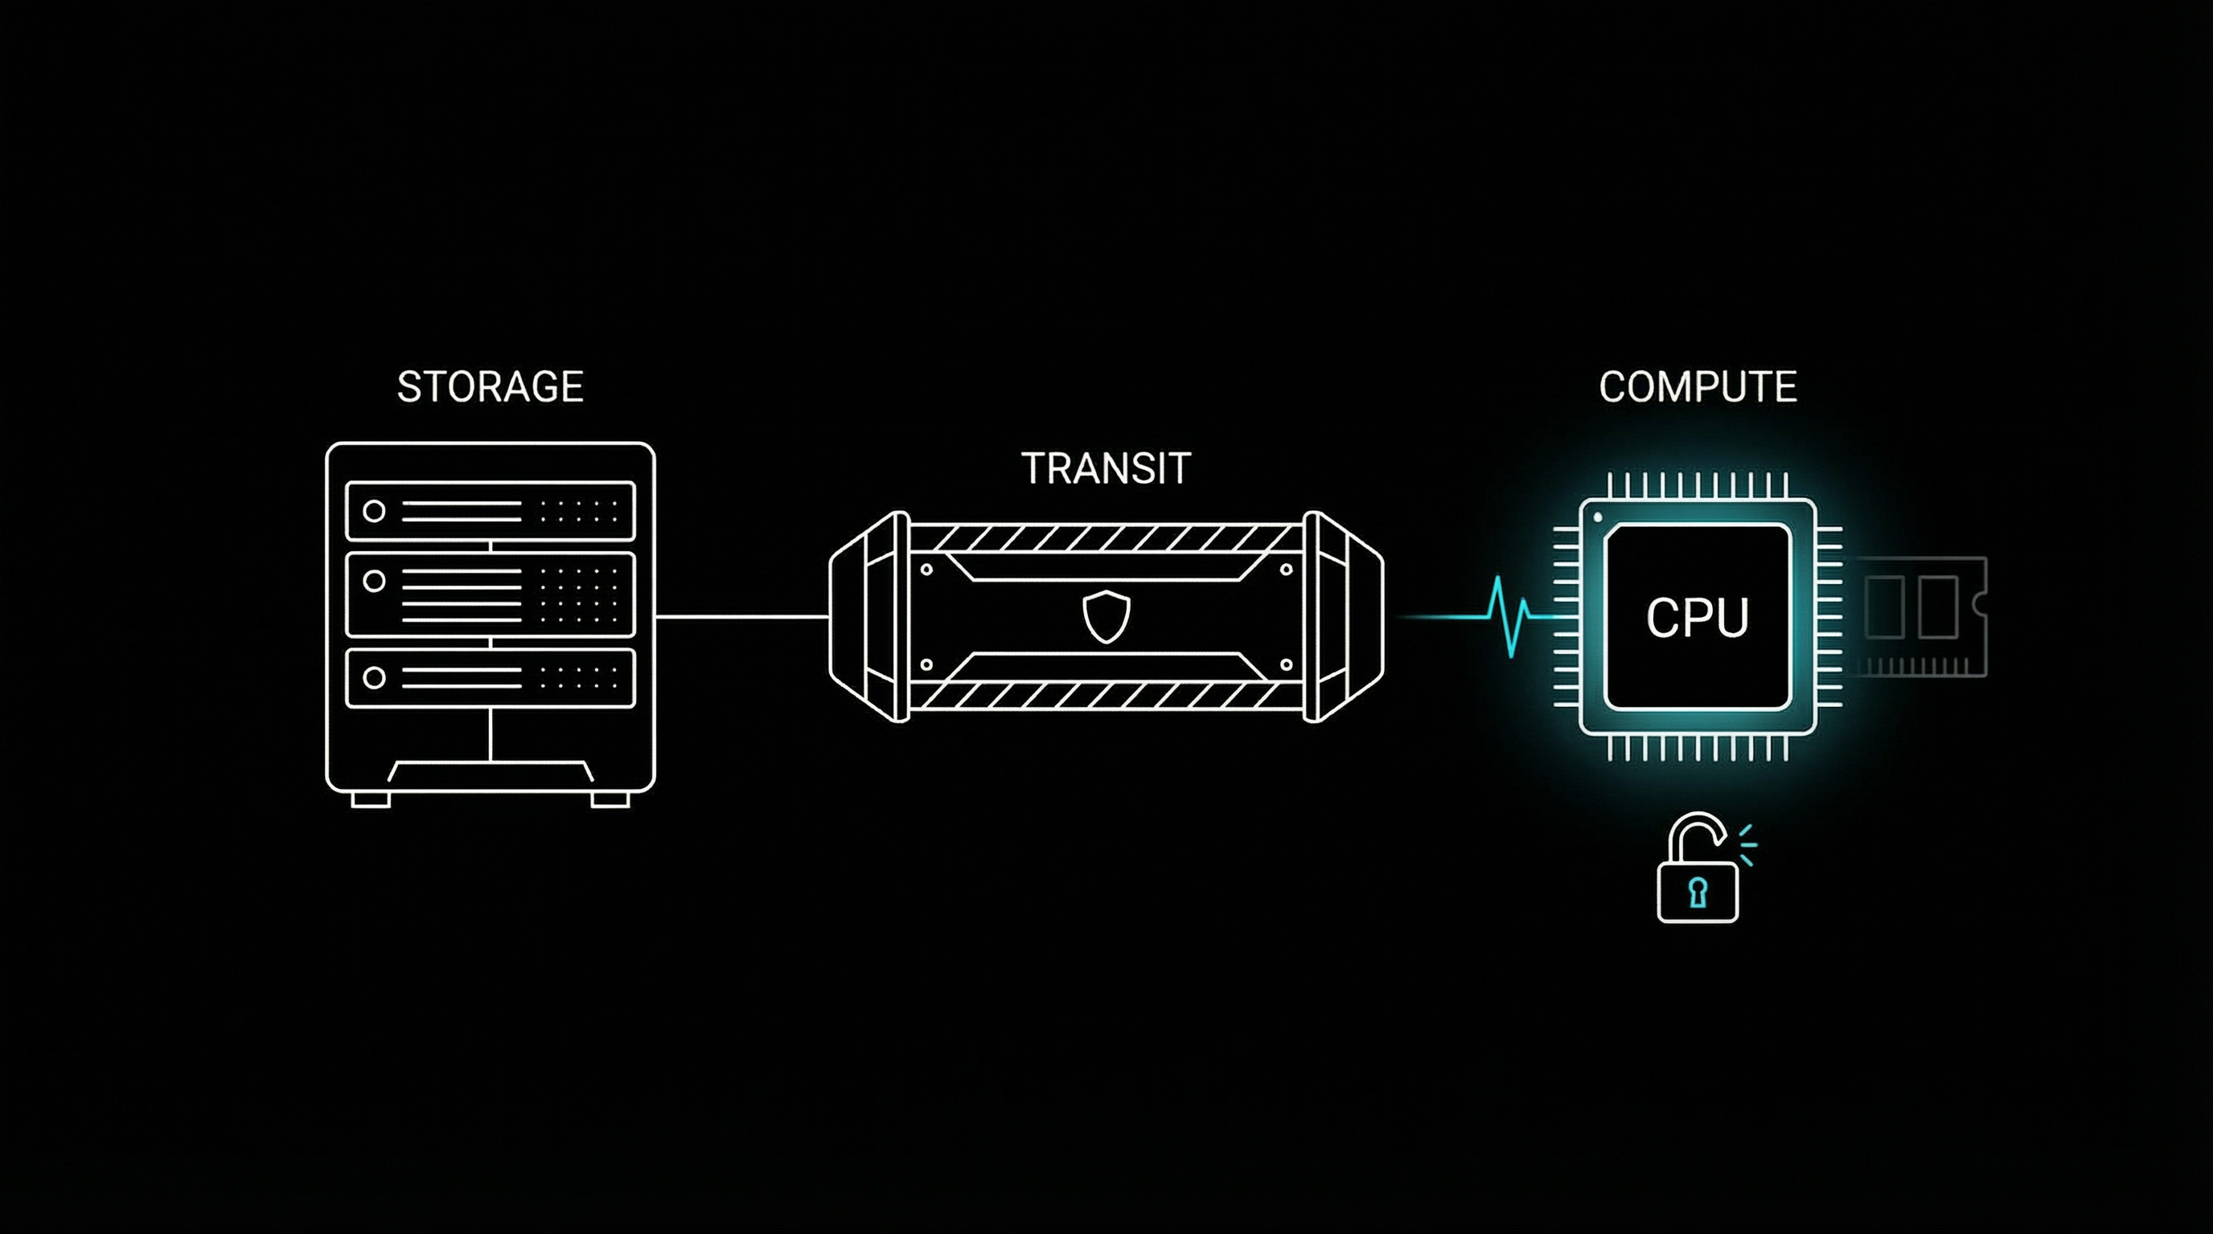
Data States
At rest
Notes:
At rest.
That is, you know, stored on disk.

Slide 17
Data States
In transit
At rest
Notes:
In transits, that is… moving around, on the network.

Slide 18
Data States
In transit
At rest
In use
Notes:
And in use, that’s the data that is being processed in memory

Slide 19

Data States
In transit
At rest
In use
Notes:
And the thing is that we have good encryption mechanisms for the fist one.

Slide 20
Data States
In transit
At rest
In use
Notes:
We have TLS, VPN, end-to-end encryption for the second one.

Slide 21

Data States
In transit
At rest
In use
Notes:
But when data is in use… Huston, we have a problem.

Slide 22
Data in Use Is Exposed
Notes:
But when data is in use… Huston, we have a problem.

Slide 23
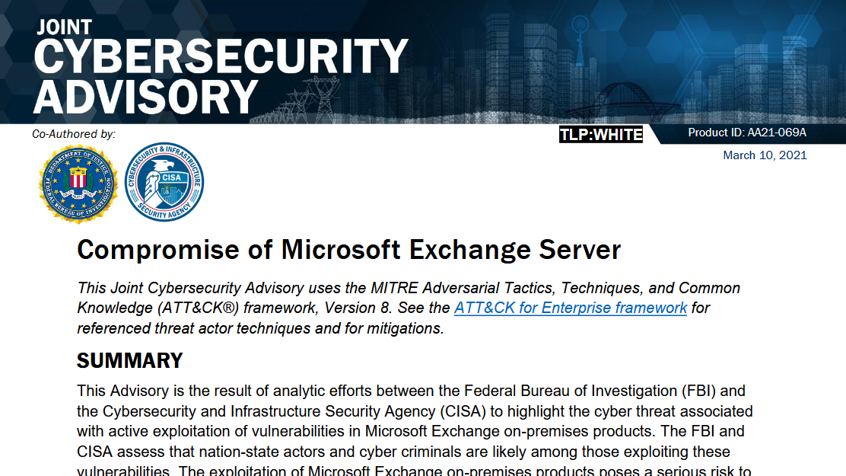
Notes:
But when data is in use… Huston, we have a problem.

Slide 24
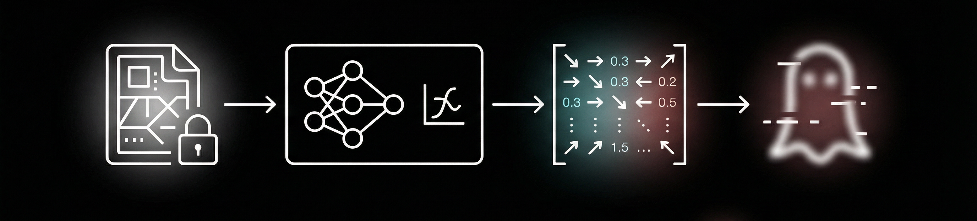
Gradients can reveal data
Zhu et al., “Deep Leakage from Gradients,” NeurIPS 2019
Notes:
The gradients can reveal data.
In other words, it’s possible to reverse engineering them.

Slide 25
Solution?
Notes:
What’s the solution then?

Slide 26
Fully Homomorphic Encryption
Notes:
Well, we’re lucky today because there’s something called “Homomorphic Encryption”

Slide 27
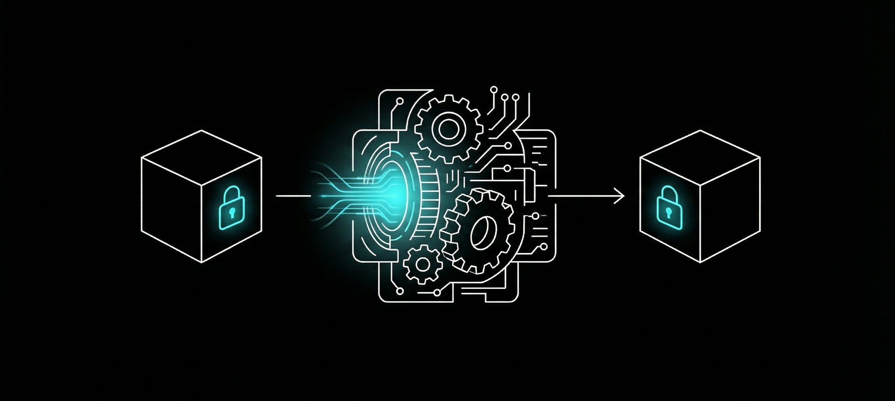
Computing on encrypted data
Notes:
So, homomorphic encryption is a way to compute on encrypted data.

Slide 28


Notes:
So, homomorphic encryption is a way to compute on encrypted data.

Slide 29

Notes:
So, homomorphic encryption is a way to compute on encrypted data.

Slide 30
Notes:
So, homomorphic encryption is a way to compute on encrypted data.

Slide 31
Notes:
So, homomorphic encryption is a way to compute on encrypted data.

Slide 32

Notes:
So, homomorphic encryption is a way to compute on encrypted data.

Slide 33
Example
Notes:
And that’s a way to achieve AI privacy by design, not by promise.

Slide 34
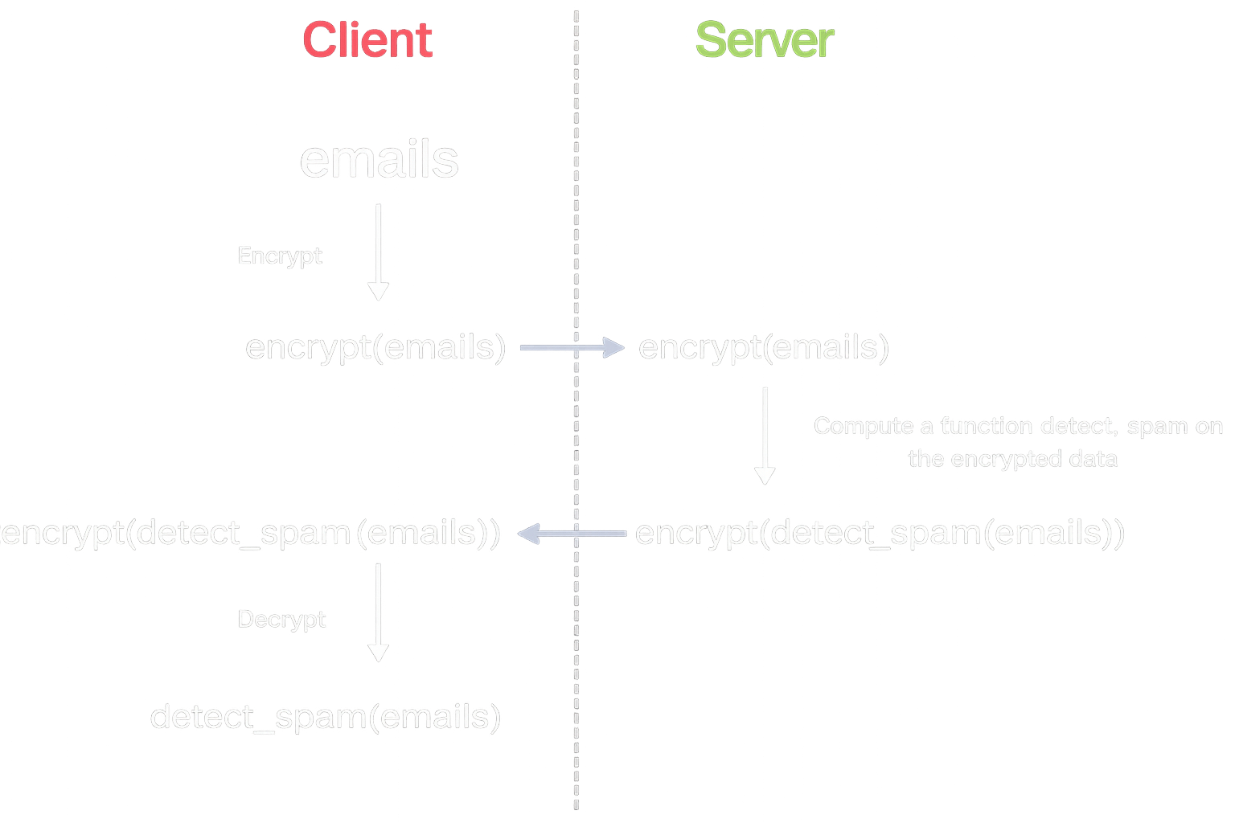
Notes:
And that’s a way to achieve AI privacy by design, not by promise.

Slide 35
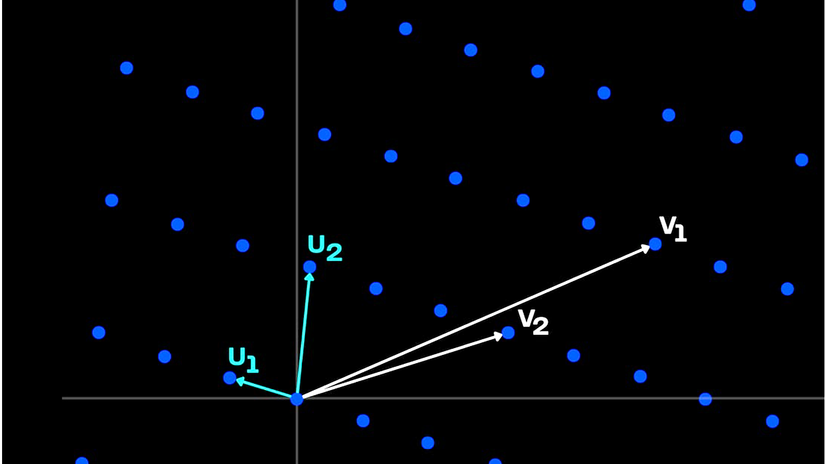
Lattice-based cryptography
Notes:
To do this transformation, FHE uses lattice-based cryptography.
Imagine a multidimensional grid of points extending infinitely in all directions.
At the heart of lattice-based cryptography are problems that are believed to be extremely hard to solve even for quantum computers.
---
Source: https://www.zama.ai/post/fully-homomorphic-encryption-and-post-quantum-cryptography

Slide 36
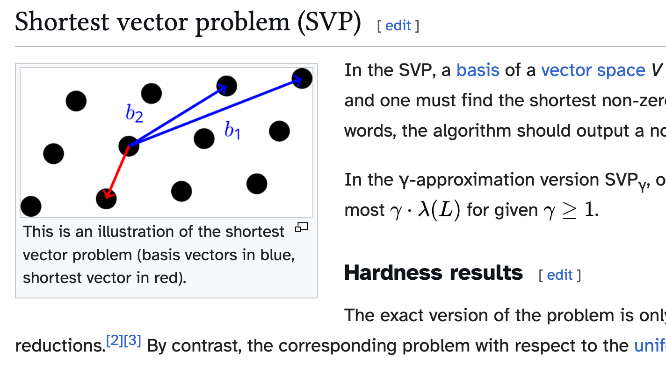
Notes:
- Closest Vector Problem (CVP): Find the lattice point nearest to any given point In 2D, these look trivial. But add 1,000,000 dimensions?
Then it becomes extremely hard, so that it is believed that even quantum computers can't crack them efficiently.
This makes FHE inherently quantum-resistant. A very important property to prepare for the possible quantum computing future.
Bonus: Lattice operations are highly parallelizable, which means they benefit enormously from modern GPUs and specialized hardware acceleration.

Slide 37

Notes:
- Closest Vector Problem (CVP): Find the lattice point nearest to any given point In 2D, these look trivial. But add 1,000,000 dimensions?
Then it becomes extremely hard, so that it is believed that even quantum computers can't crack them efficiently.
This makes FHE inherently quantum-resistant. A very important property to prepare for the possible quantum computing future.
Bonus: Lattice operations are highly parallelizable, which means they benefit enormously from modern GPUs and specialized hardware acceleration.

Slide 38
❶
❷
❸
Encrypt
Compute
Decrypt
Notes:
So we encrypt, then we computer, and then decrypt, right?
This is the proper way.

Slide 39
Moore’s Law of
Fully Homomorphic Encryption
Notes:
What’s the solution then?

Slide 40
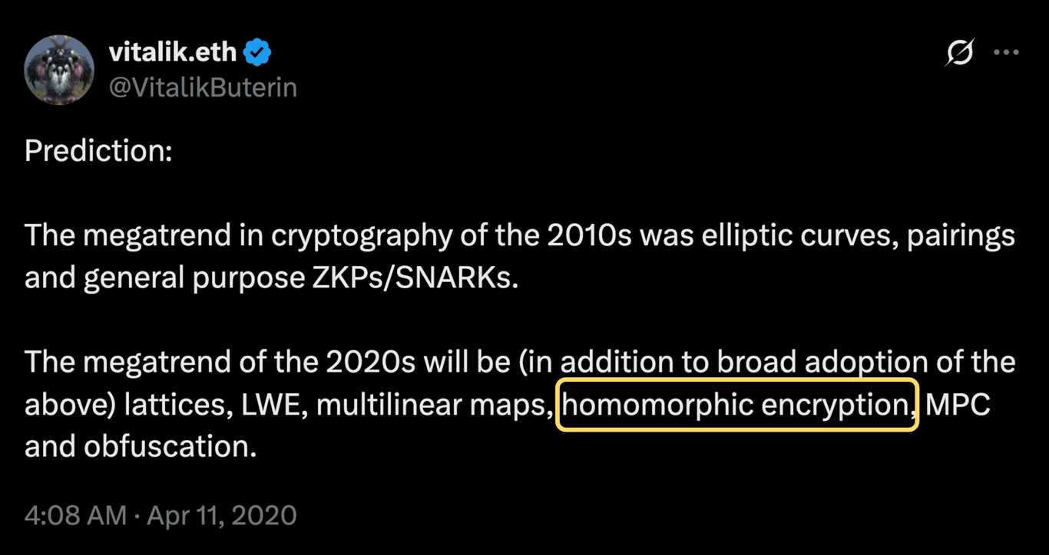
Notes:
And this is also not new.
Homomorphic Encryption has been a megatrend in the last few years.
Why?

Slide 41
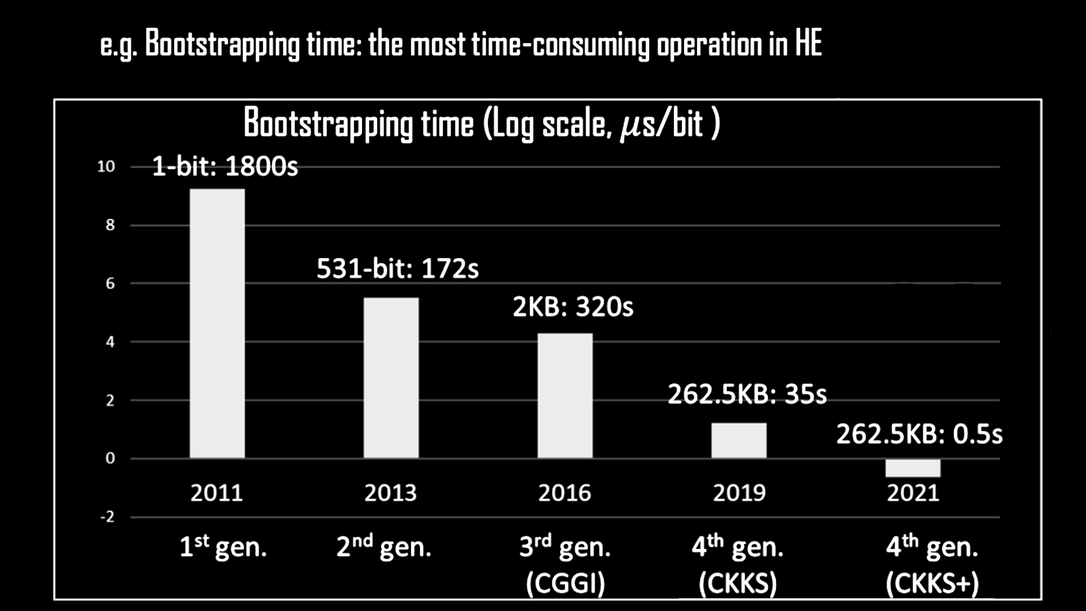
It is getting 8x faster every year
Notes:
Well, computing on encrypted data gets faster and faster every year.
Actually, around 8 times faster every year.

Slide 42
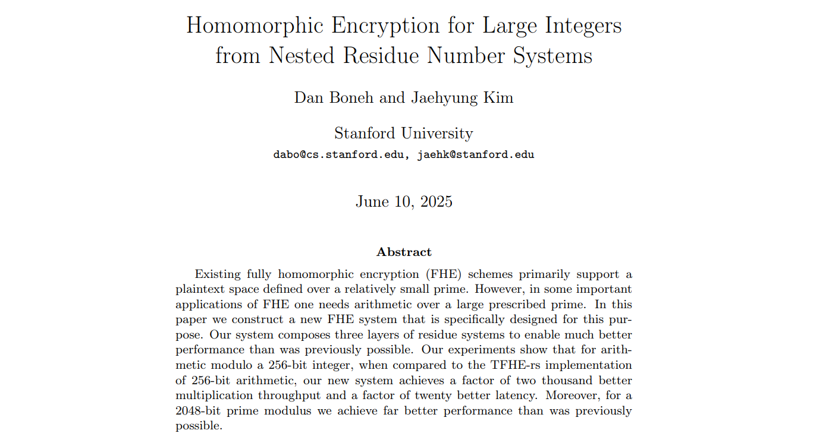
Notes:
A recent paper published in June 2025 claims 1,000× higher multiplication throughput and 10× lower latency (for large-integer operationss) Alongside with algorithm improvements, hardware improvements are also happening, compounding the effect.
Hardware acceleration could increase the speed by more that another 1,000x.

Slide 43
Applications
Notes:
There are even compilers for this.

Slide 44
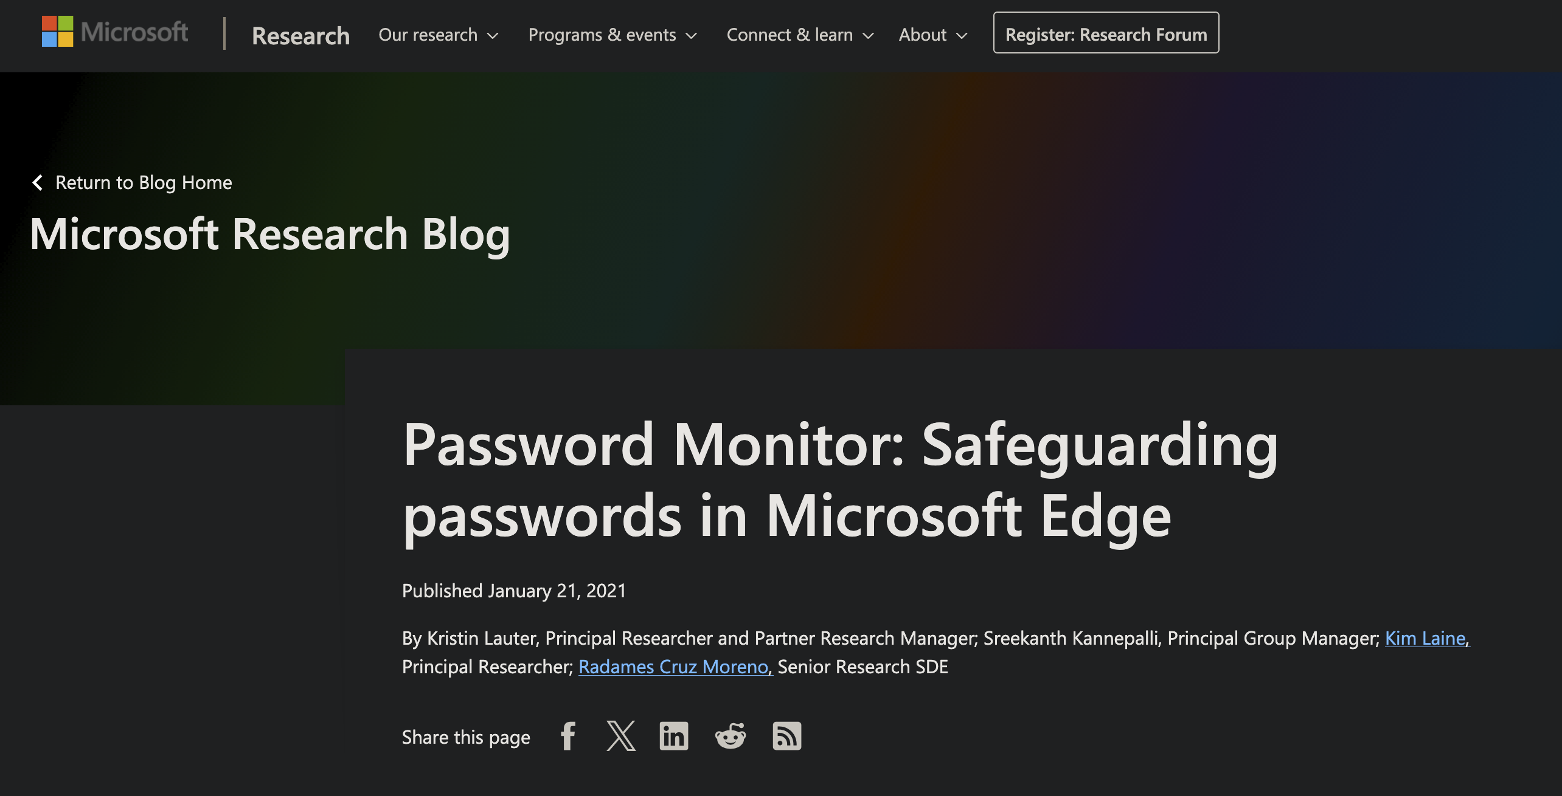
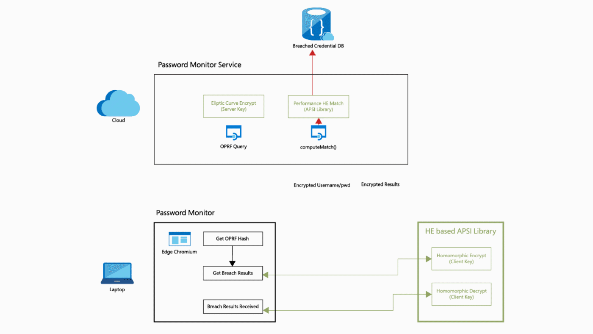
Notes:
Because it’s really useful.
Homomorphic Encryption is already being applied in real wold applications,
Mycrosoft security uses HE for Password Checkup in the Edge browser, they do private set intersection on encrypted data.

Slide 45
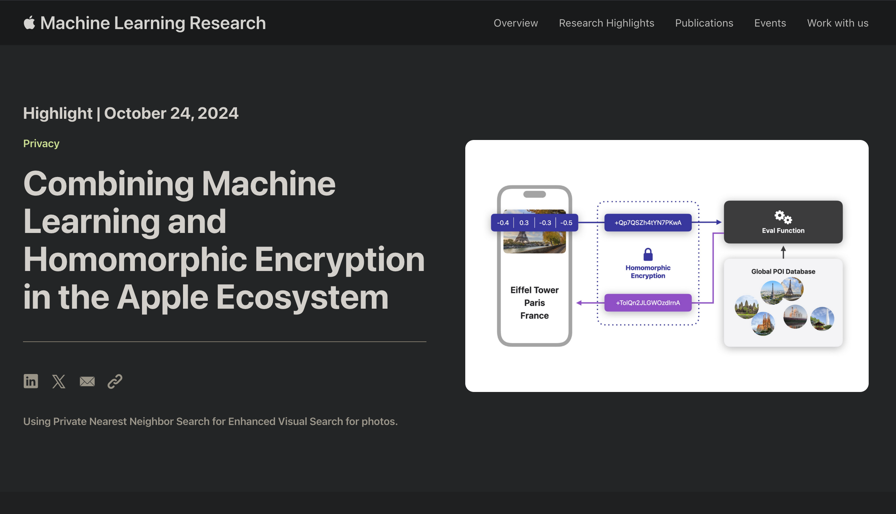
Notes:
Apple uses Homomorphic Encryption for Machine learning on for private nearest neighbours search

Slide 46
Tools
Notes:
A recent paper published in June 2025 claims 1,000× higher multiplication throughput and 10× lower latency (for large-integer operationss) Alongside with algorithm improvements, hardware improvements are also happening, compounding the effect.
Hardware acceleration could increase the speed by more that another 1,000x.

Slide 47
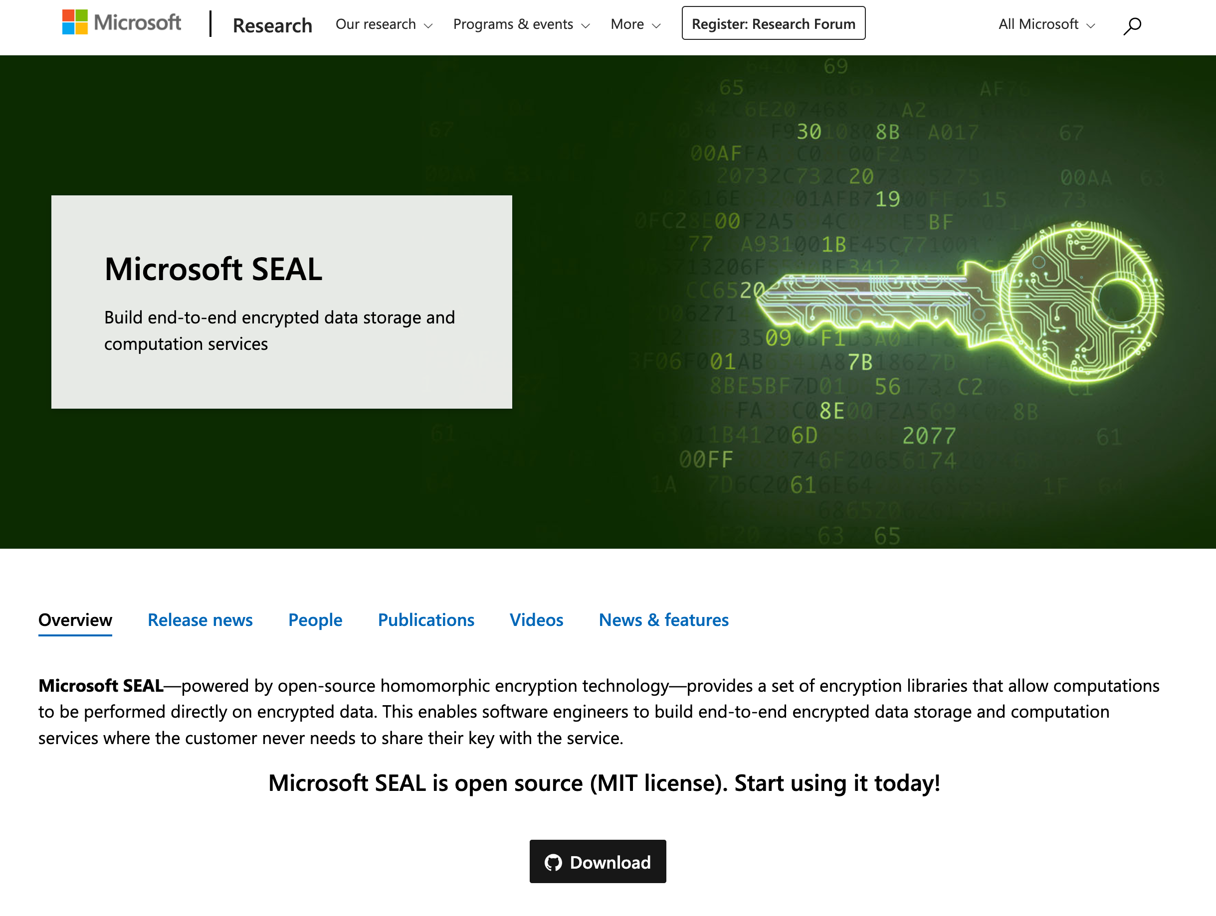
SEAL
https://github.com/Microsoft/SEAL
Notes:
For example, Microsoft has library called SEAL that supports all of this.

Slide 48
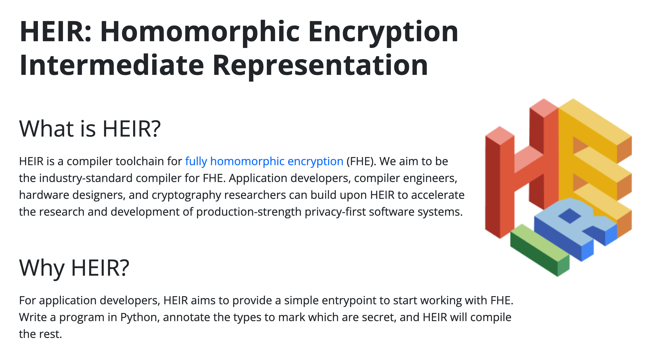
HEIR
https://heir.dev
Notes:
There are even compilers for this.

Slide 49
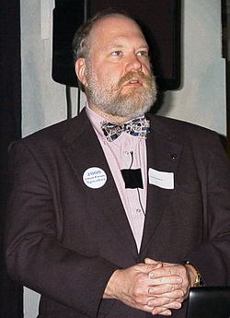
“Using encryption on the Internet is the equivalent of arranging an armoured car to deliver credit card information from someone living in a cardboard box to someone living on a park bench.”
– Gene Spafford (a.k.a Spaf)

Slide 50

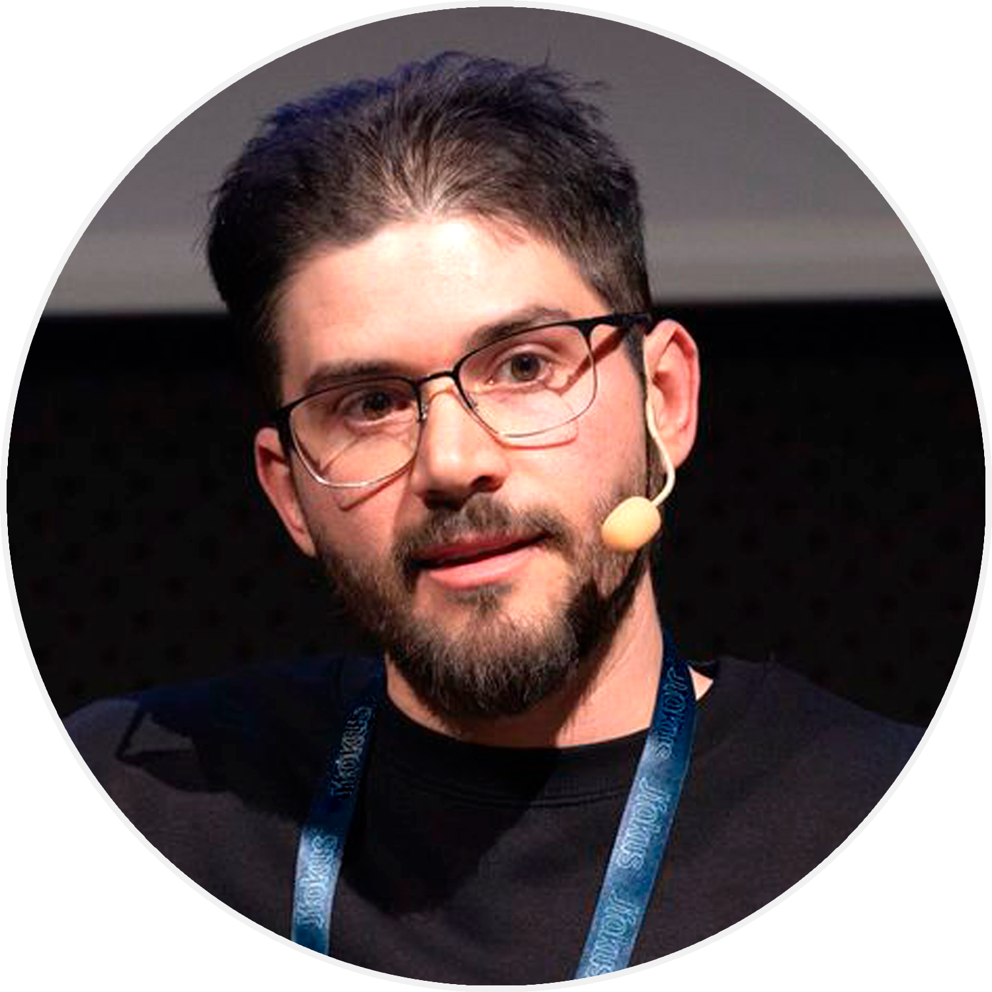

cesarsotovalero.net

