Slide 1
Moving Fast and Importing Things
The Software Supply Chain of Agentic AI
César Soto Valero
The 5th KTH Workshop on the Software Supply Chain, 24 April 2026.
Notes:
Yes, Let’s get started. Good afternoon, everyone.
My name is César, I did my PhD here at KTH, graduated 3 years ago. Now I work in the finance industry in Stockholm, and this talk is about the software supply chain of agentic AI

Slide 2
vibe coding
Notes:
Just a quick disclaimer, this is not about the dangers of blindly vibe coding and shipping code in production that we have never read, we don’t even understand, because I think vibe coding

Slide 3
coding
Notes:
Just a quick disclaimer, this is not about the dangers of blindly vibe coding and shipping code in production that we have never read, we don’t even understand, because I think vibe coding is now just the way to do coding.

Slide 4
code
Notes:
So in the end, what matters is the code.

Slide 5
Importing Things
code dependencies,
runtime tool ecosystems,
persistence layers,
model registries,
cloud services,
multiple states,
storage,
deployment,
integration surfaces,
…
Notes:
And in order to deliver code, we import many things. We know about dependencies, we know about the runtime tooling ecosystem

Slide 6
Importing Things
code dependencies,
runtime tool ecosystems,
persistence layers,
model registries,
cloud services,
multiple states,
storage,
deployment,
integration surfaces,
…
Notes:
But now, with this new agentic layer, we have a bunch of other things, persistence layers, model registries, storage, deployments, and so on.
But and the core of all this, there’s one thing.

Slide 7
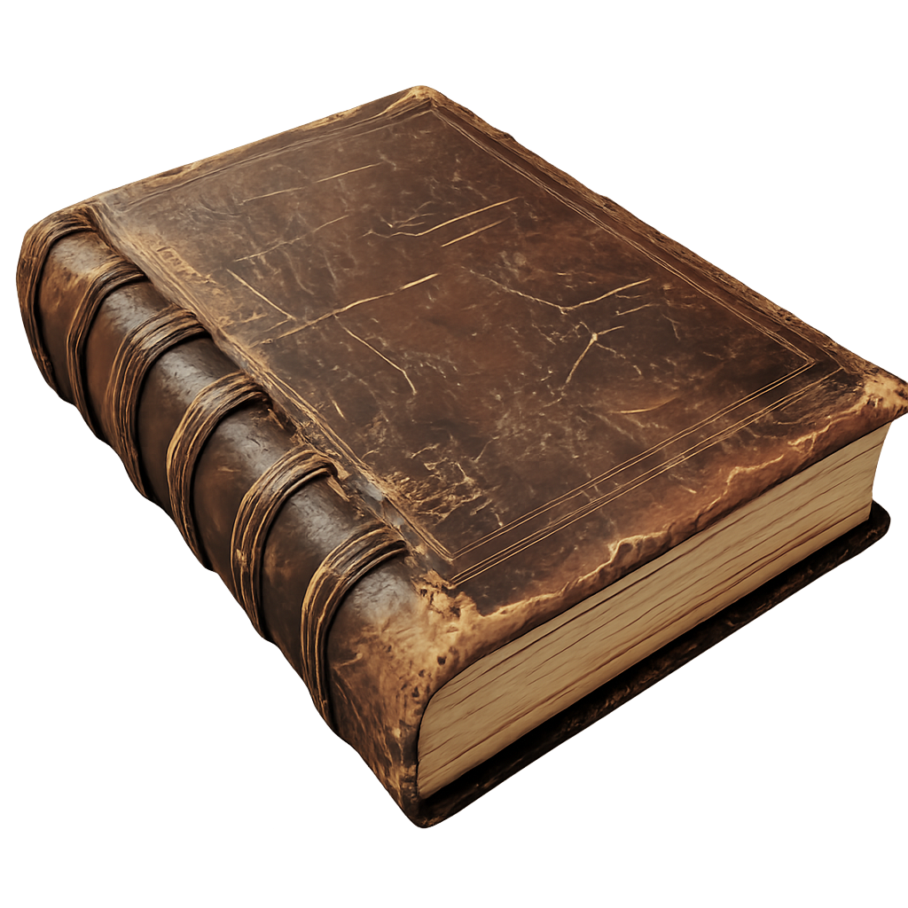
“The application code could be small, but
the trust boundary is enormous”

Slide 8
Accountability
Notes:
Accountability

Slide 9
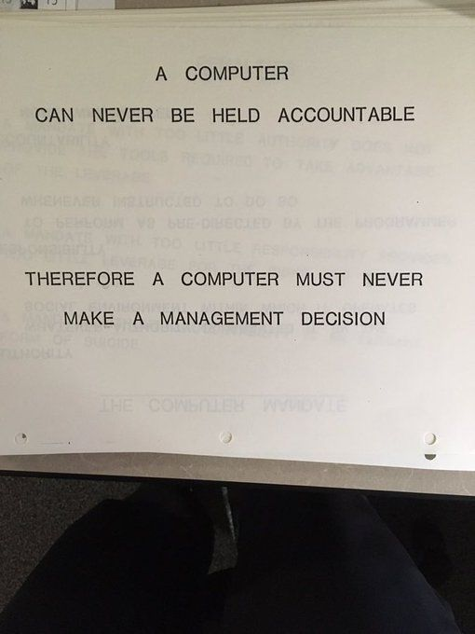
IBM - 1979
Notes:
This is from IBM, 1979.
“A computer can never be held accountable.
Therefore, a computer must never make a management decision.”
Today, AI systems choose models, feed on your data, trigger actions, spend money, affect outcomes and most teams can’t answer a simple question:

Slide 10
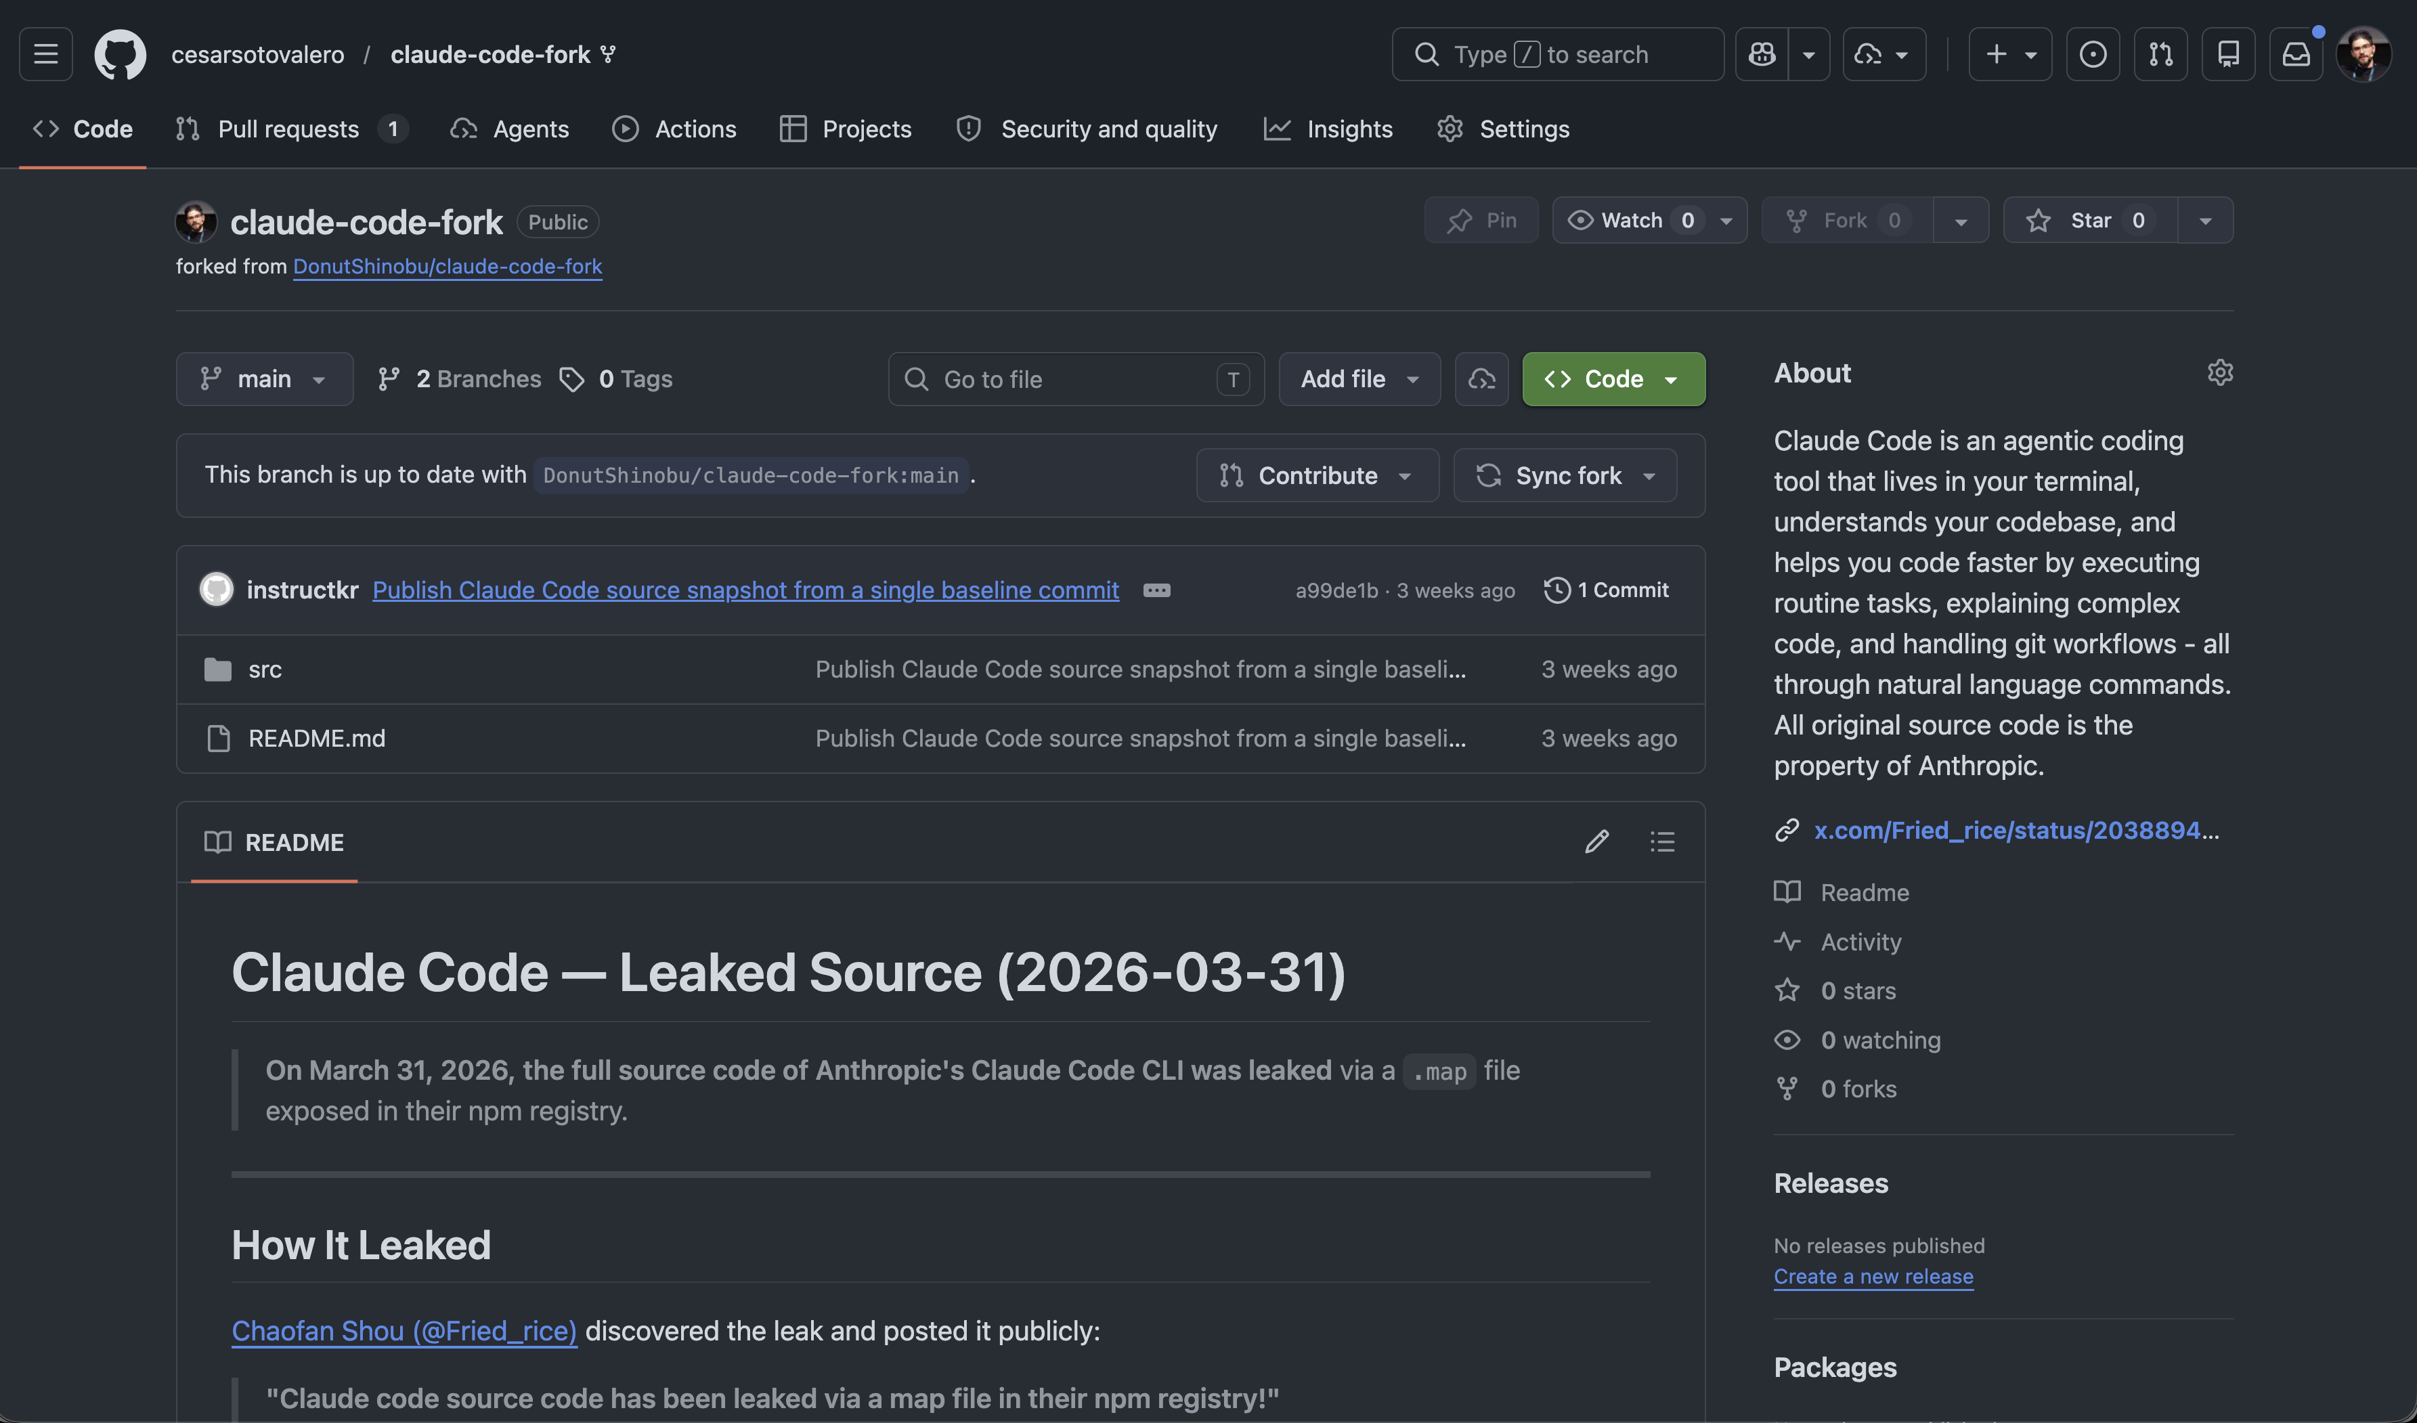

Notes:
Accountability

Slide 11

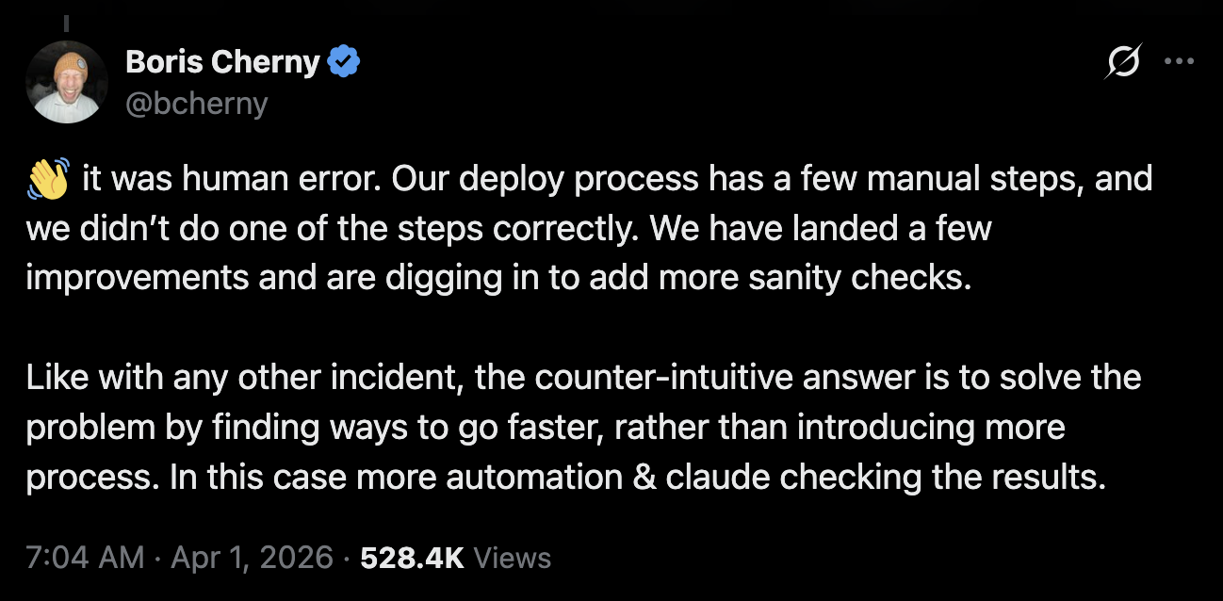
Notes:
The developer himself, Kevin Naughton, said he did not expect that. He believed that "the safeguards Claude Code had built for me would be adequate".
He also said "I take full responsibility."
The following day, when Kevin was fired...

Slide 12
Agentic Frameworks
Notes:
So, let’s look at agentic frameworks.

Slide 13
Model
Framework
World
Input
prompts, docs, web pages
Actions
APIs, DBs, files, browsers
State
threads, checkpoints, memory
Updates
new versions, new CVEs, breakage
Notes:
These agentic frameworks facilitate the development of agentic applications.
They are in between the model, and the world.
They handle the inputs, orchestrated actions, handle state, do updates.

Slide 14
Packages and registries
Agent framework and runtime
Tools, memory, and actions
Notes:
So, since you are mostly an academic audience, I have to show you papers.
There are three categories of supply chain attacks in this domain.
First one is the upstrem composition, these are the package registries, there’s has been a lot of work about Agents hallucinating packages and so on.

Slide 15
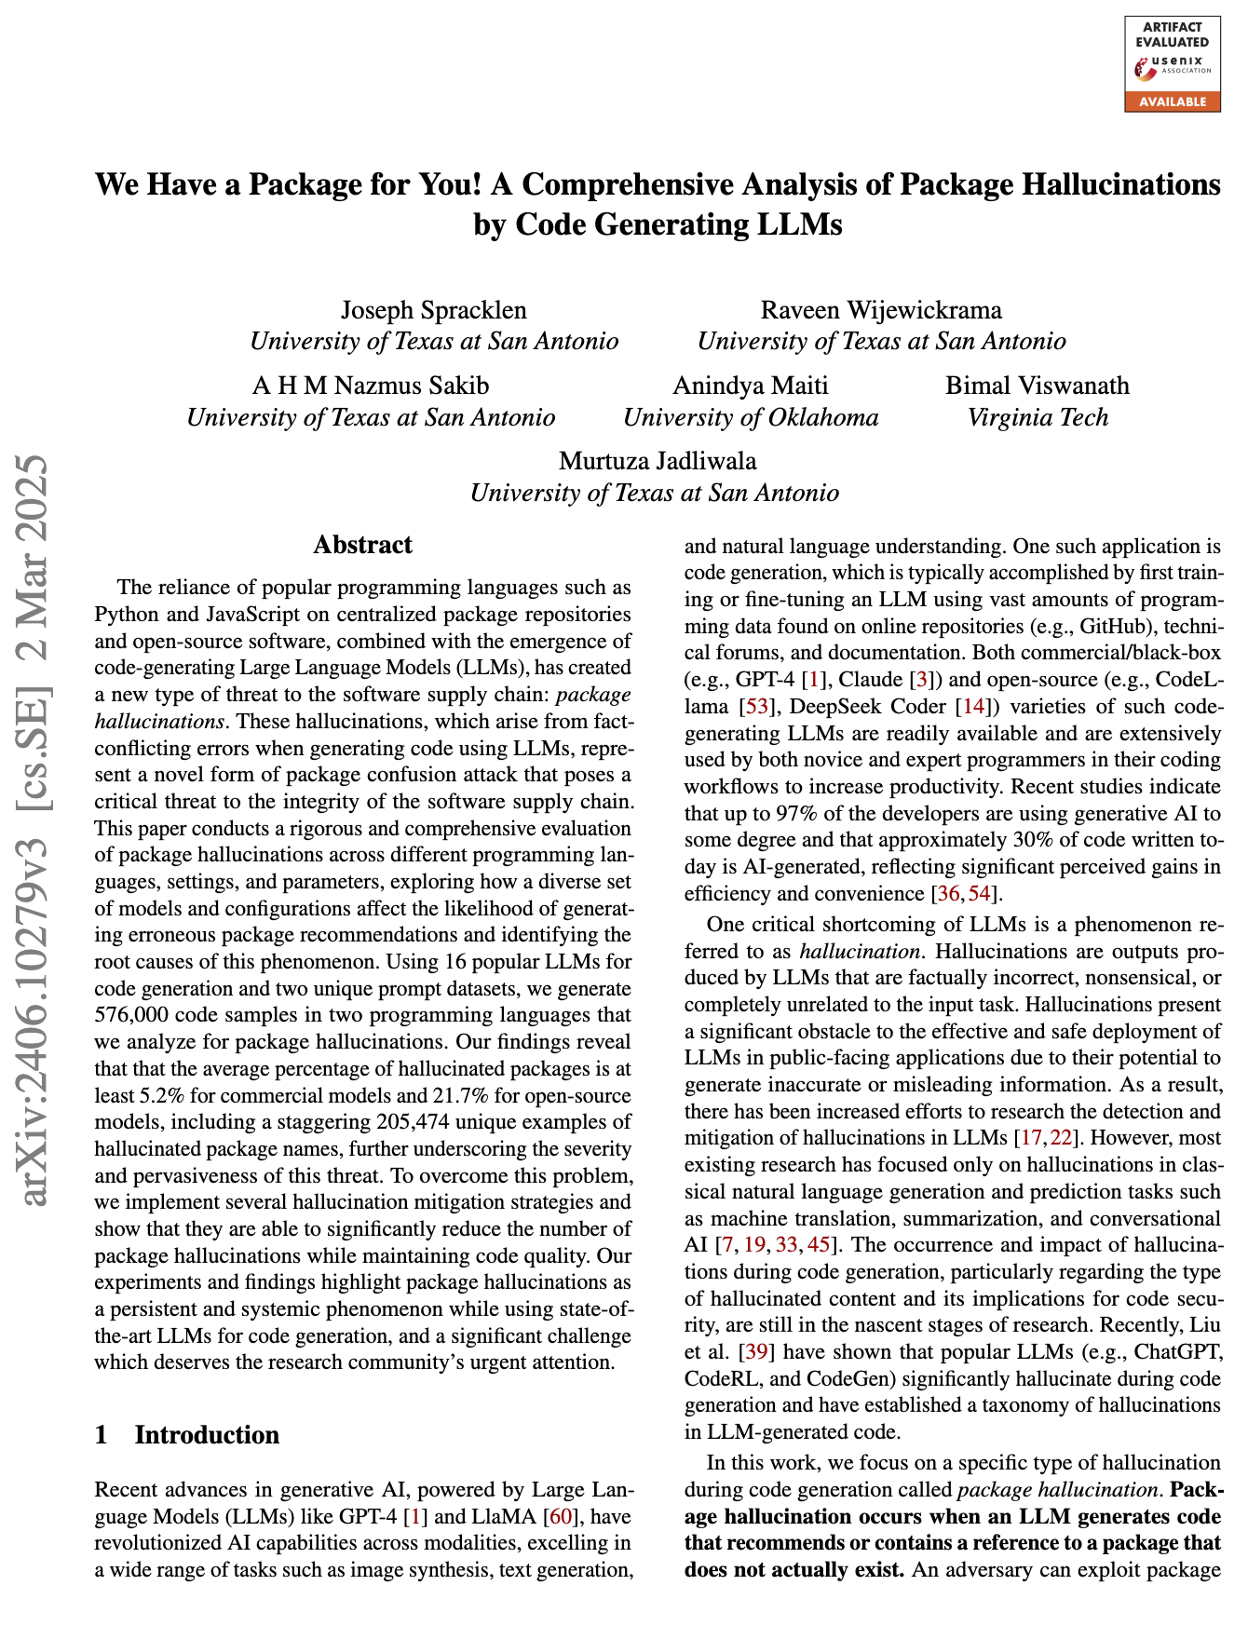
Upstream composition risks
Packages and registries
Agent framework and runtime
Tools, memory, and actions
Notes:
So, since you are mostly an academic audience, I have to show you papers.
There are three categories of supply chain attacks in this domain.
First one is the upstrem composition, these are the package registries, there’s has been a lot of work about Agents hallucinating packages and so on.

Slide 16
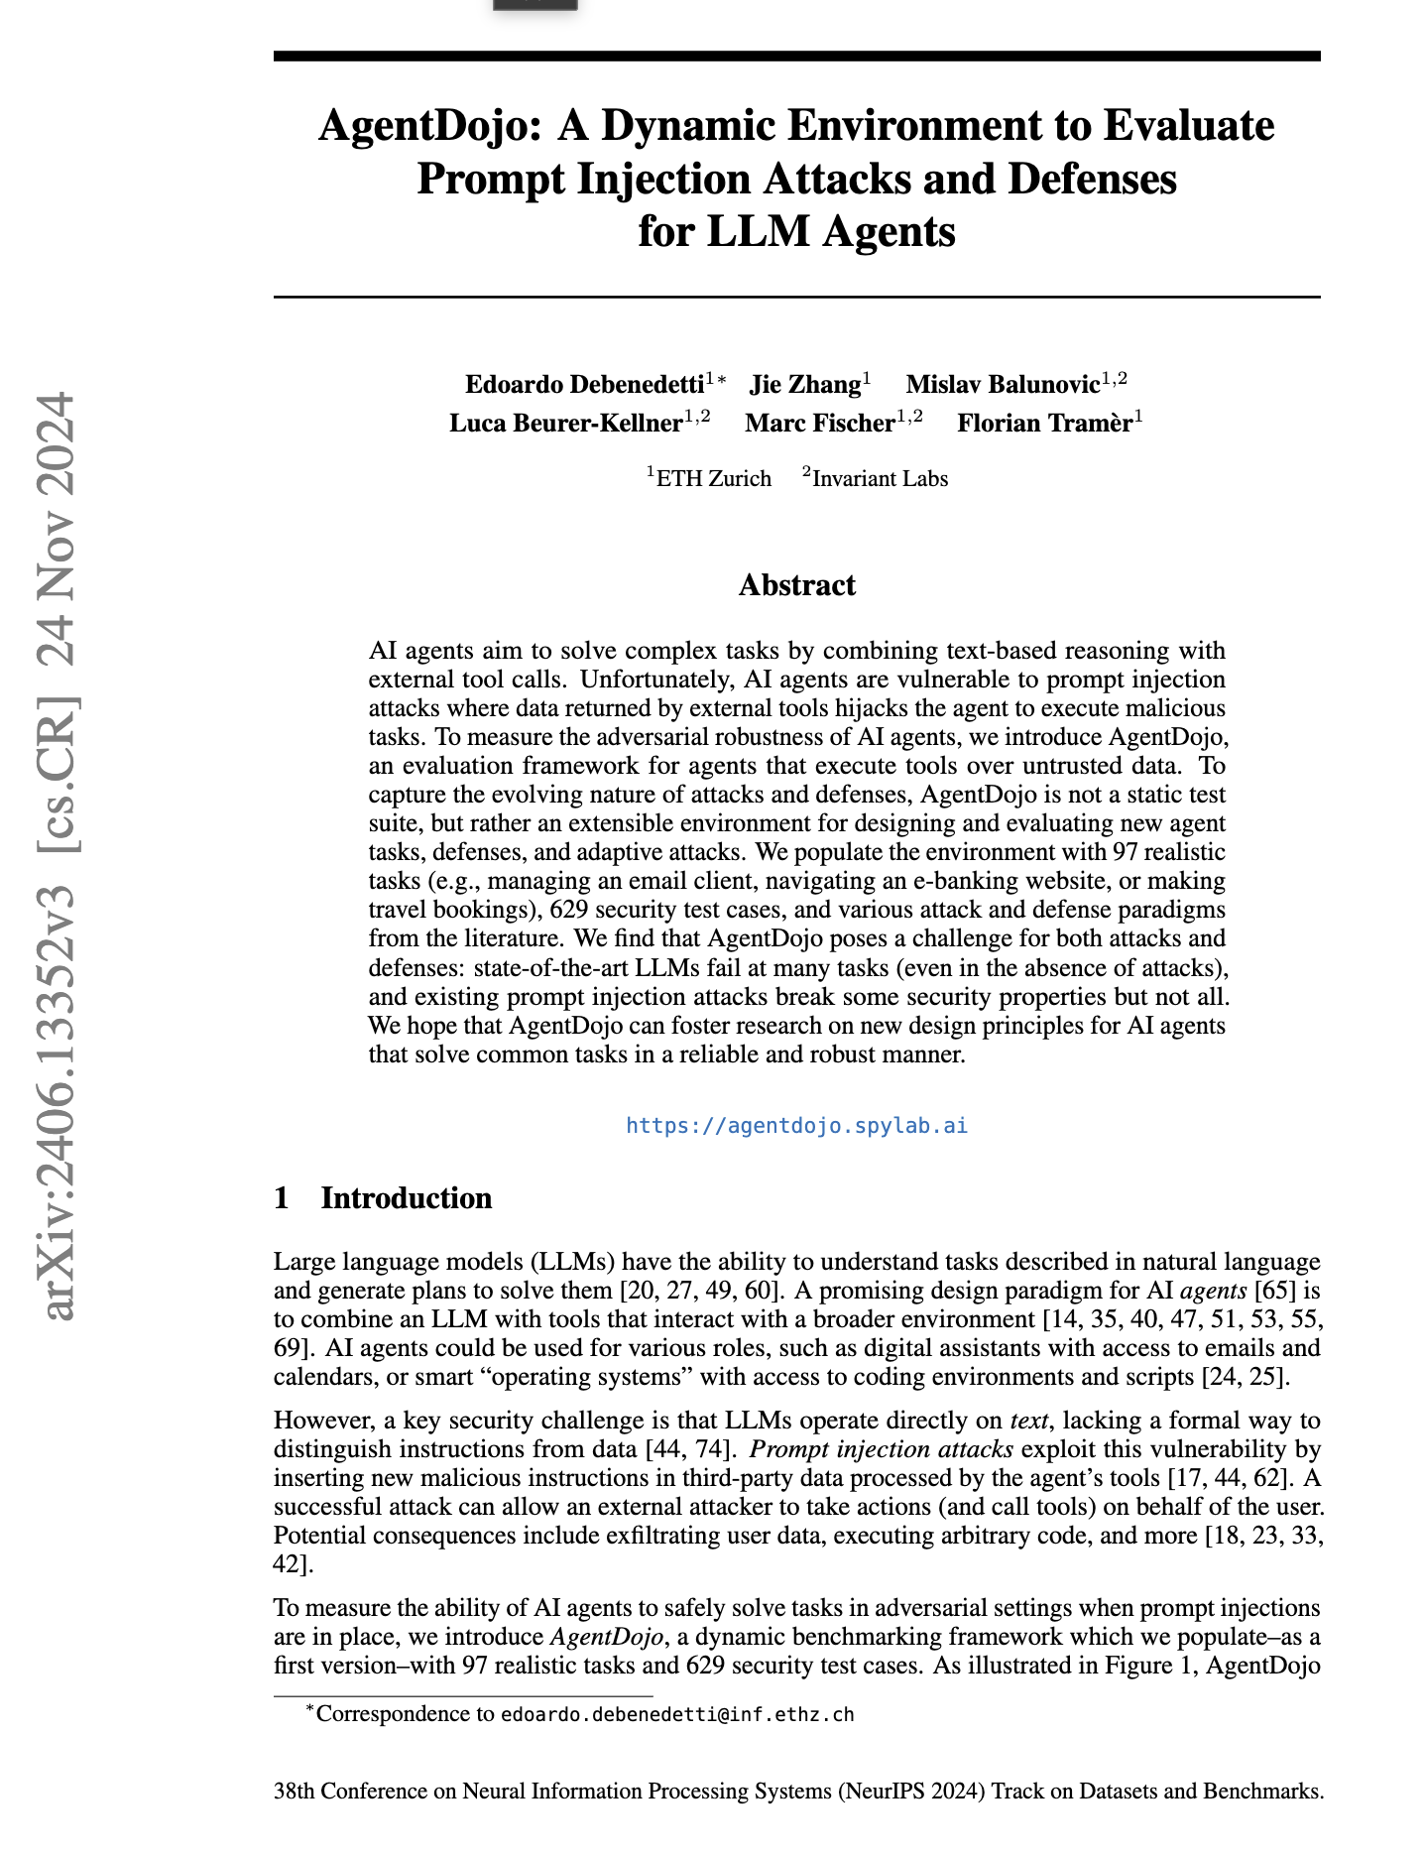
Tool-integration runtime risks
Packages and registries
Agent framework and runtime
Tools, memory, and actions
Notes:
There’s also another layer, the agentic framework at runtime, this is prompt injection.

Slide 17
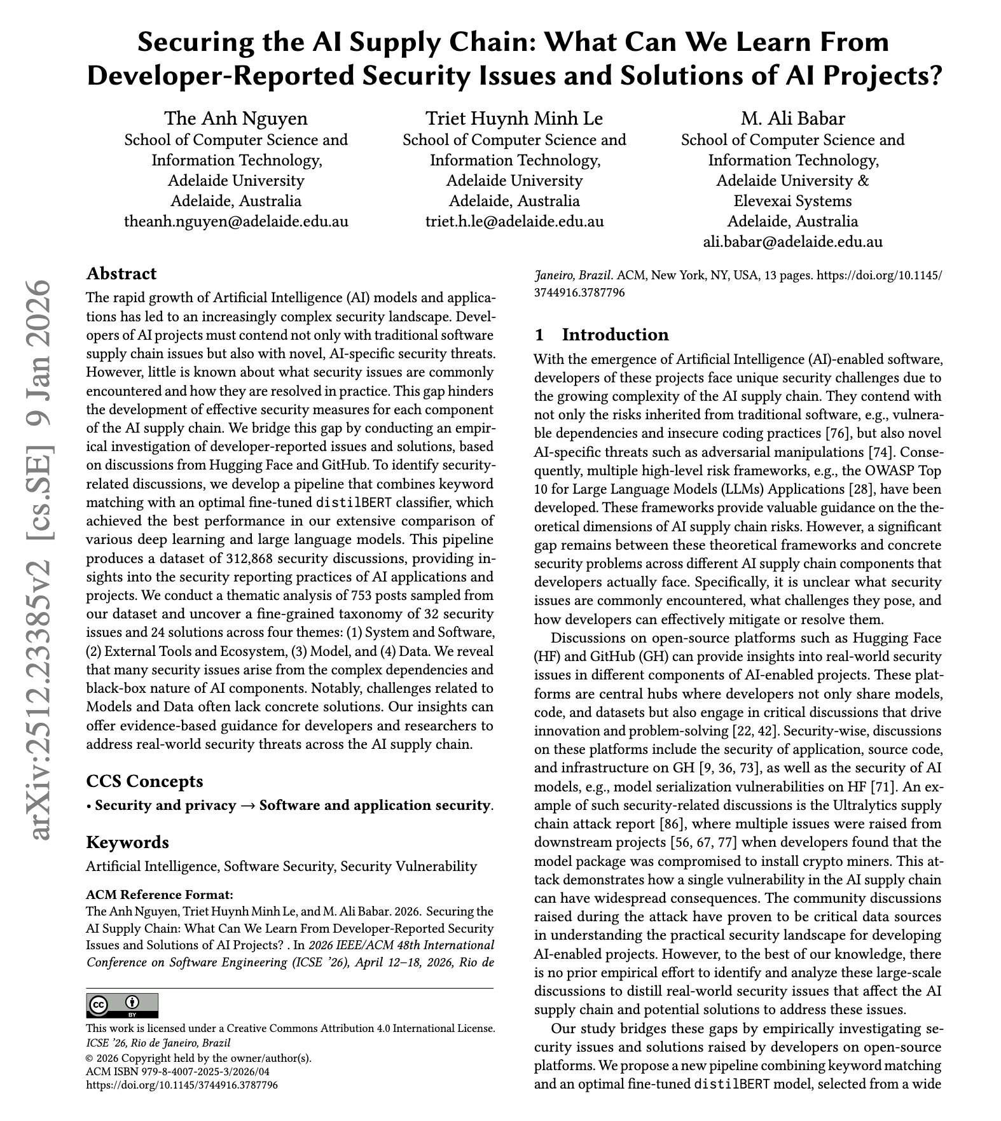
Cross-cutting AI supply chain analysis
Packages and registries
Agent framework and runtime
Tools, memory, and actions
Notes:
More recently, this is a recent ICSE paper, which presents a taxonomy covering many other risks, like MCP, memory, actions, etc.

Slide 18
Every new agent capability creates a new trust edge
Package
Loader
Runtime
Memory or tool
Blast radius
typosquat
compromise
deserializer
legacy API
planner
subgraph
checkpoint
external API
Tools : code can act, not just answer
Memory : compromise can persist across runs
Connectors : pull untrusted content into the reasoning loop
Packages : make “import” a live security decision
Notes:
Tools mean code can act, not just answer.
Memory means compromise can persist across runs.
Connectors pull untrusted content into the reasoning loop.
BIPIA established that indirect prompt injection is broadly effective when models consume external content.
InjecAgent showed the problem gets worse when the model can use tools and act on the environment.
So the supply chain of an agent is partly code and partly content.

Slide 19
OSS risks + Agentic Properties = Larger Blast Radius
Notes:
Agent frameworks turn ordinary dependency risk into runtime, stateful, delegated risk

Slide 20
The LangGraph Framework
Notes:
So, let’s look at agentic frameworks.

Slide 21
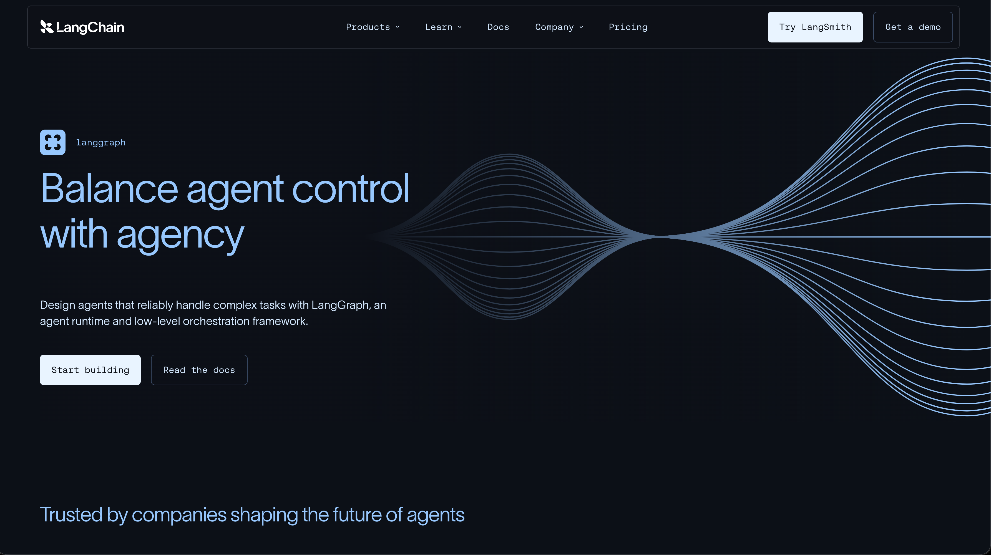

Slide 22
The LangGraph framework
LangGraph is the orchestration layer between models, tools, memory, and deployment.
What LangGraph itself promises
Application layer
workflows, prompts, business logic
Durable execution
Human in the loop
Framework layer
LangGraph, LangChain, orchestration
Memory and persistence
Tool calling
Model and data
LLMs, embeddings, vector stores, retrieval
Deployment and SDKs
Infrastructure
cloud, queues, runtimes, secrets, registries
The safer the framework tries to be for long-lived agents, the more state and infrastructure it must own.
Sources: LangGraph PyPI and documentation (durable execution, memory, HITL, deployment).

Slide 23
Why agent frameworks amplify supply-chain risk
Four design features make agent stacks riskier than plain libraries.
ACTION
STATE
Tools and actions
Memory and checkpoints
A bad dependency can become a bad action.
Persistence increases dwell time.
CONTENT
AUTONOMY
Connectors and untrusted content
Autonomy and long-lived loops
External content can carry instructions, not just data.
One compromise can cascade before detection.

Slide 24
A single LangGraph app already spans a large OSS surface
The application layer looks small in code. The trust boundary is not small.
Representative top-level dependencies
700,387
langgraph
langchain-openai
packages listed in the PyPI ecosystem
(Libraries.io snapshot)
langchain-anthropic
langchain
8
7+
langchain-fireworks
python-dotenv
template deps
repo libraries
langchain-elasticsearch
langchain-pinecone
The shocking part is not just depth. It is churn, heterogeneity, and the fact that some of these packages call the outside world for you.
LangGraph itself is split across multiple libraries (checkpoint, prebuilt, SDK, SQLite and Postgres backends, CLI), so the framework already arrives as a mini-supply-chain.
Sources: LangChain retrieval-agent template, LangGraph repo dependency map, Libraries.io PyPI package count.

Slide 25
LangGraph case study: the attack surface is not hypothetical
Recent advisories show how framework features map directly to classic software weakness classes.
Recent LangGraph and LangChain issues
Why these bugs matter specifically for agents
Dec 2025
CVE-2025-67644
Checkpoint bugs are agent bugs because checkpoints are part of the control plane.
SQL injection in SQLite checkpoint metadata filtering
Deserialization bugs matter more when agents store tool outputs, memory, and human feedback for replay.
Nov 2025
GHSA-wwqv-p2pp-99h5
RCE in JsonPlusSerializer json mode
Path traversal matters because agent apps often load prompts, examples, and local policies dynamically.
Mar 2026
CVE-2026-28277
Statefulness and flexibility are features. They are also risk multipliers.
Unsafe msgpack deserialization during checkpoint loading
Mar 2026
CVE-2026-34070
Path traversal in legacy prompt loading APIs
Agent frameworks do not invent new bugs so much as repackage old bugs behind very productive abstractions.
Sources: GitHub, GitLab, and NVD advisories for 2025 to 2026 LangGraph and LangChain issues.

Slide 26
Exploring one of my projects…

Slide 27
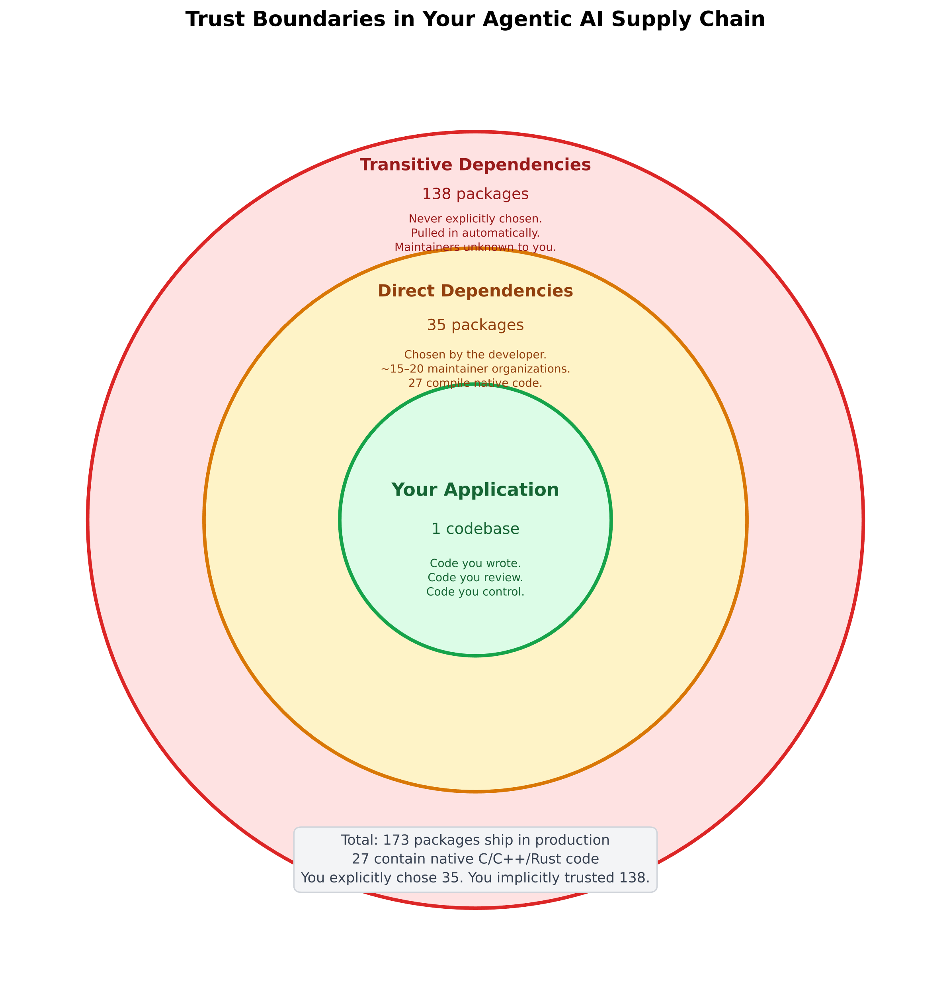
EDA

Slide 28
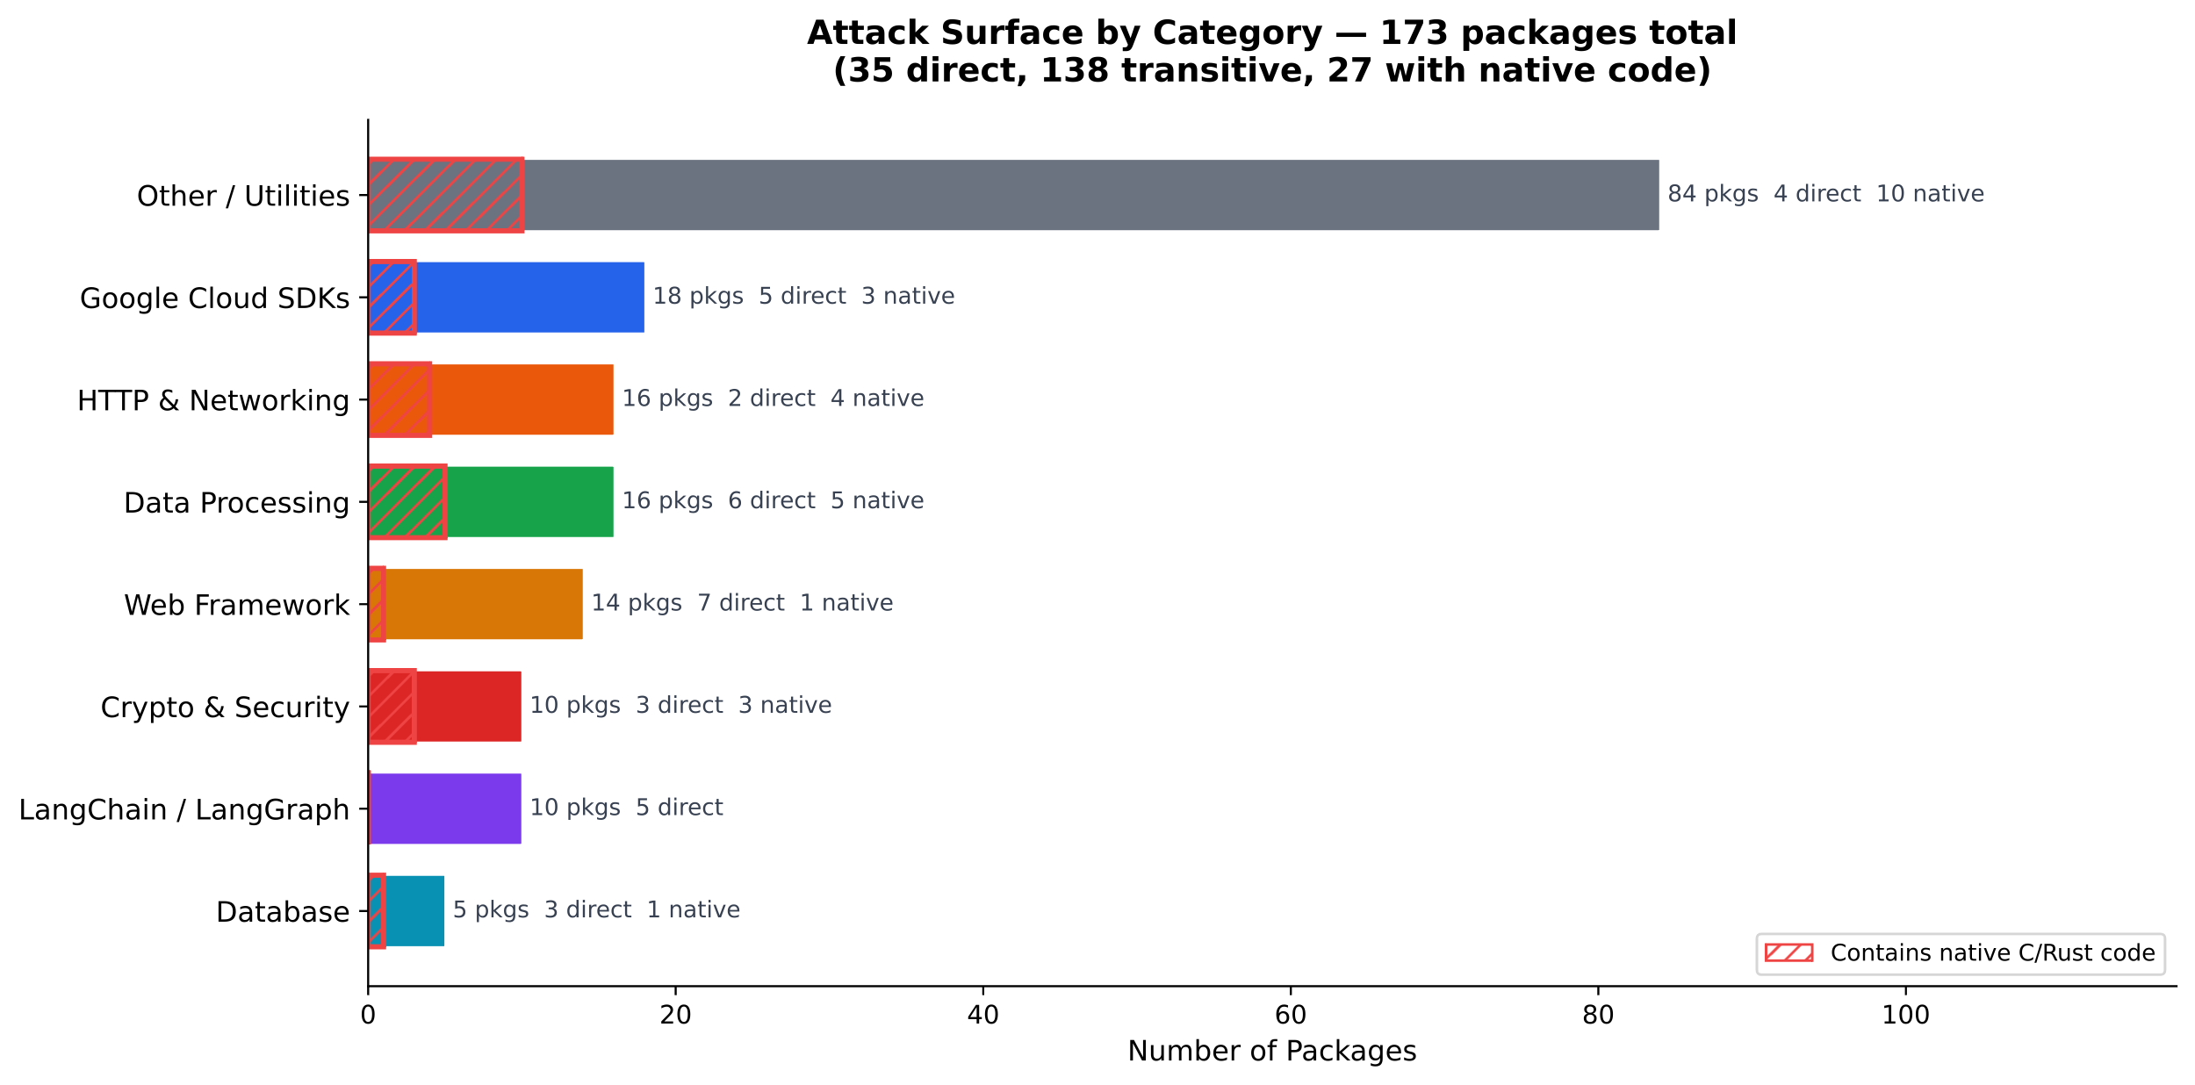
Notes:
It breaks down all 173 packages by functional category (LangChain Ecosystem, Google Cloud SDKs, Crypto & Security, HTTP & Networking, Data Processing, Database, Web Framework, Other/Utilities) and shows:
Bar length = number of packages in that category
Annotations next to each bar = total packages, how many are direct deps, how many contain native C/Rust code
Hatched red overlay = the subset of packages with native code (higher supply chain risk)

Slide 29
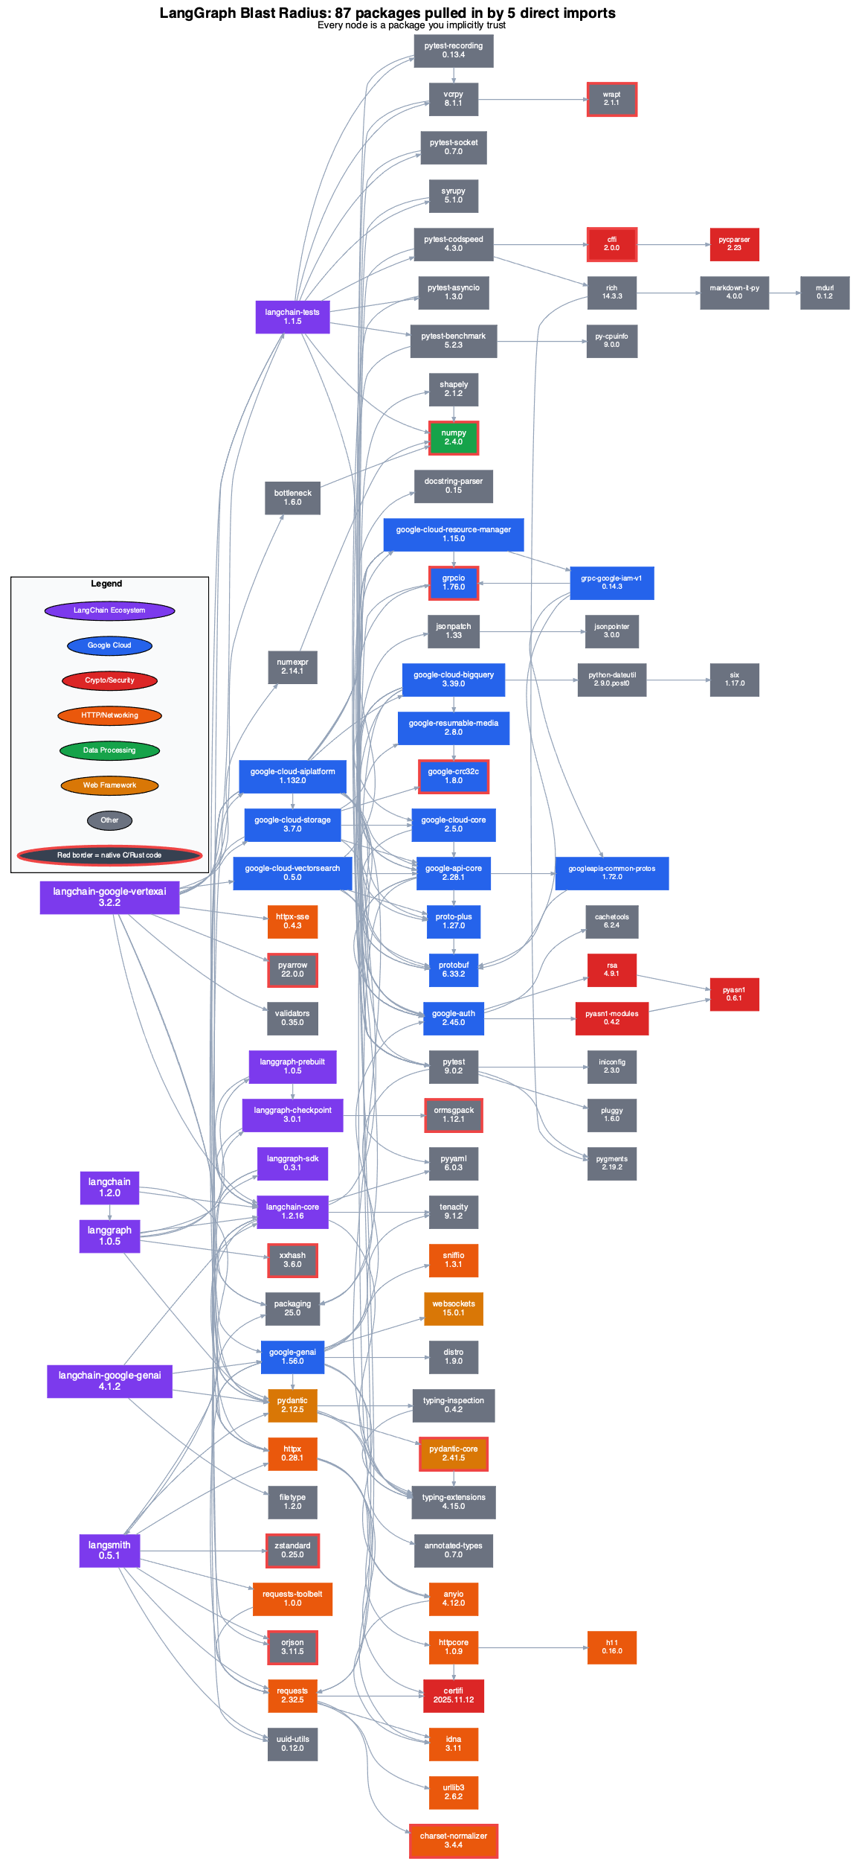
LangGraph dependency tree forest
Starting from the 5 imports:
langgraph
langchain
langchain-google-genai
langchain-google-vertexai
langsmith
87 packages total, max depth = 5
Notes:
What it shows: Starting from the 5 LangChain/LangGraph imports (langgraph, langchain, langchain-google-genai, langchain-google-vertexai, langsmith), it traces every transitive dependency — 87 packages total, max depth 5.
Layout:
Left → Right = dependency depth. The 5 root packages are at the left edge (depth 0), their direct deps at depth 1, and so on through depth 5
Nodes are rank-grouped by depth so you can visually see the fan-out at each level
Arrows show actual dependency relationships between packages
Color coding (same palette as the other diagrams):
Purple = LangChain ecosystem
Blue = Google Cloud
Red = Crypto/Security
Orange = HTTP/Networking
Green = Data Processing
Amber = Web Framework
Gray = Other
Red borders highlight packages with native C/C++/Rust code (e.g., grpcio, pydantic-core, orjson, cryptography) — these are the highest-risk nodes since a supply chain attack could inject compiled binaries.
Key takeaway for the audience: 5 lines in pyproject.toml pull in 87 packages from ~15 distinct maintainer organizations, including 9+ native code packages you never explicitly chose and almost certainly never audited.

Slide 30


Slide 31
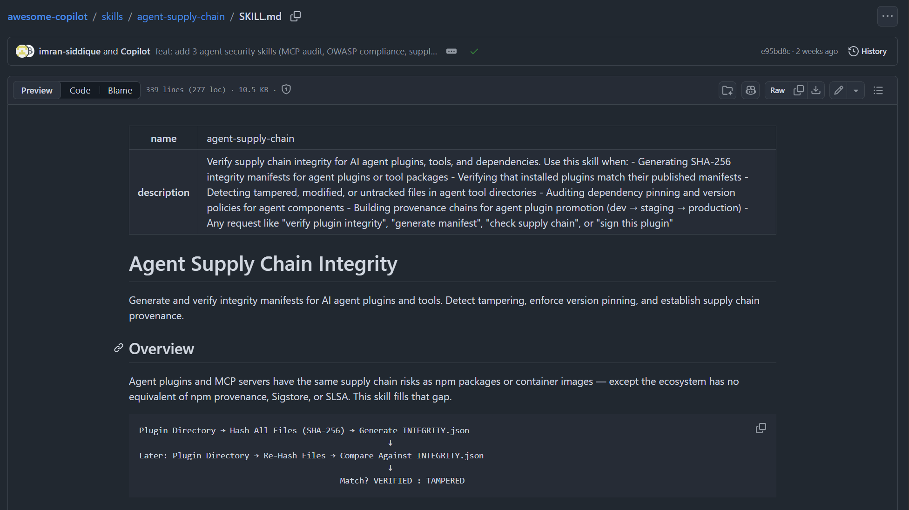
https://github.com/github/awesome-copilot/blob/main/skills/agent-supply-chain/SKILL.md

Slide 32
Recommendations
1. Inventory the real graph
Generate SBOMs for the agent app and for runtime-loaded tools, extensions, and models.
2. Pin and verify
Use lockfiles, hashes, trusted registries, signed releases, and provenance when available.
3. Monitor agent state
Harden checkpoint stores, serializers, and memory backends as if they were code-adjacent infrastructure.
4. Isolate the agent
Use least privilege, egress controls, sandboxing, secret scoping, and human approval for risky actions.
5. Ground the automation
Never let an agent select packages or versions from stale model memory alone. Verify against live registries and live security intelligence.

Slide 33
Selected references
Year
Paper
Why it matters
Memorable finding
2024
InjecAgent
Tool-integrated agent security
1,054 test cases. ReAct-prompted GPT-4 was vulnerable 24 percent of the time.
2024
BIPIA
Indirect prompt injection
LLMs do not reliably separate instructions from external content.
2024
We Have a Package for You!
Package hallucinations
Code LLMs can invent package names, creating a slopsquatting entry point.
2025
AI-Induced Supply-Chain Compromise
Systematic review
Frames hallucination and slopsquatting as an AI-era supply-chain threat class.
2024
Instruction Hierarchy
Mitigation direction
Improves robustness, but reinforces the need for privileged instruction boundaries.
2026
Securing the AI Supply Chain
Systematic review
Taxonomy of agentic AI risks inc. systems, tools and ecosystem, model, and data.

Slide 34
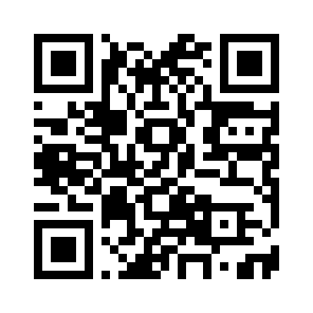

cesarsotovalero.net

