Slide 1
The AI Secret
Why Predictive ML Still Rules the Real World
César Soto Valero
Data Engineer, SEB

Slide 2
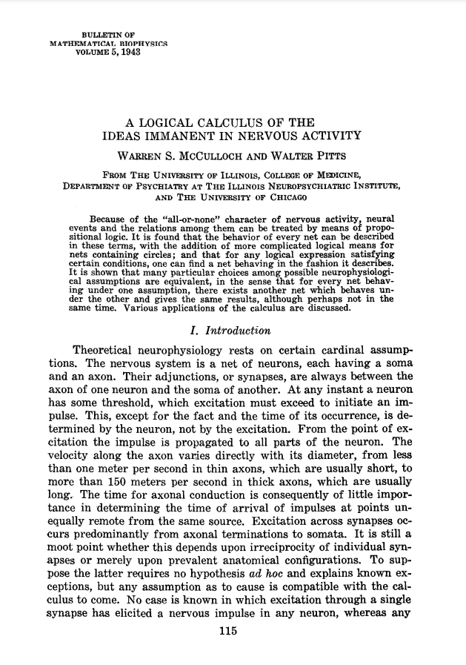

Slide 4
I started coding

Slide 5
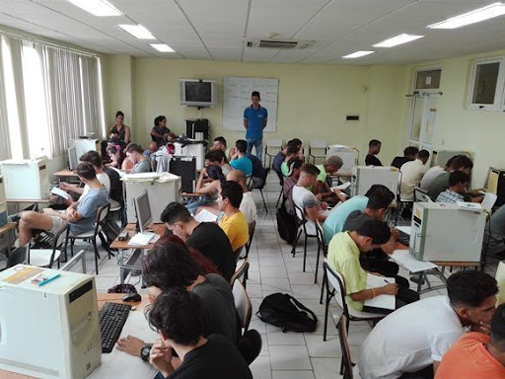

Slide 6
AI was not “a thing”

Slide 7
1943-2013
AI
Machine Learning

Slide 8
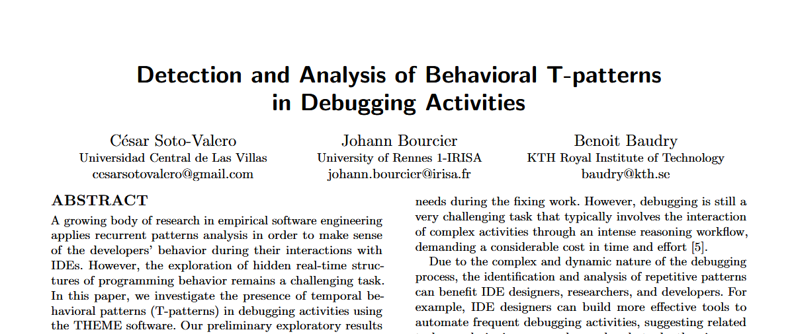

Slide 9
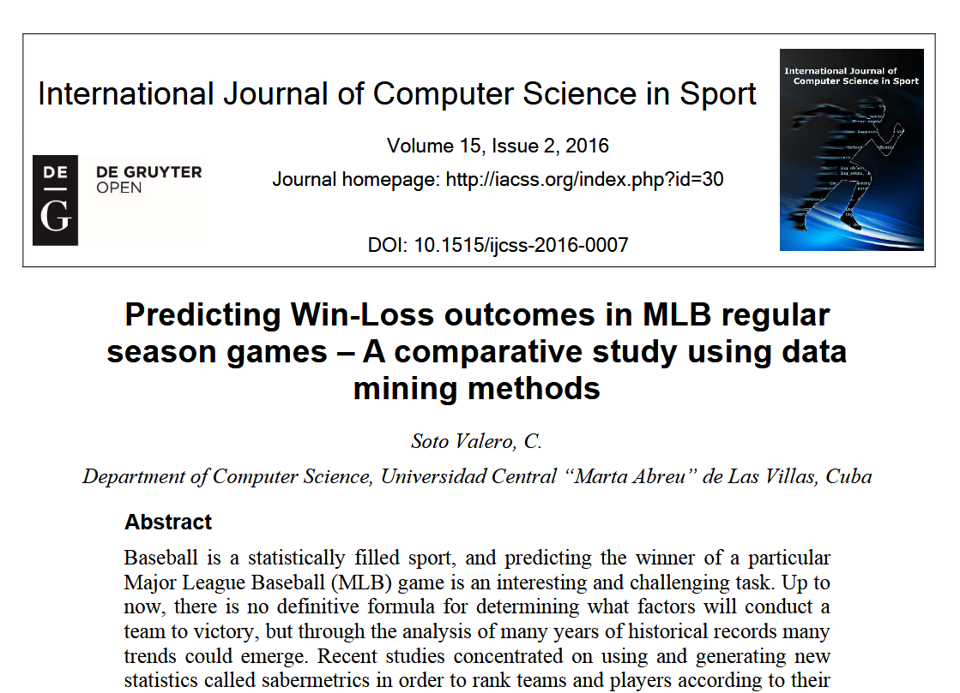

Slide 10
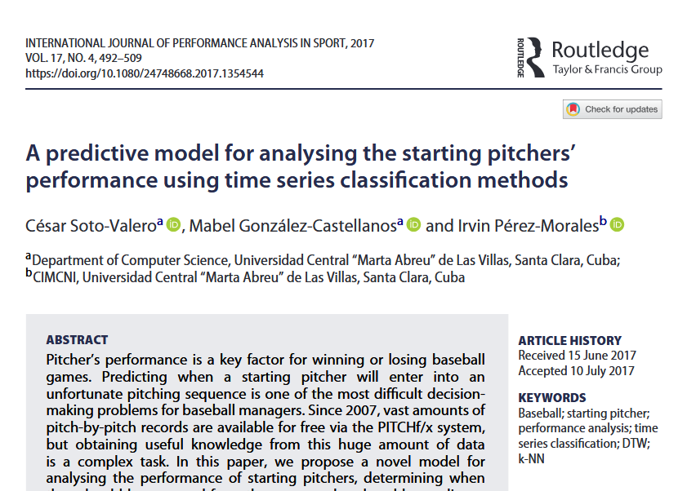

Slide 11
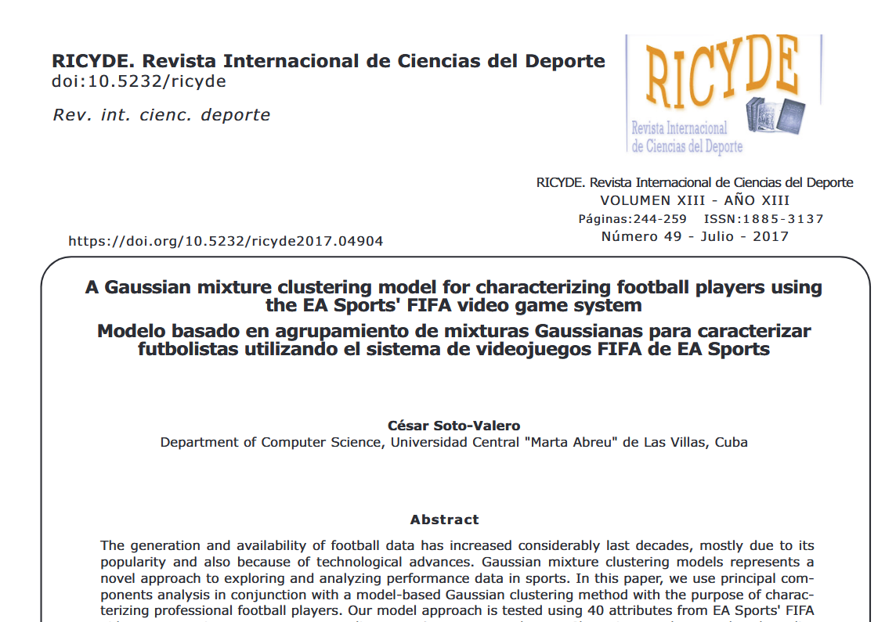

Slide 12
2013-2020
AI
Machine Learning
Deep Learning

Slide 13
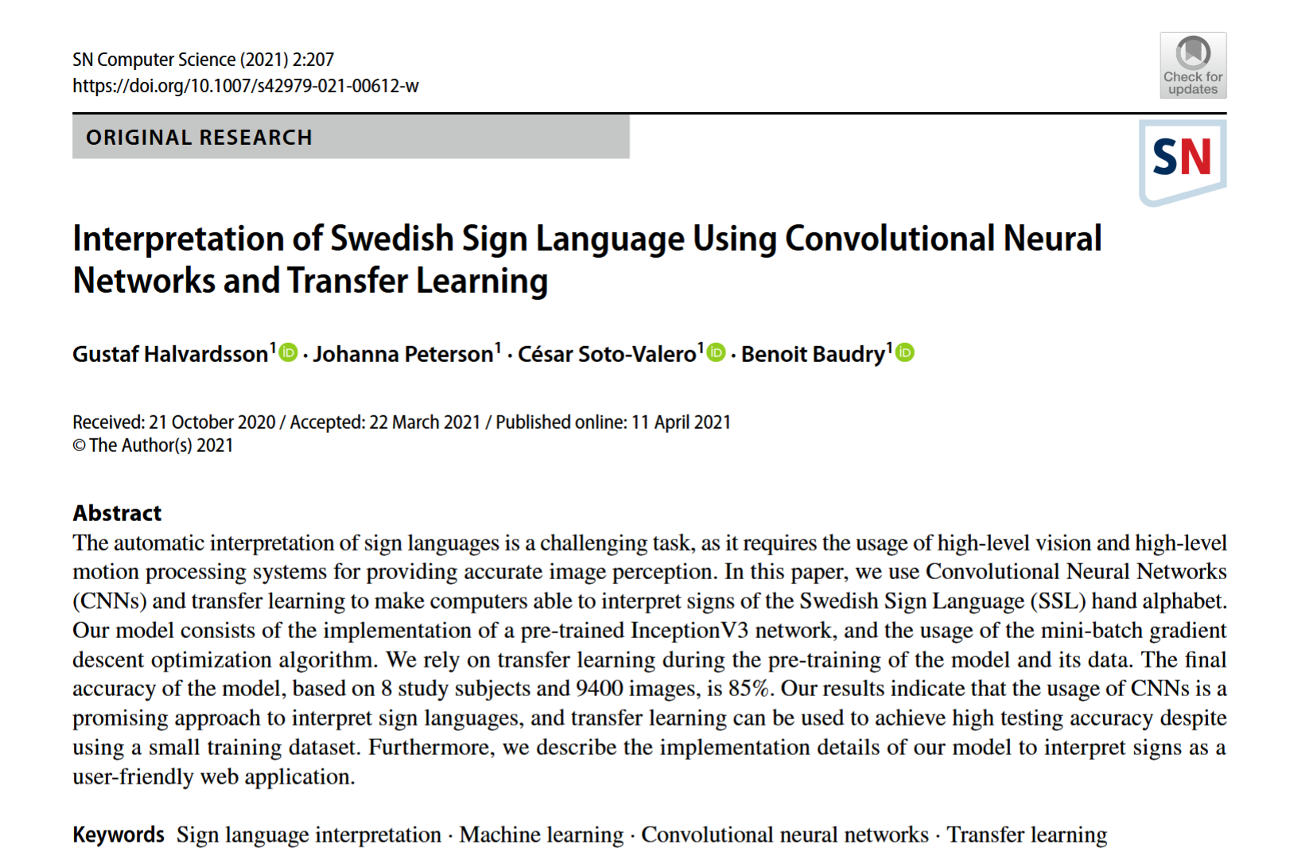

Slide 14
Something happened!

Slide 15
2020-2024
AI
Predictive
Generative

Slide 16
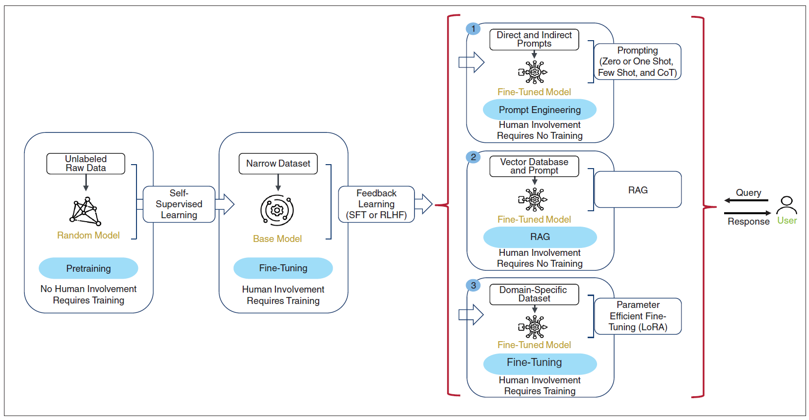
Source: Hints for Generative AI Software Development, IEEE Software, 13rd August 2024

Slide 17
Source: Hints for Generative AI Software Development, IEEE Software, 13rd August 2024

Slide 18
Source: Hints for Generative AI Software Development, IEEE Software, 13rd August 2024

Slide 19
Source: Hints for Generative AI Software Development, IEEE Software, 13rd August 2024

Slide 20
Source: Hints for Generative AI Software Development, IEEE Software, 13rd August 2024

Slide 21
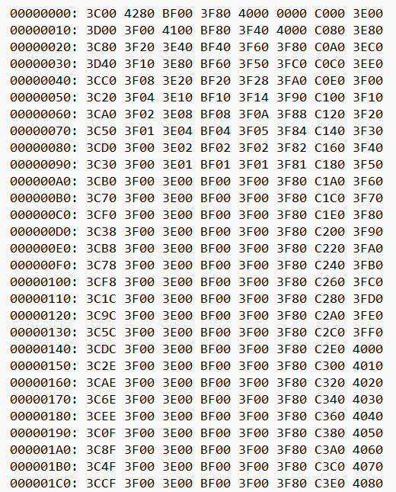
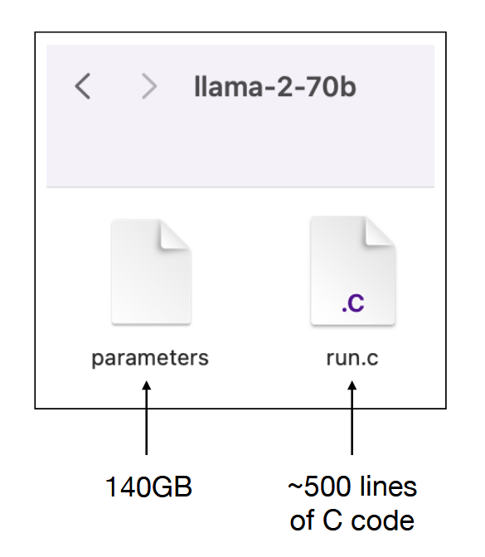
Source: [1hr Talk] Intro to Large Language Models by Andrej Karpathy, 23rd November 2023

Slide 22
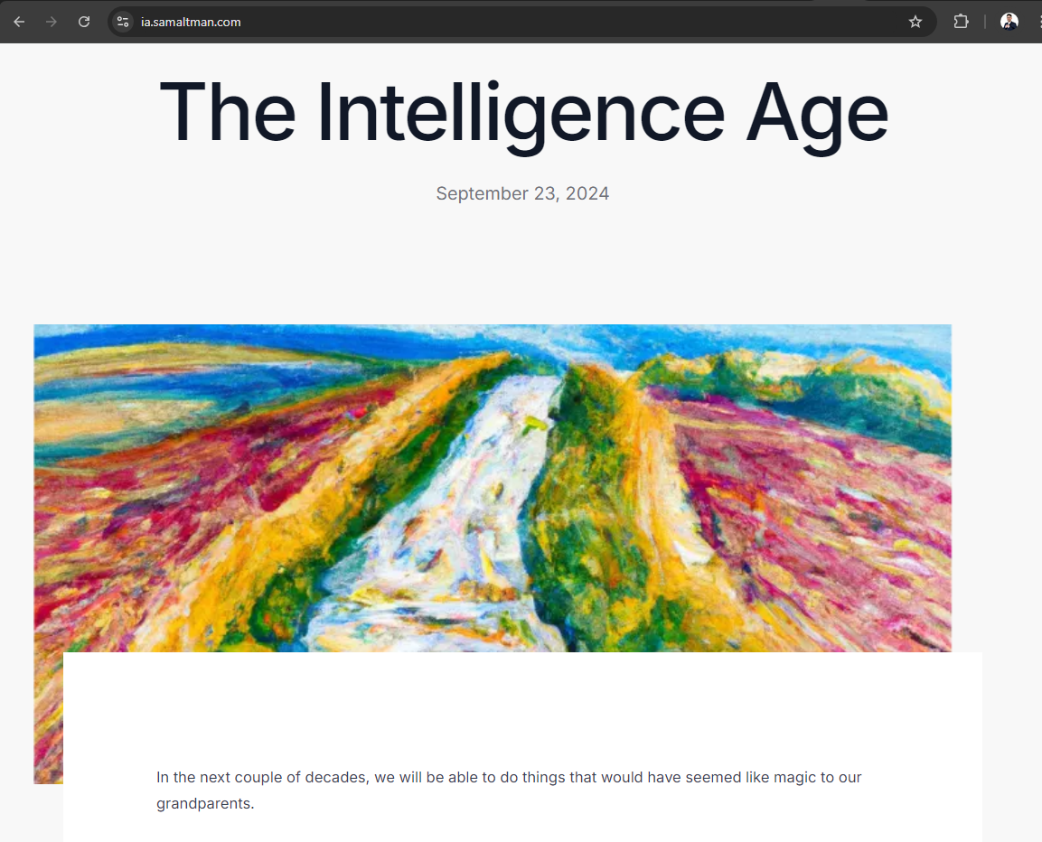

Slide 23
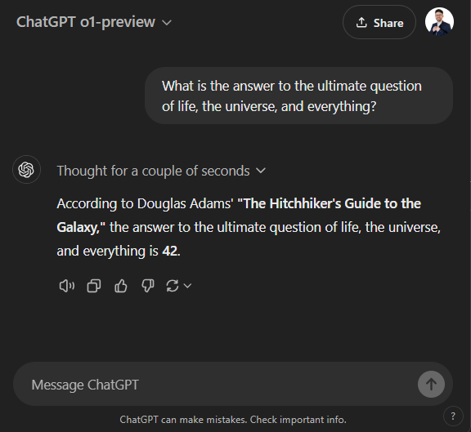

Slide 27
Awesome, right?

Slide 28
But…

Slide 30
Source: Hints for Generative AI Software Development, IEEE Software, 13rd August 2024

Slide 31
Source: Hints for Generative AI Software Development, IEEE Software, 13rd August 2024

Slide 32
Source: Hints for Generative AI Software Development, IEEE Software, 13rd August 2024

Slide 33
Source: Hints for Generative AI Software Development, IEEE Software, 13rd August 2024

Slide 34
Source: Hints for Generative AI Software Development, IEEE Software, 13rd August 2024

Slide 35
Example

Slide 36
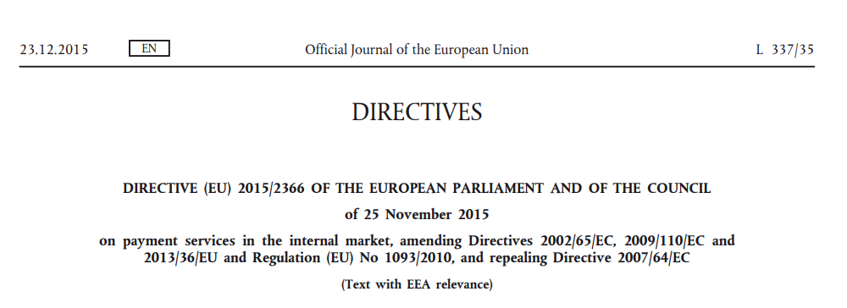
PSD2

Slide 37
Fraud Prevention
performs
train
used for
Customer
Transactions
ML Model
Detection
improve
Response: 10 < ms per transaction

Slide 38
Fraud Prevention
performs
train
used for
Customer
Transactions
ML Model
Detection
Assistant
Assistant
Investigator

Slide 39
Takeaway
Predictive AI + Generative AI = Better Business Decisions

