Slide 1

There’s No Such Thing
as Free Intelligence
Tokenomics and the Hidden Cost of AI
César Soto Valero

Slide 2
From Tokens to AGI
The Hidden Cost of “Dark Tokens”
Token Efficiency
THIS TALK

Slide 3
From Tokens to AGI
The Hidden Cost of “Dark Tokens”
THIS TALK

Slide 4
From Tokens to AGI
The Hidden Cost of “Dark Tokens”
Token Efficiency
THIS TALK

Slide 5
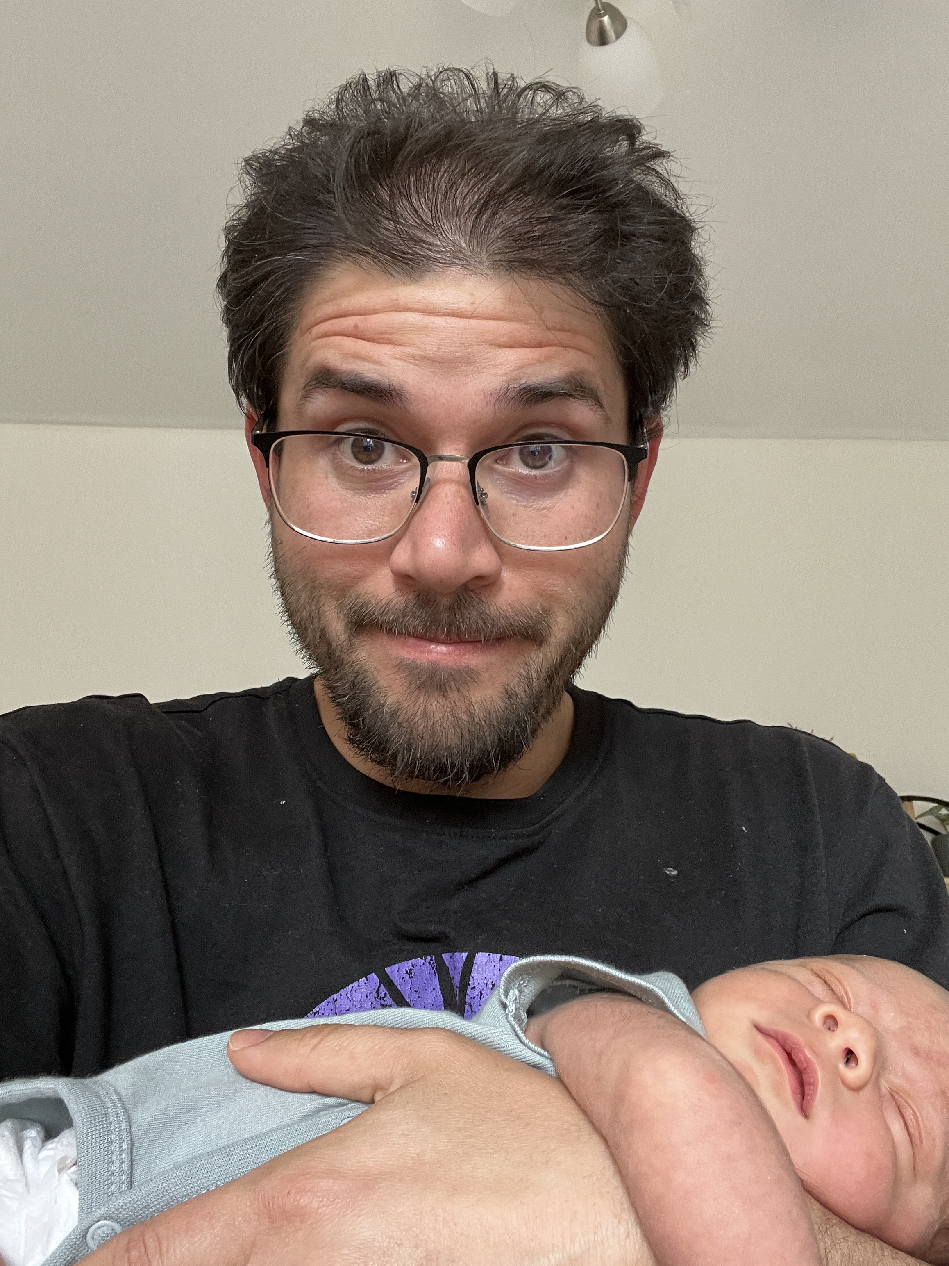
Notes:
This is my

Slide 6
What is intelligence?

Slide 7

$$I_{\text{observed}}=f(T,E,D,A)$$
INTELLIGENCE
time
data
energy
architecture

Slide 8
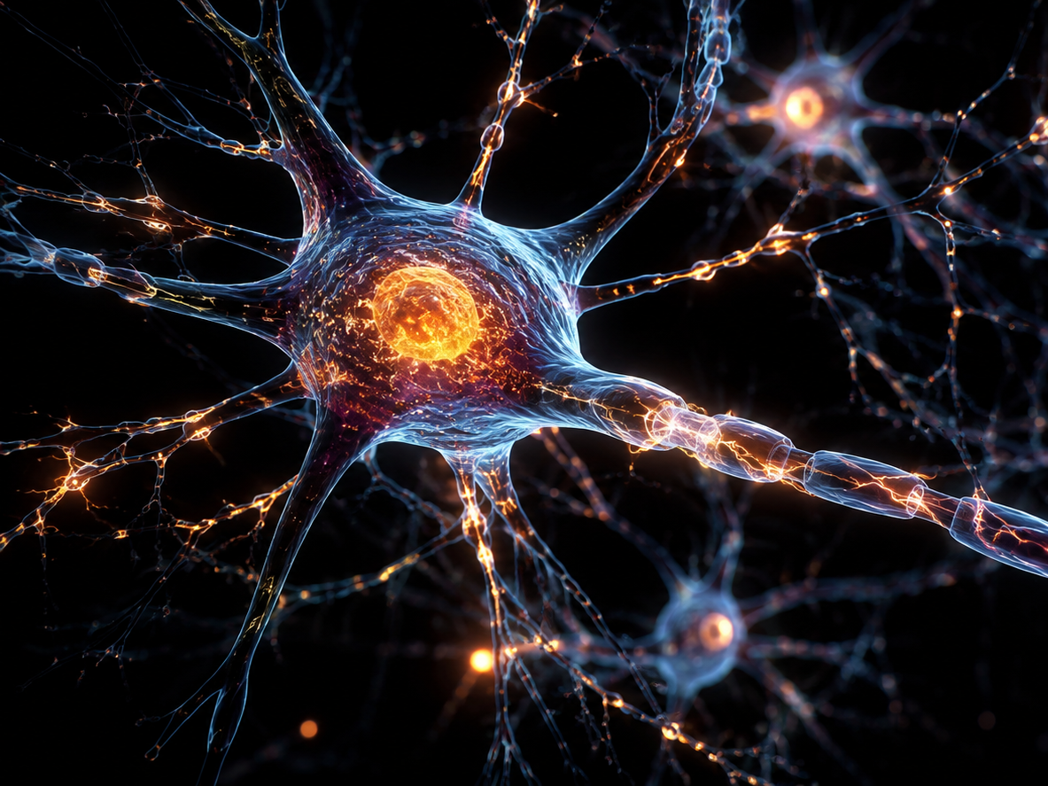

Slide 9
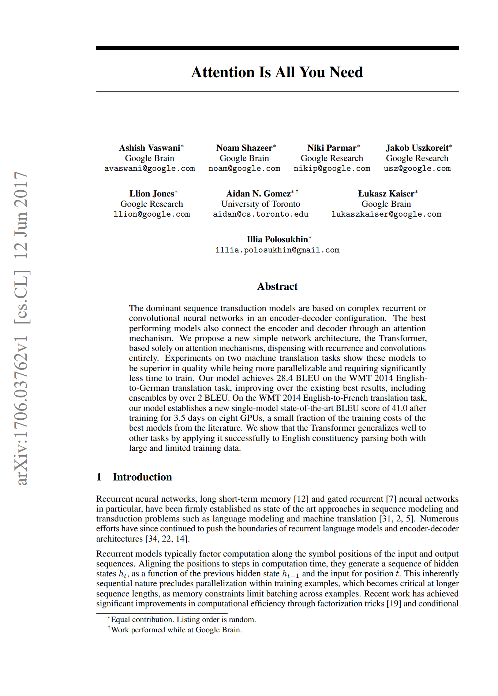
ATTENTION

Slide 10
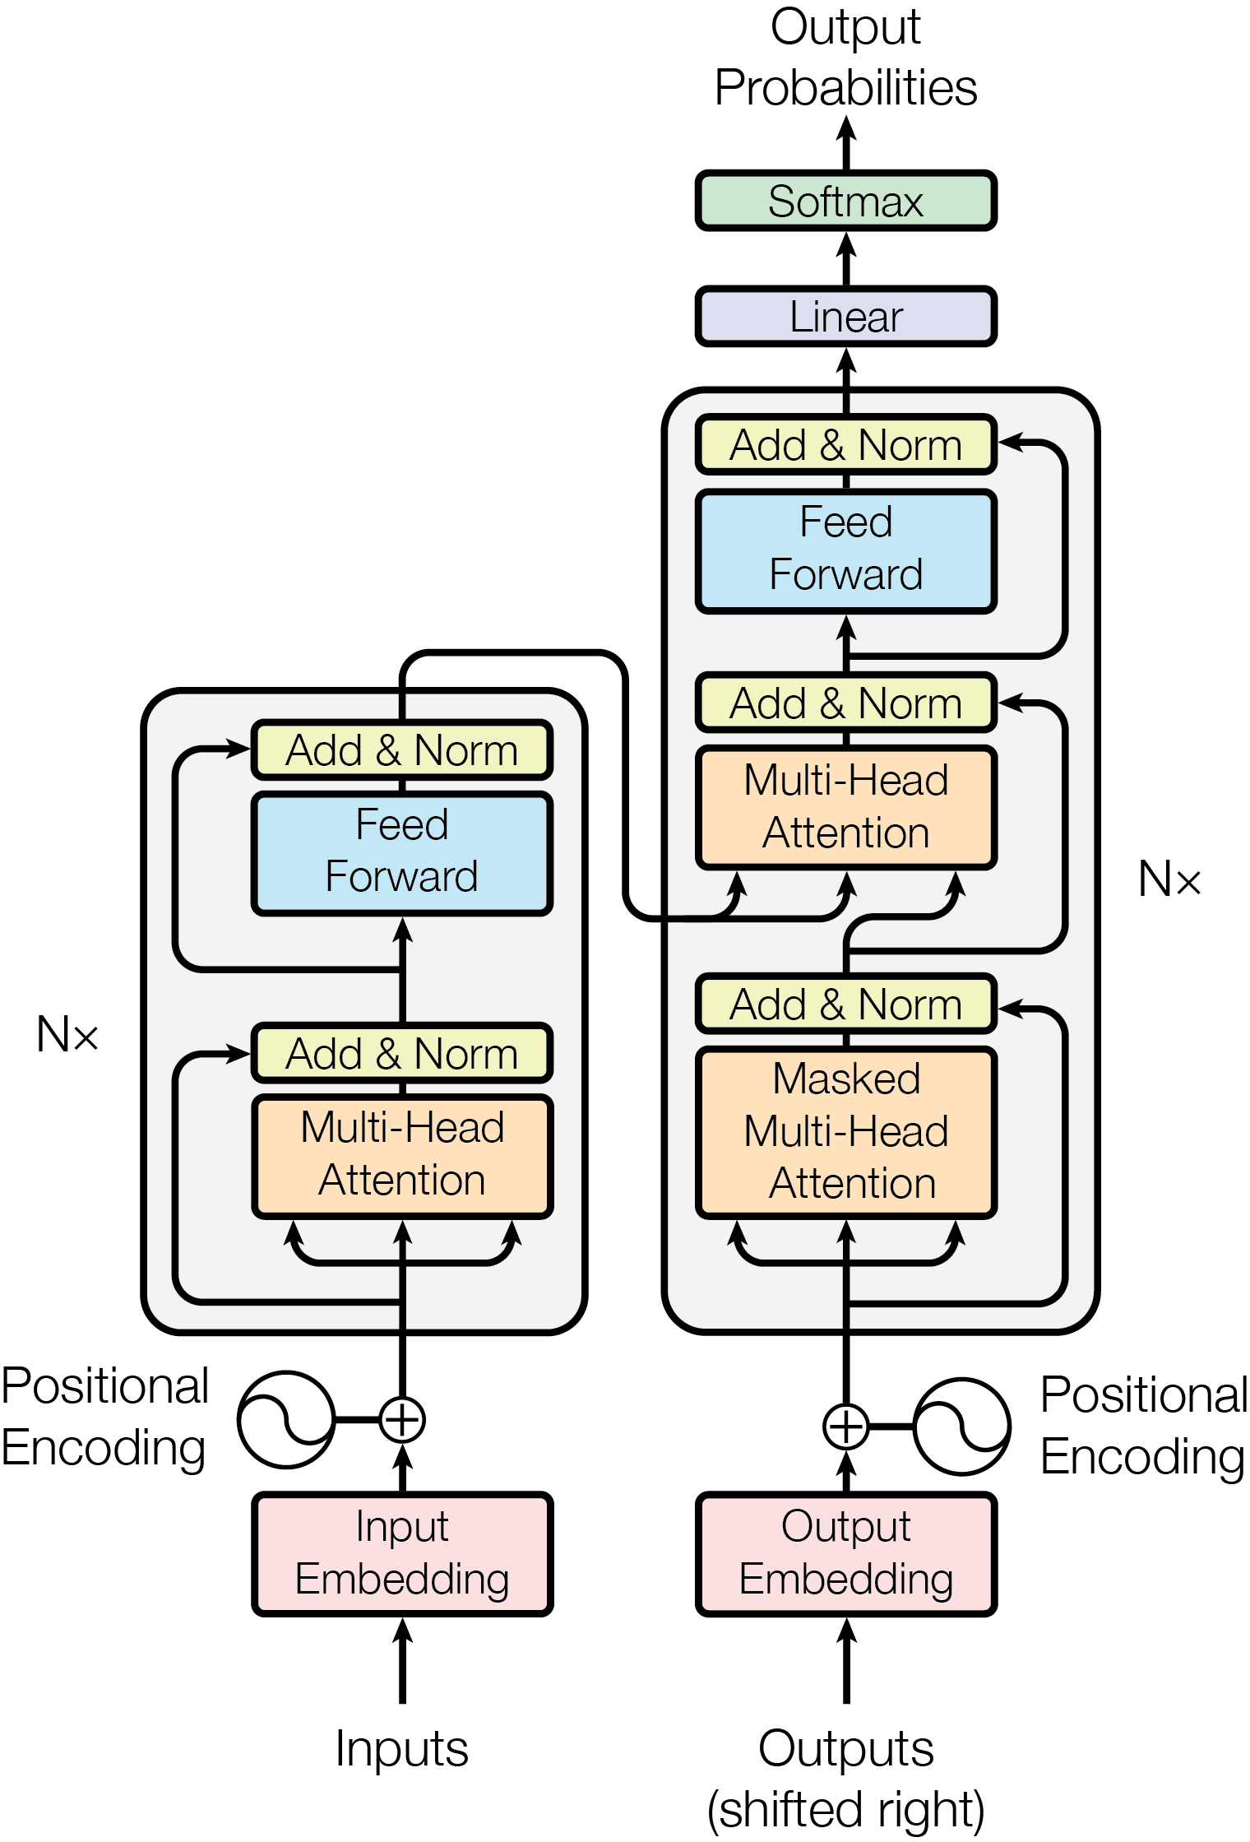
ATTENTION

Slide 11

Source: 3Blue1Brown
Notes:
https://youtu.be/wjZofJX0v4M?si=6hkSiyrIcL_CH5M1&t=198

Slide 12
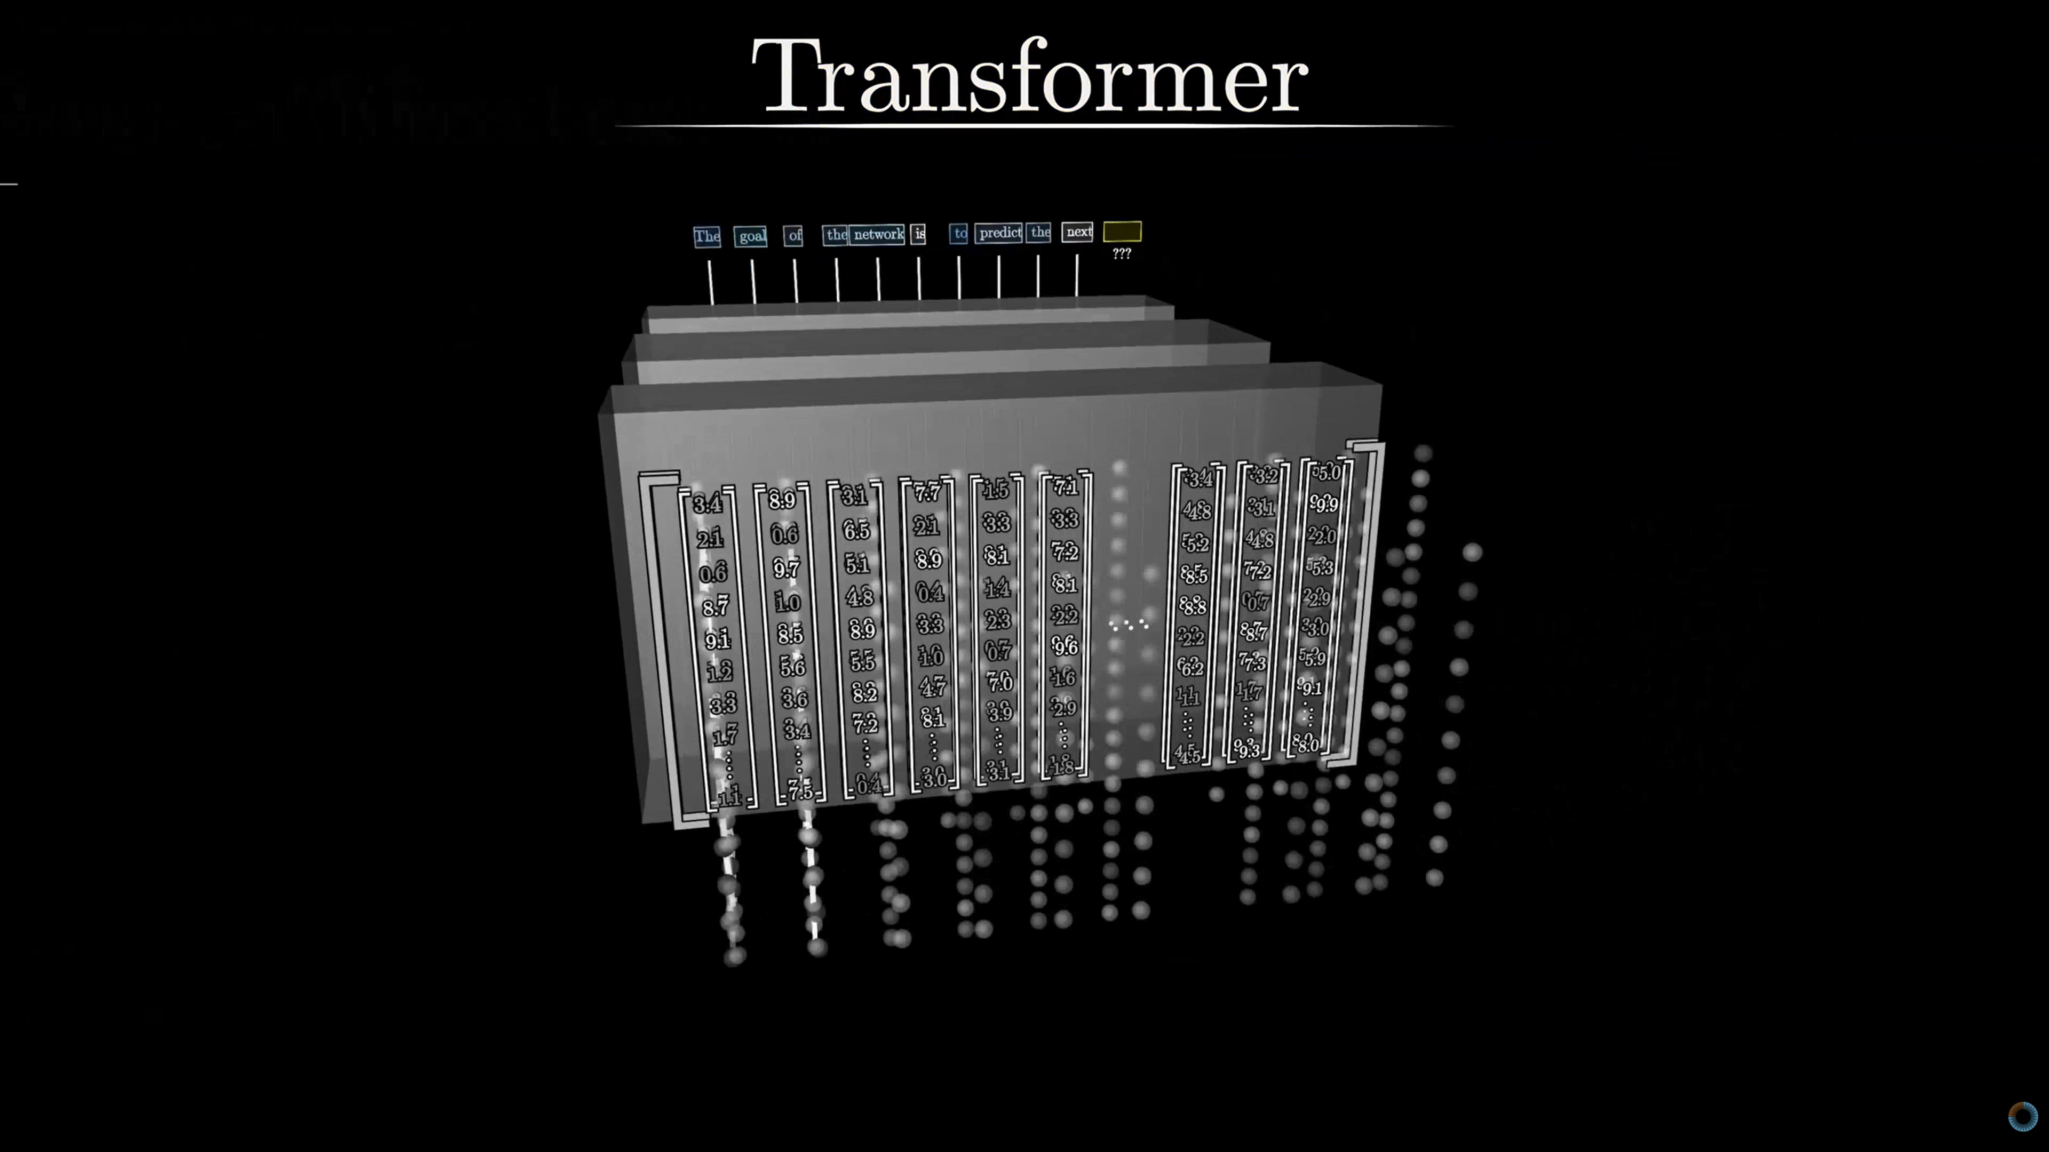
Source: 3Blue1Brown
Notes:
https://youtu.be/wjZofJX0v4M?si=iUTNH-Ku25Wb9Bcv&t=39

Slide 13
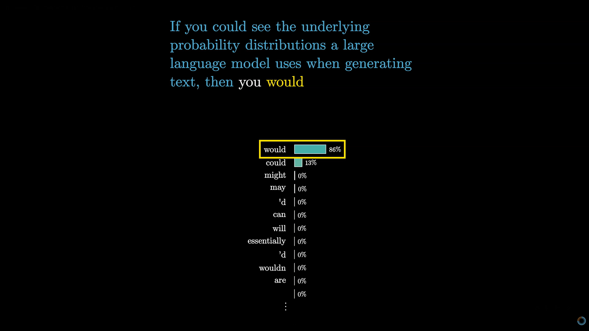
Source: 3Blue1Brown
Notes:
https://youtu.be/wjZofJX0v4M?si=2tkAd8vGFQJ9FhsL&t=173

Slide 14
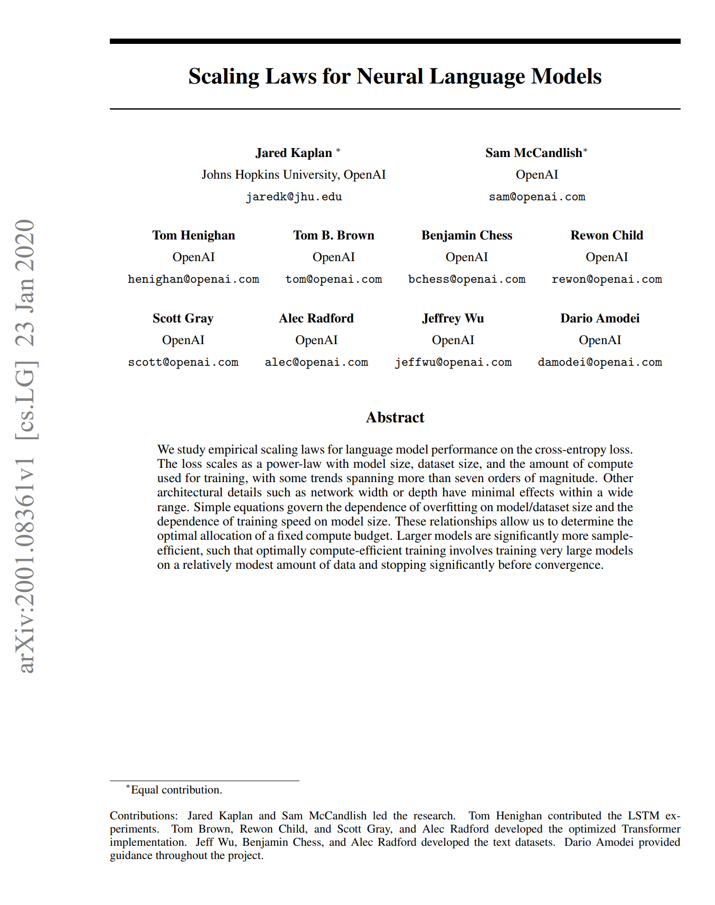
SCALING

Slide 15
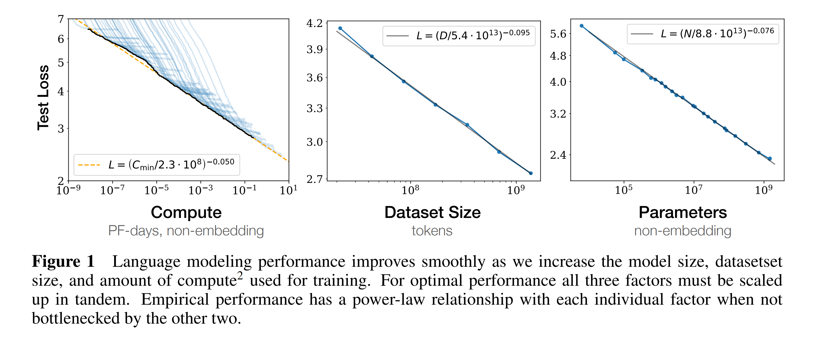
SCALING
Source: “Scaling Laws for Neural Language Models”

Slide 16
We just need more compute!

Slide 17
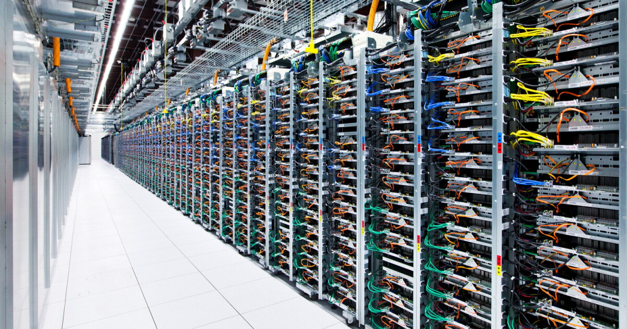

Slide 18
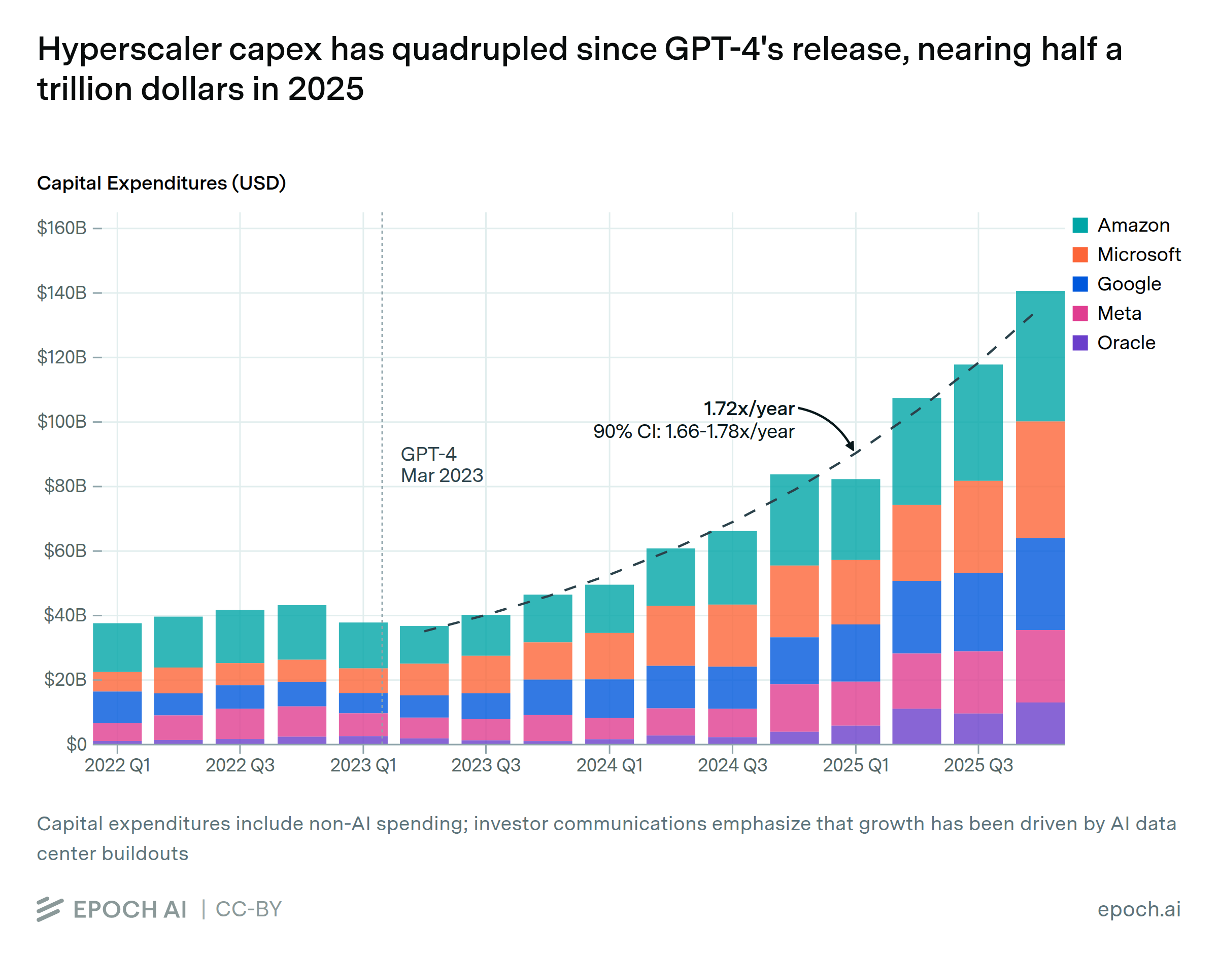

Slide 19
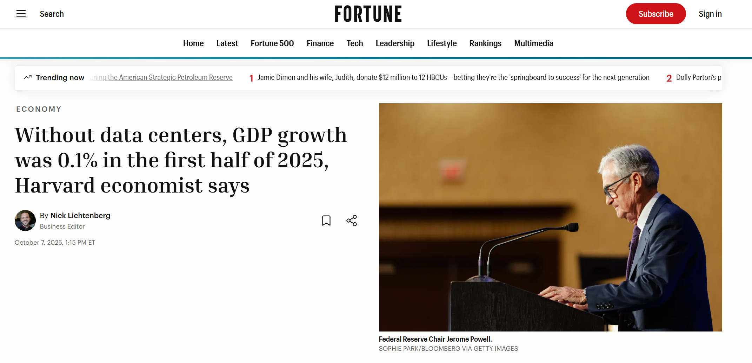

Slide 20
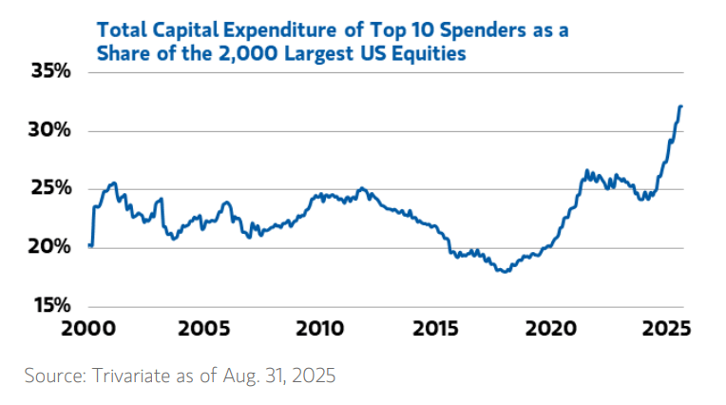

Slide 21
We now live in a token economy

Slide 22
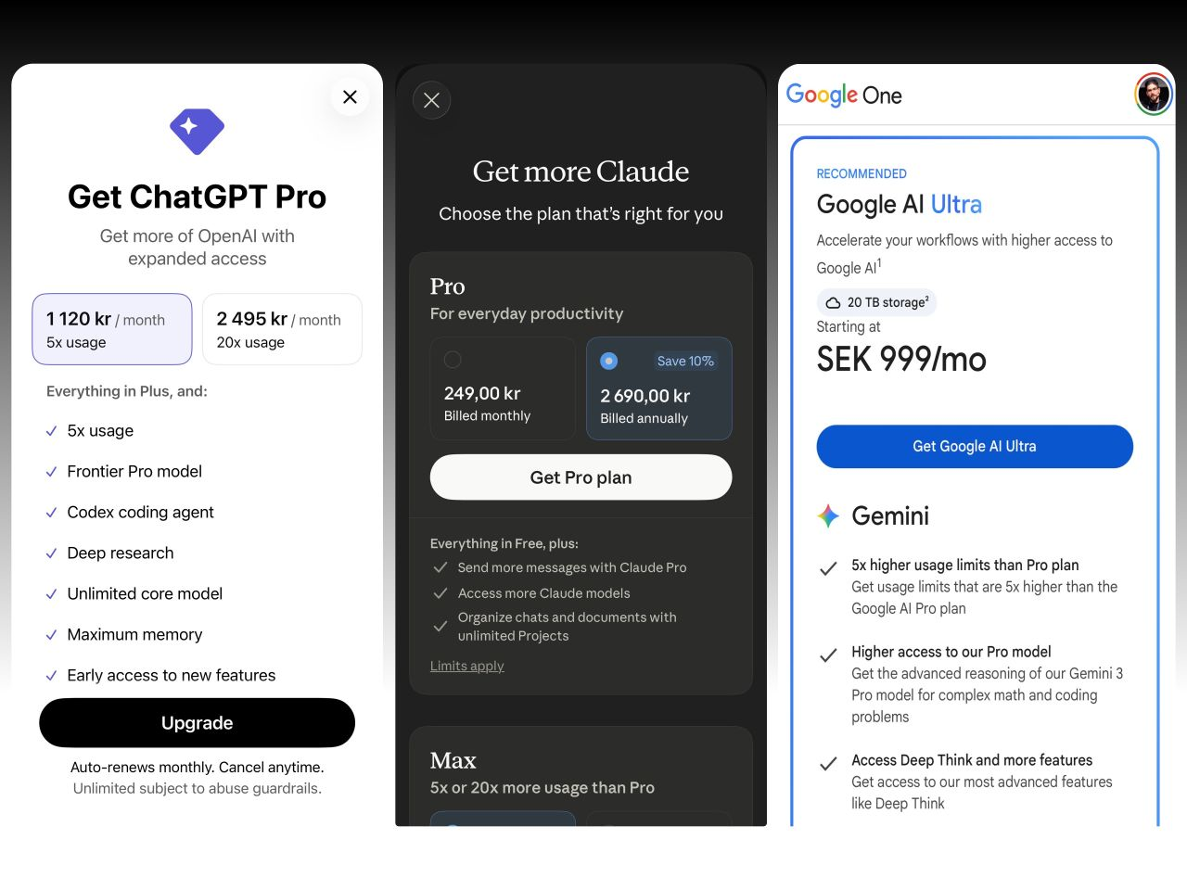

Slide 23
Tokens are the currency of intelligence

Slide 24
5× RATIO
INPUT
OUTPUT
RATIO
OPENAI
$4
$20
5×
ANTHROPIC
$2
$10
5×
GOOGLE
$0.75
$3.75
5×
Notes:
Timing: 0:18
As of August 25, 2026, these representative OpenAI, Anthropic, and Google models all price ordinary output at five times ordinary input. They are not comparable products. The shared ratio is a metering clue, not a benchmark result.
[Sources]
- https://developers.openai.com/api/docs/models/gpt-5.6-sol
- https://docs.anthropic.com/en/docs/about-claude/pricing
- https://ai.google.dev/gemini-api/docs/pricing

Slide 25
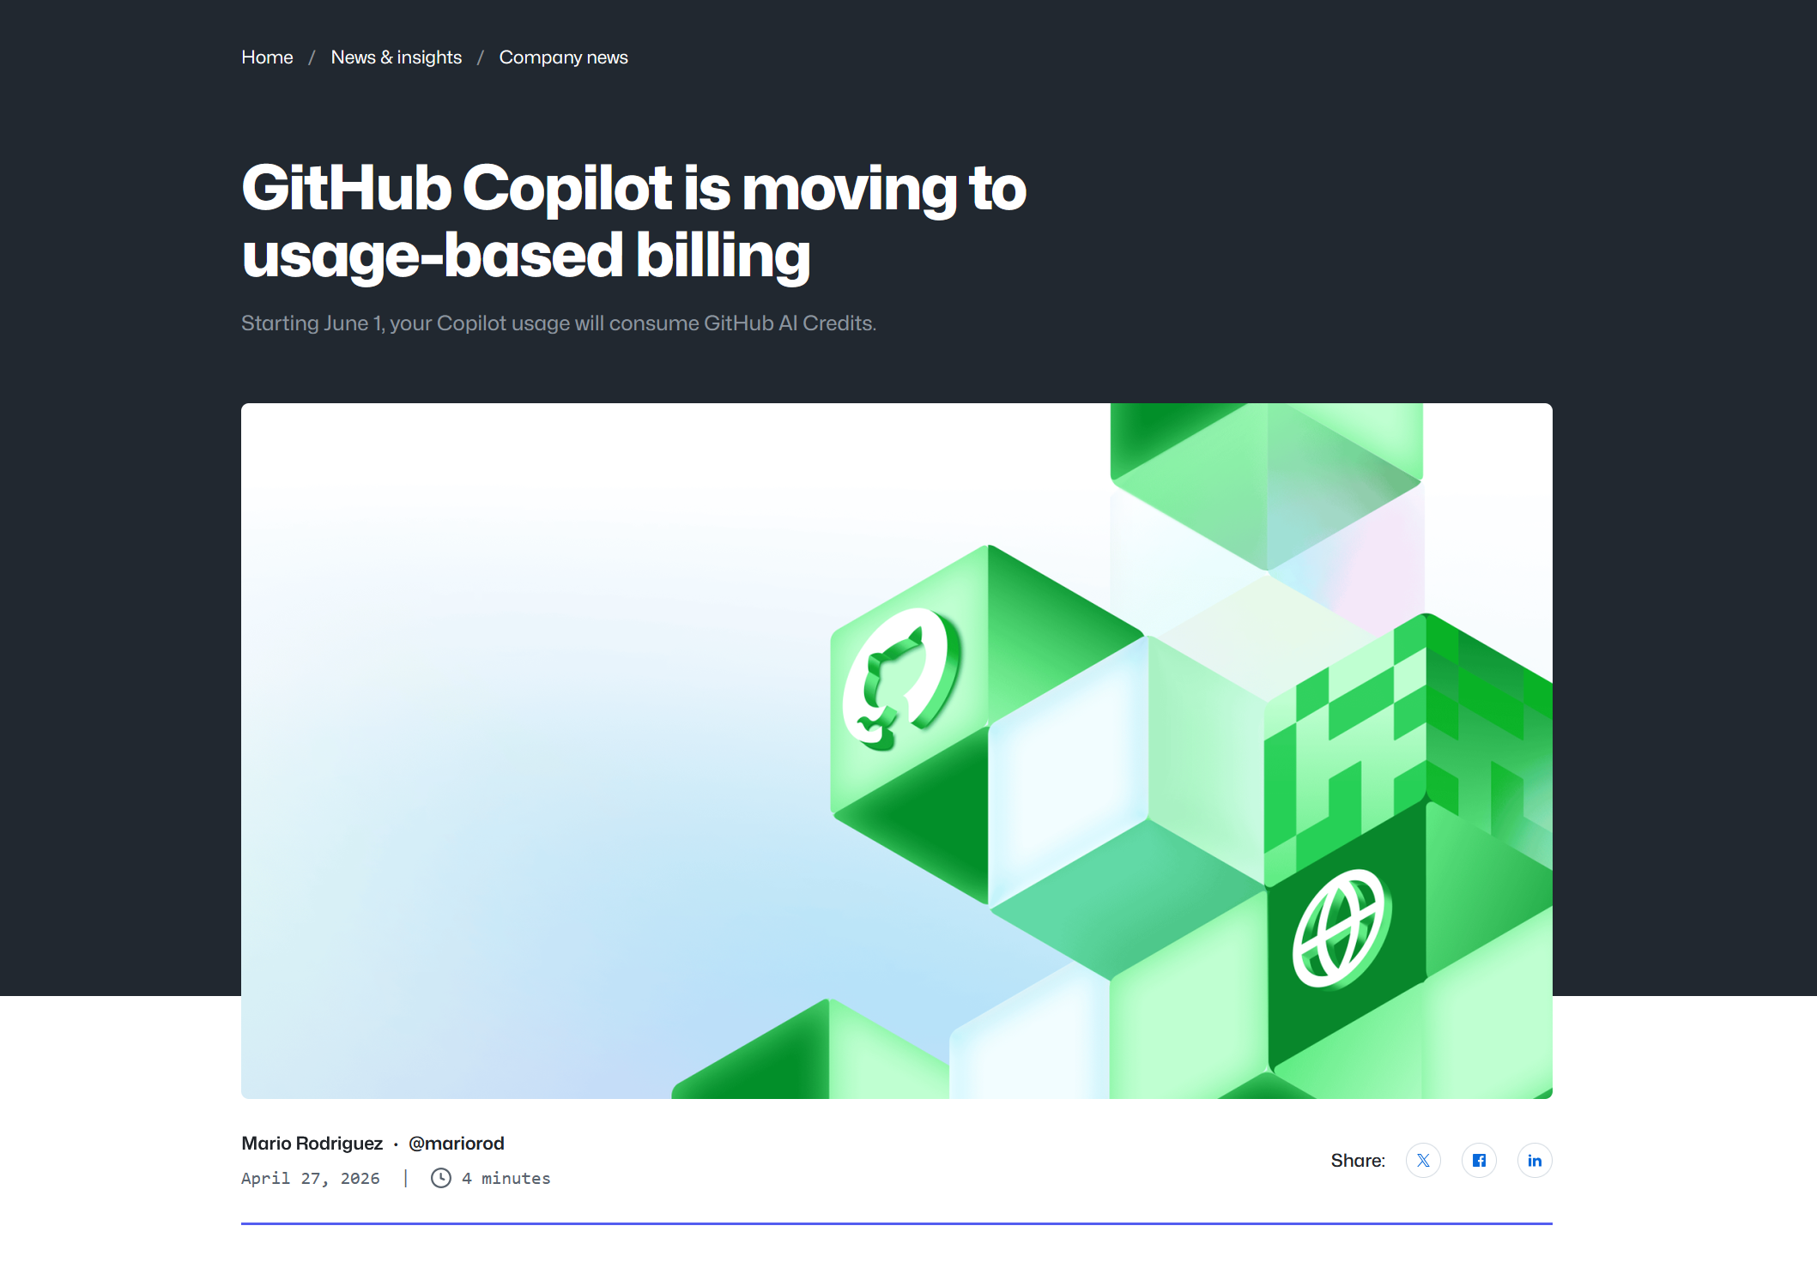

Slide 26
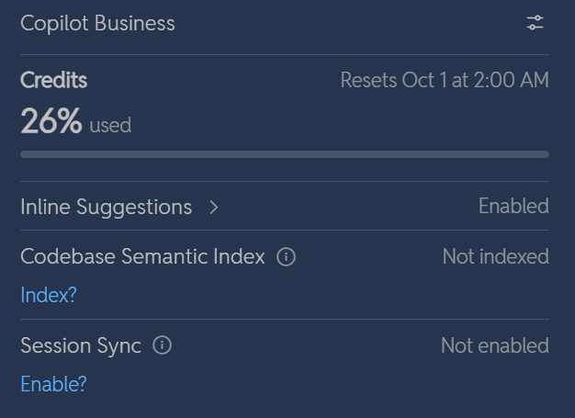

Slide 27
No all tokens are created the same

Slide 28
COORDINATION
COGNITION
CONTEXT

Slide 29
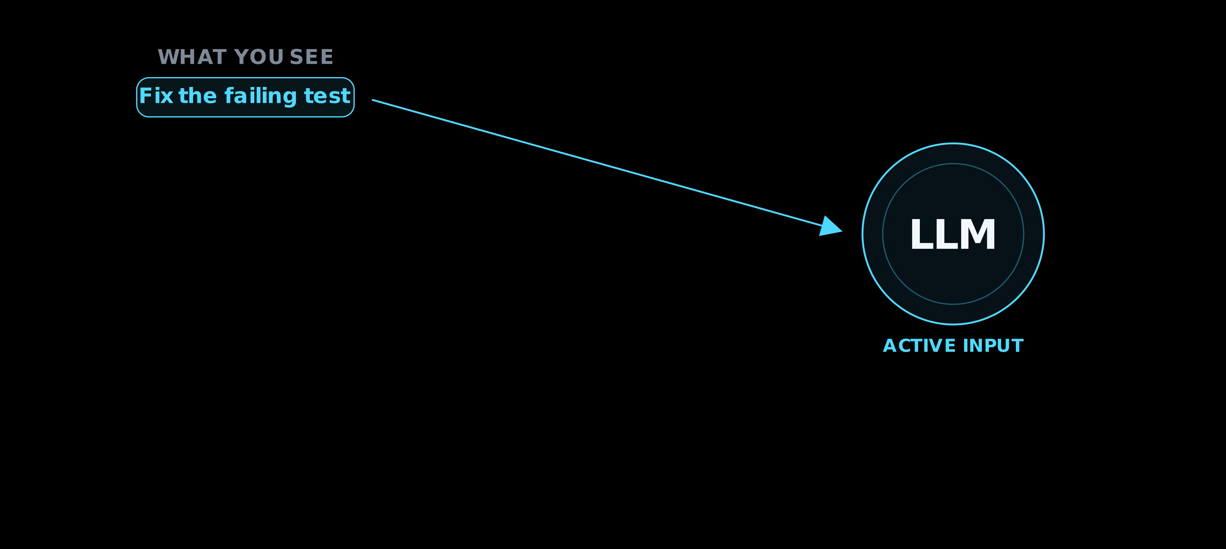
CONTEXT

Slide 30

COGNITION

Slide 31
COORDINATION

Slide 32
Token efficiency

Slide 33
SCALE BECOME MILLIONS
11,000,000
AI TASKS / YEAR
$1.1M
$5.5M
$0.10 / TASK
$0.50 / TASK
5×

Slide 34
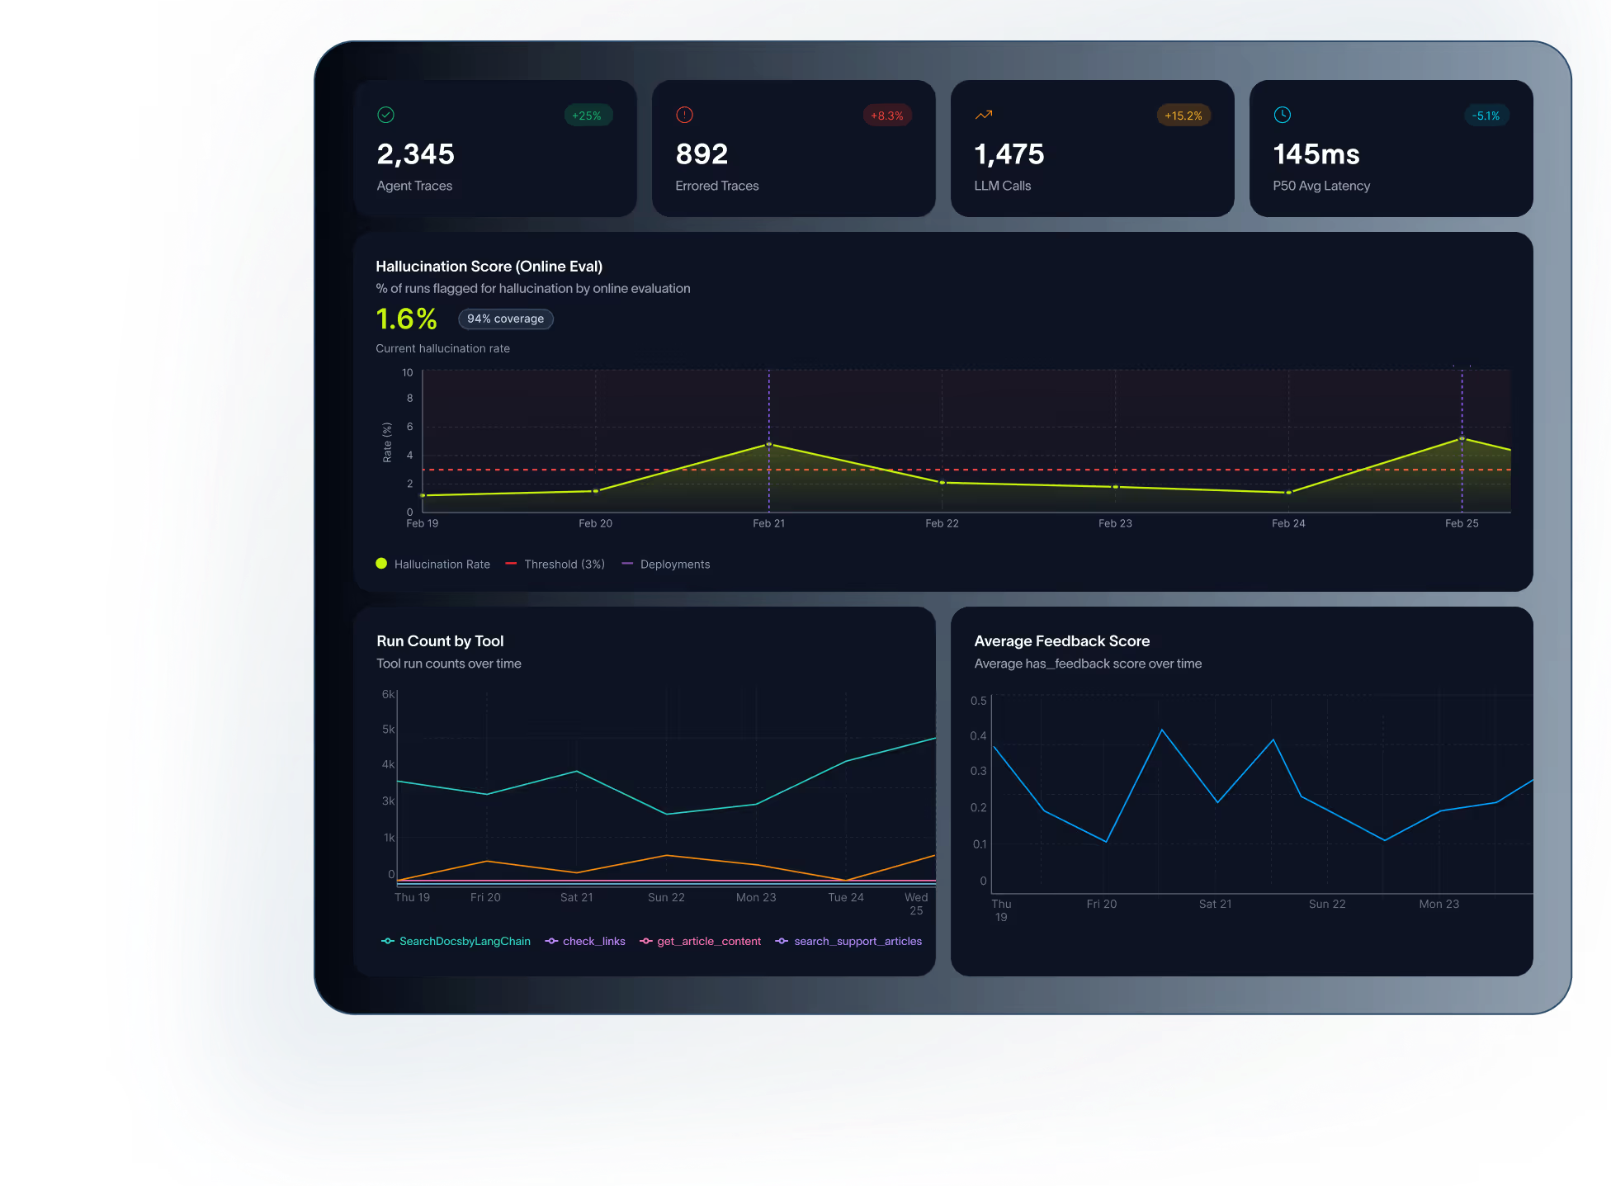
TRACE

Slide 35
TRIM CONTEXT
THE ANSWER CAN BE IN THE MIDDLE

Slide 36
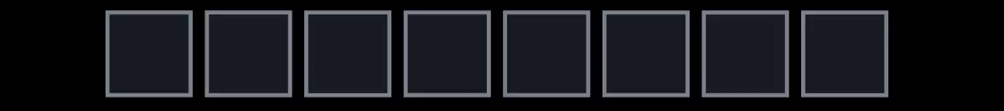
CACHE PREFIXES
STABLE PREFIX
DYNAMIC

Slide 37

ROUTE
LOW
MID
HIGH

Slide 38
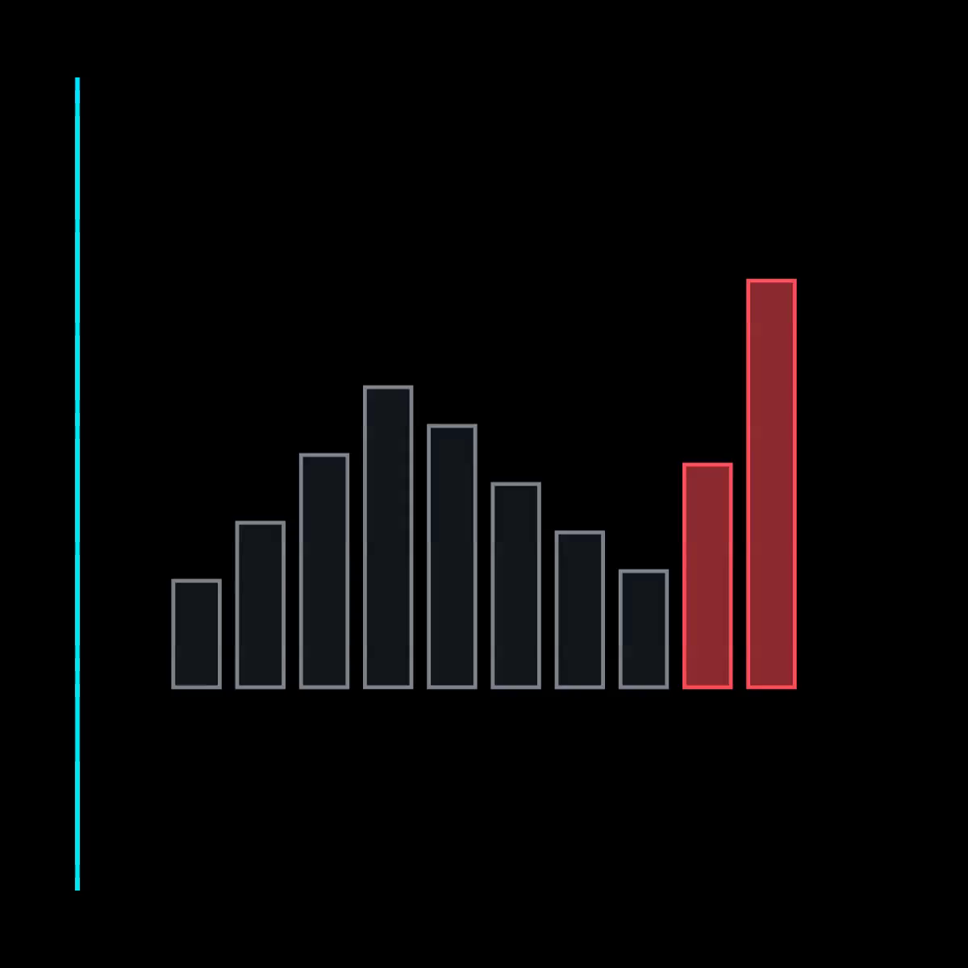
CAP COST

Slide 39

UNIT ECONOMICS
ACCEPTED OUTCOMES
$$max$$
TOTAL WORKFLOW COST

Slide 40
TAKEAWAY
Let’s spend our tokens where they change decisions

Slide 41
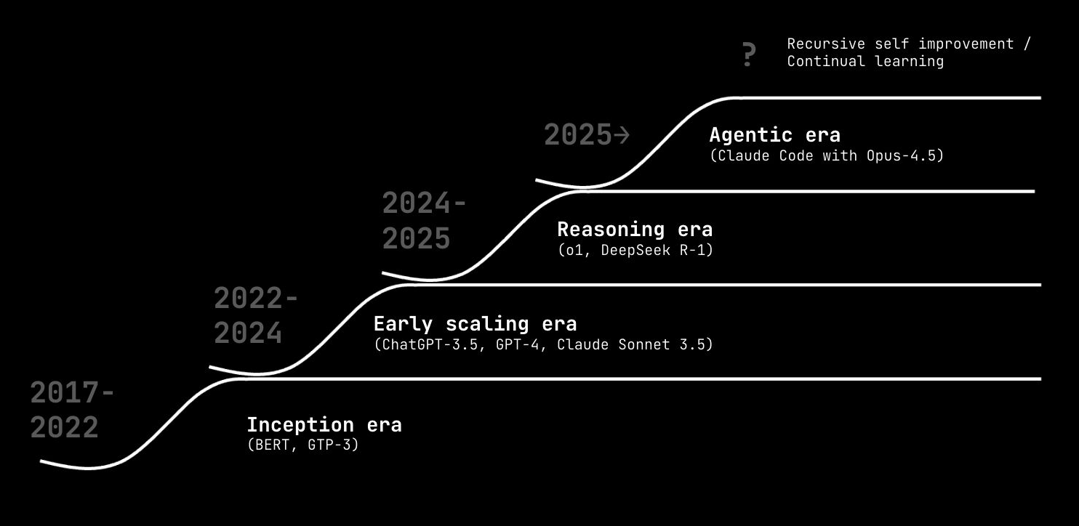
TO BE CONTINUED…

