Slide 1
Why listening to me?

Slide 2
Because I was one of you!

Slide 3
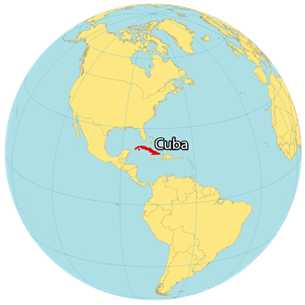



Slide 4


2026
Senior Data Scientist @ SEB
2023
Data Engineer @ SEB
2018
WASP PhD Student @ KTH

Slide 5
Post-PhD Career Paths
Academia
Industry
Entrepreneurship

Slide 6
Post-PhD Career Paths
Academia
Industry
Entrepreneurship

Slide 7
2026
Senior Data Scientist @ SEB
2023
Data Engineer @ SEB
2018
WASP PhD Student @ KTH

Slide 8
WASP PhD Student @ KTH

Slide 9
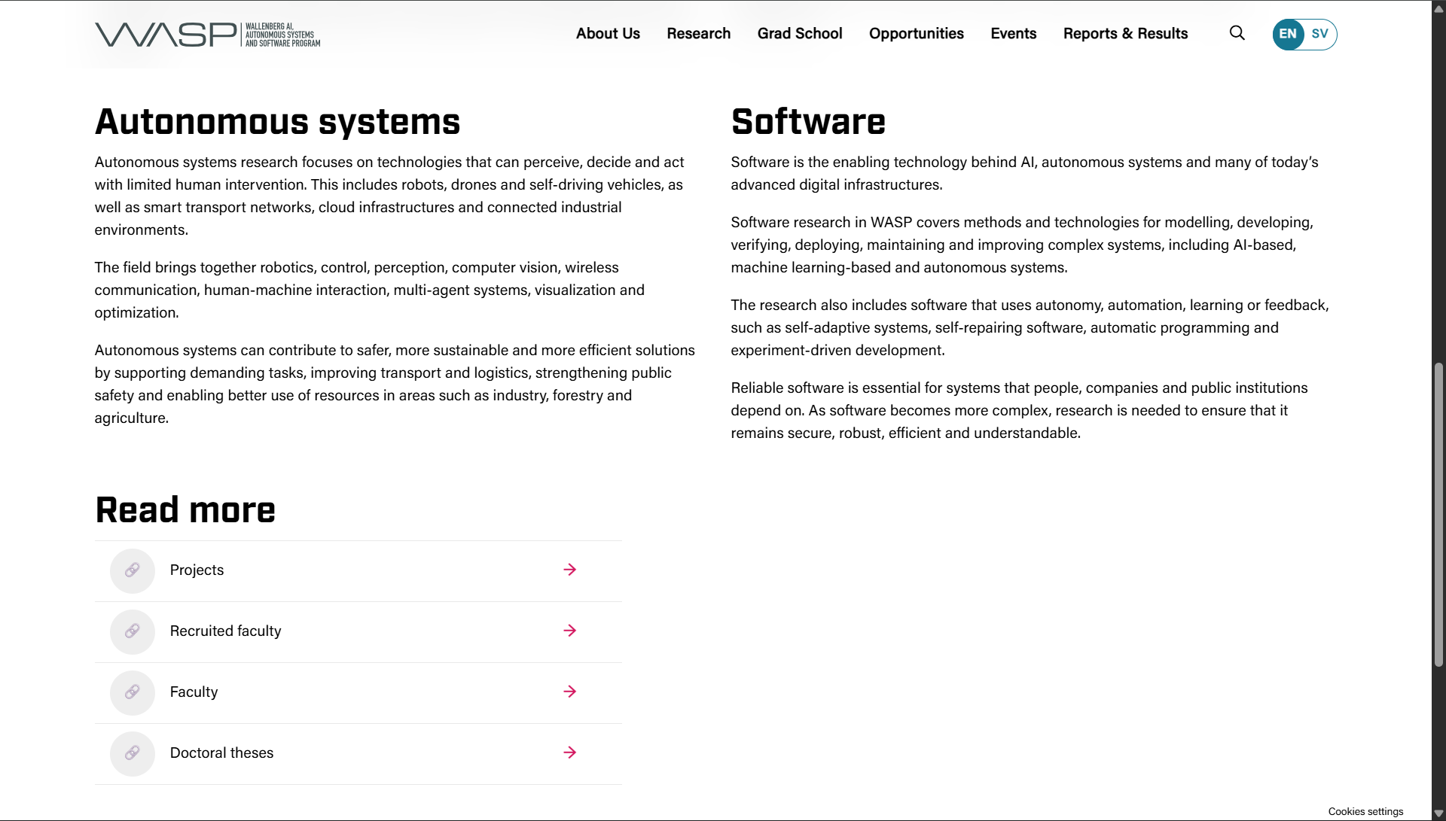


Slide 10
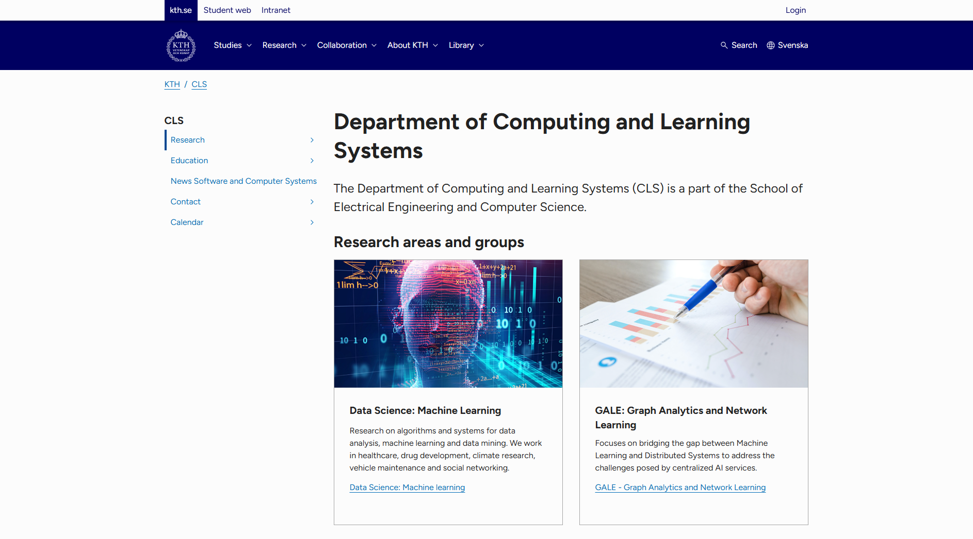

Slide 11
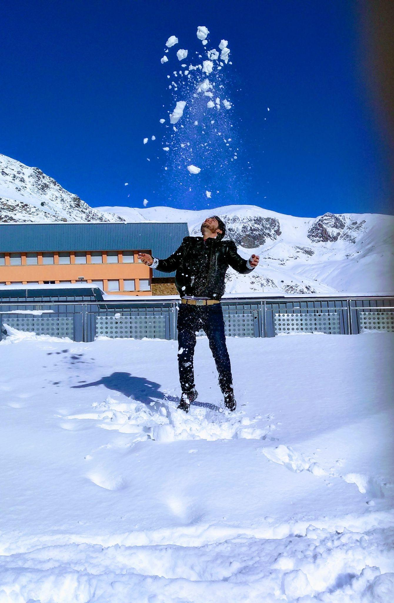
2018 – WASP Trip (Andorra)

Slide 12
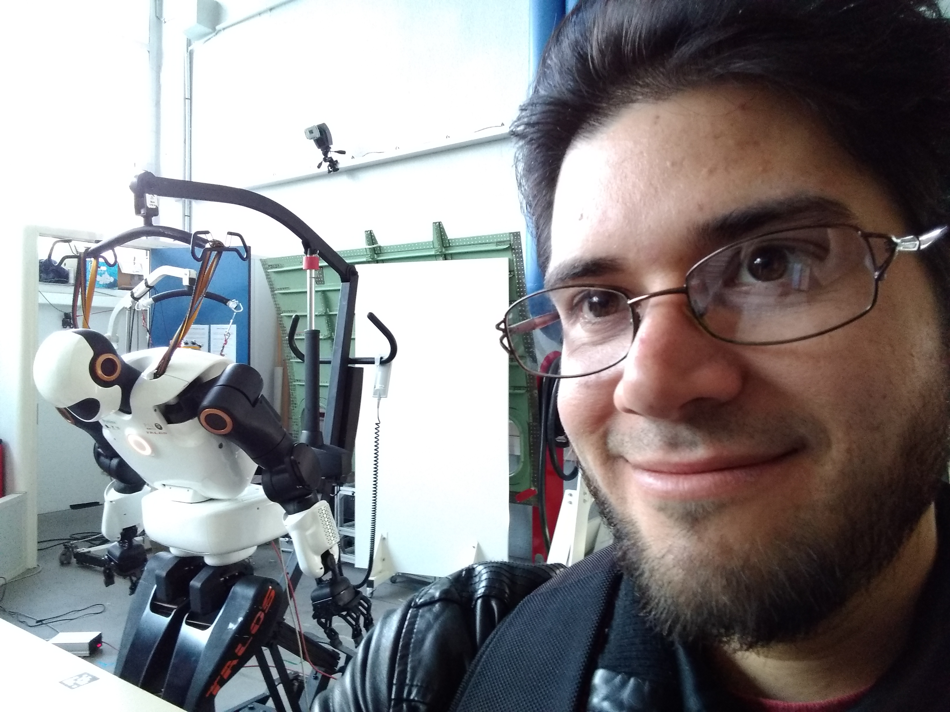
2018 – WASP Trip (France)

Slide 13
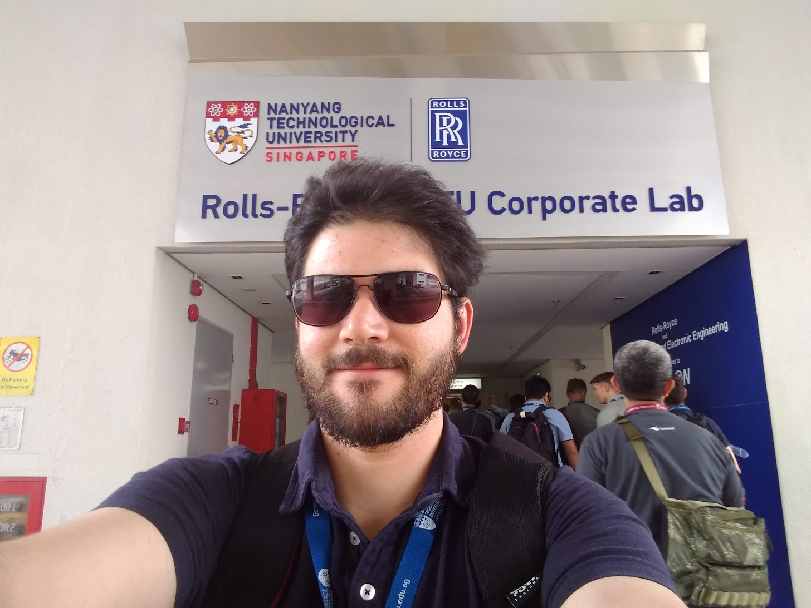
2019 – WASP Trip (Singapore)

Slide 14
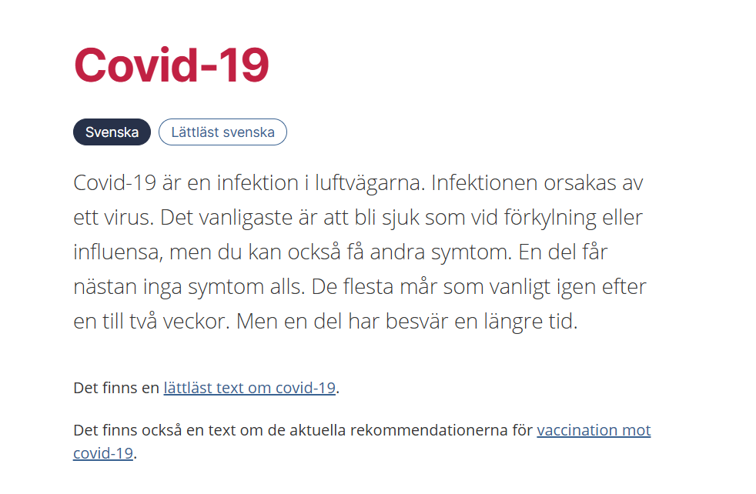

Slide 15
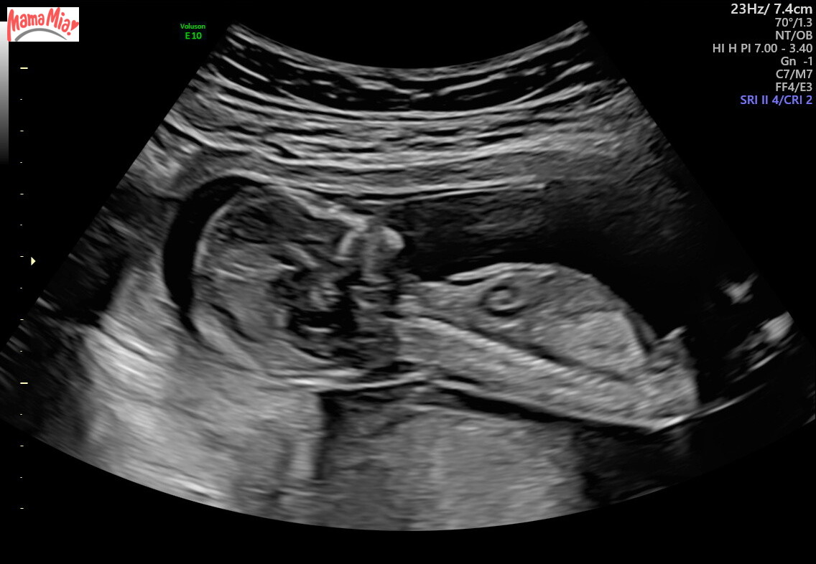

Slide 16
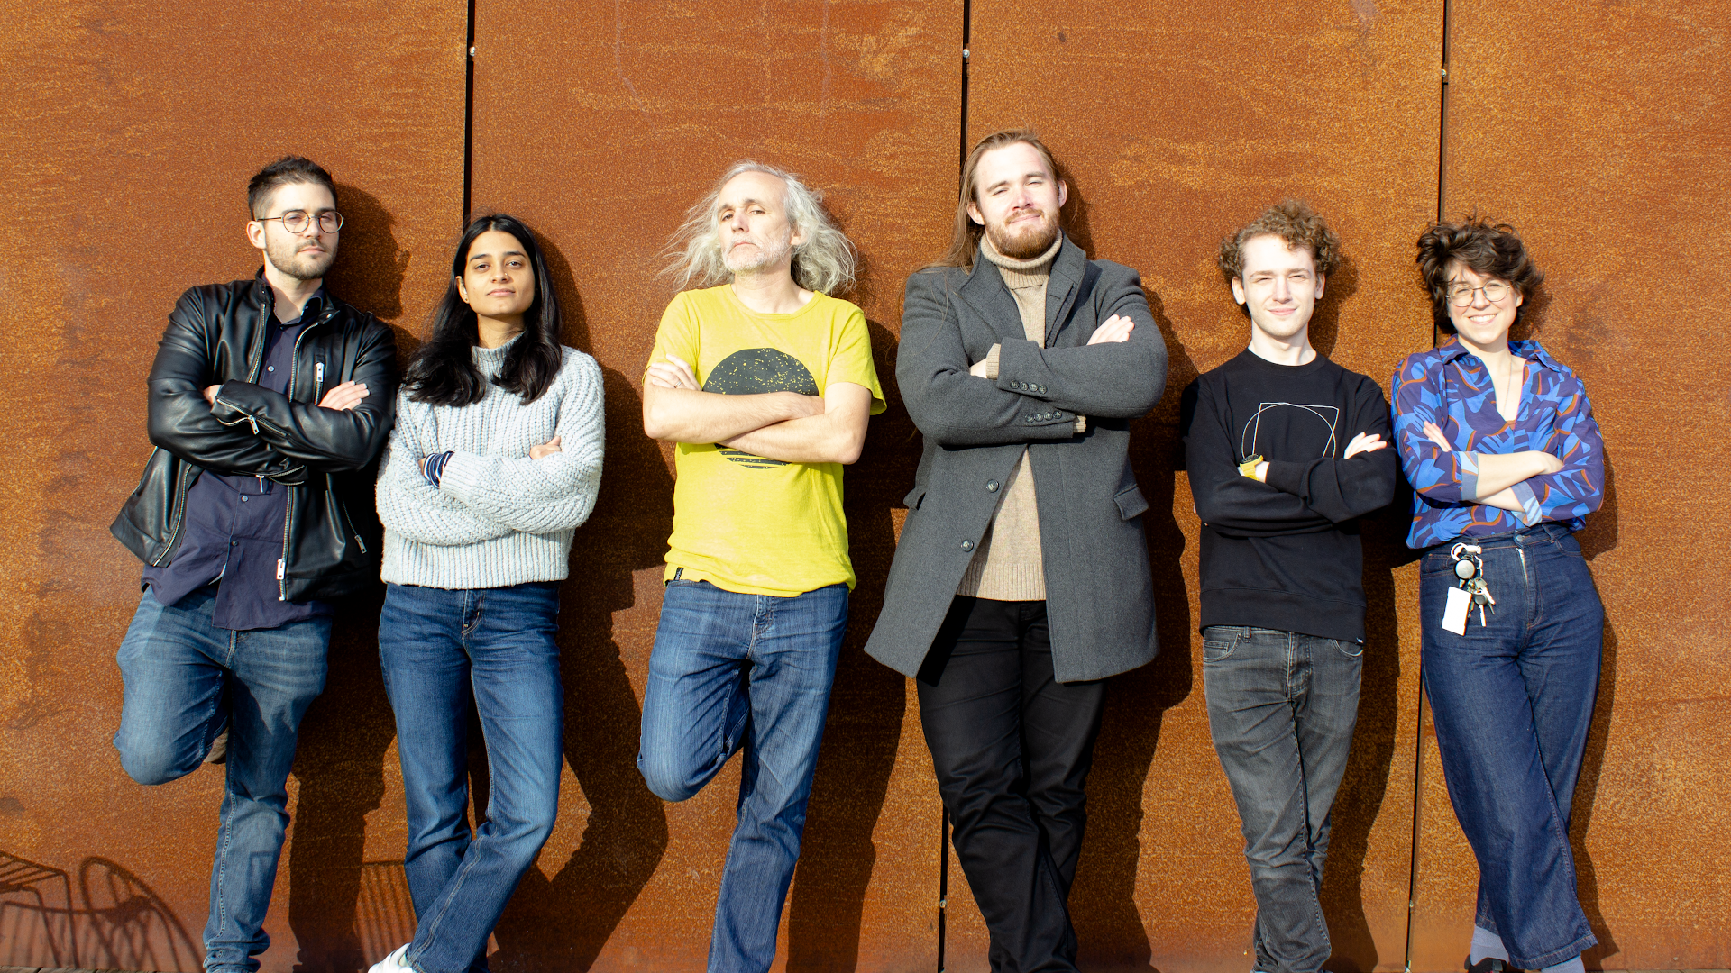
2021 – KTH

Slide 17
WASP Trips Restarted

Slide 18
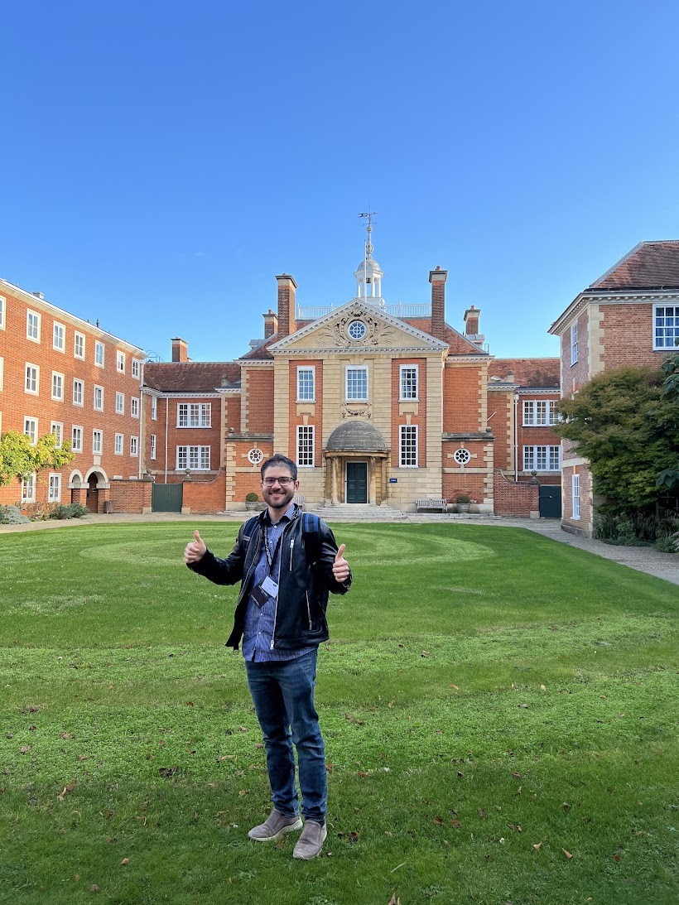
2022 – WASP Trip (Oxford)

Slide 19
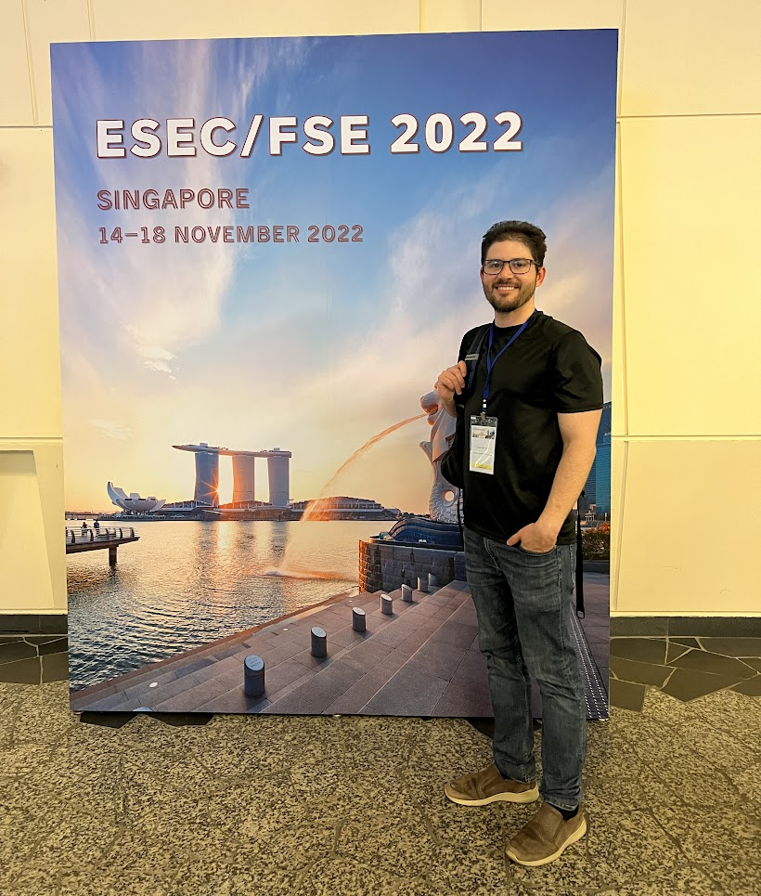
2022 – Conference Trip (Singapore)

Slide 20
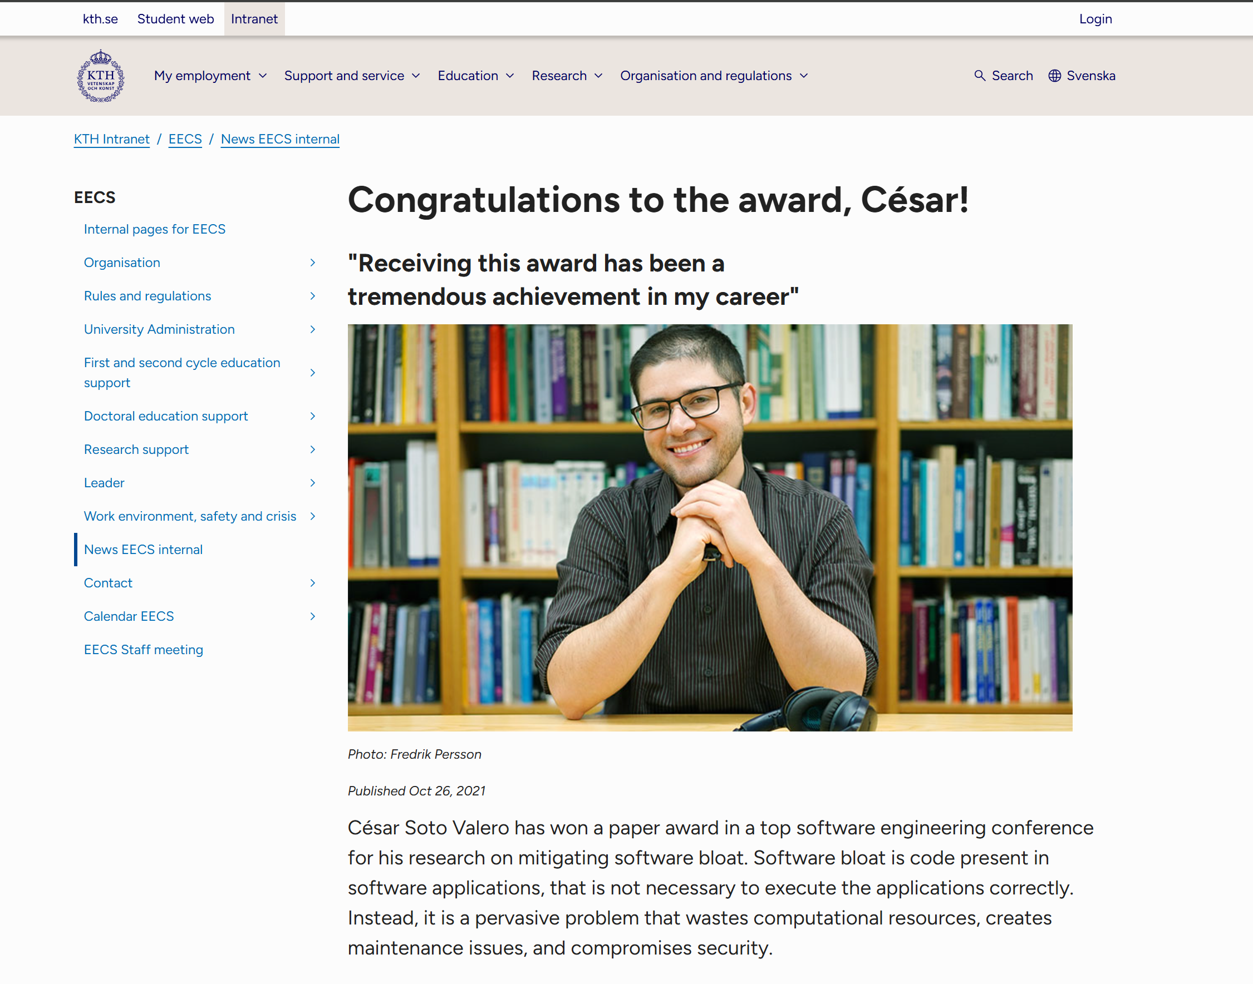

Slide 21
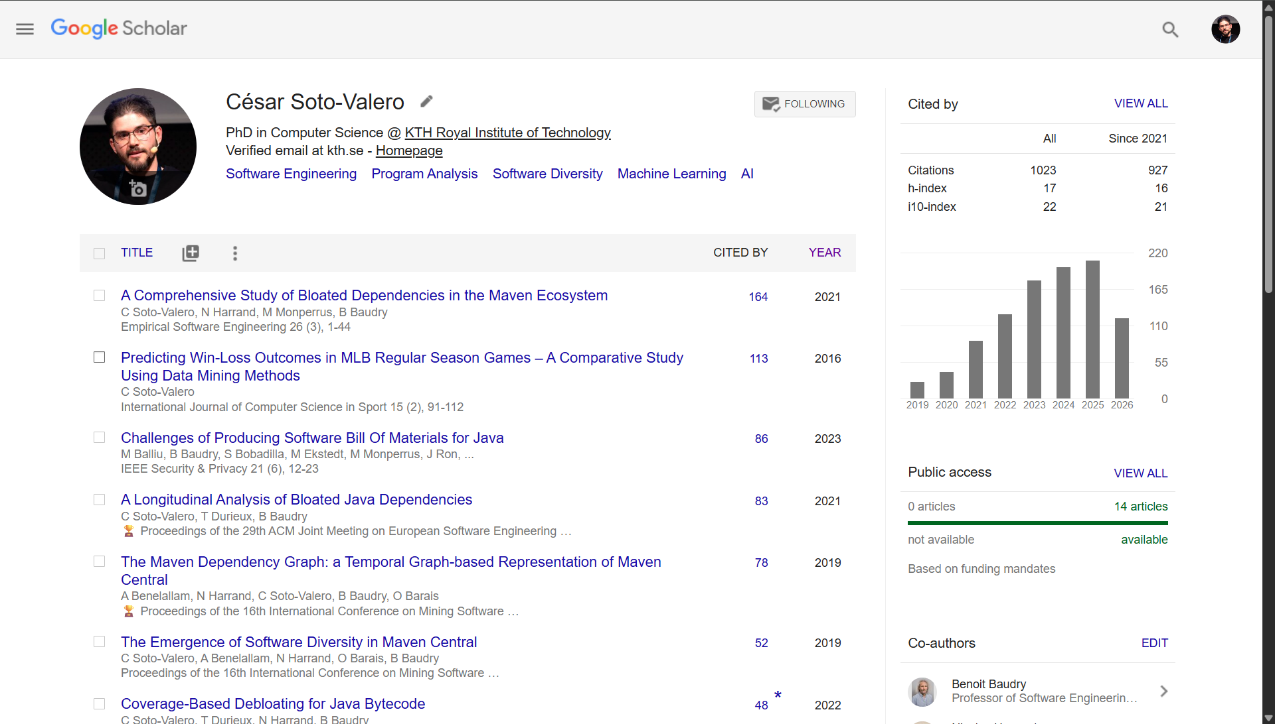

Slide 22
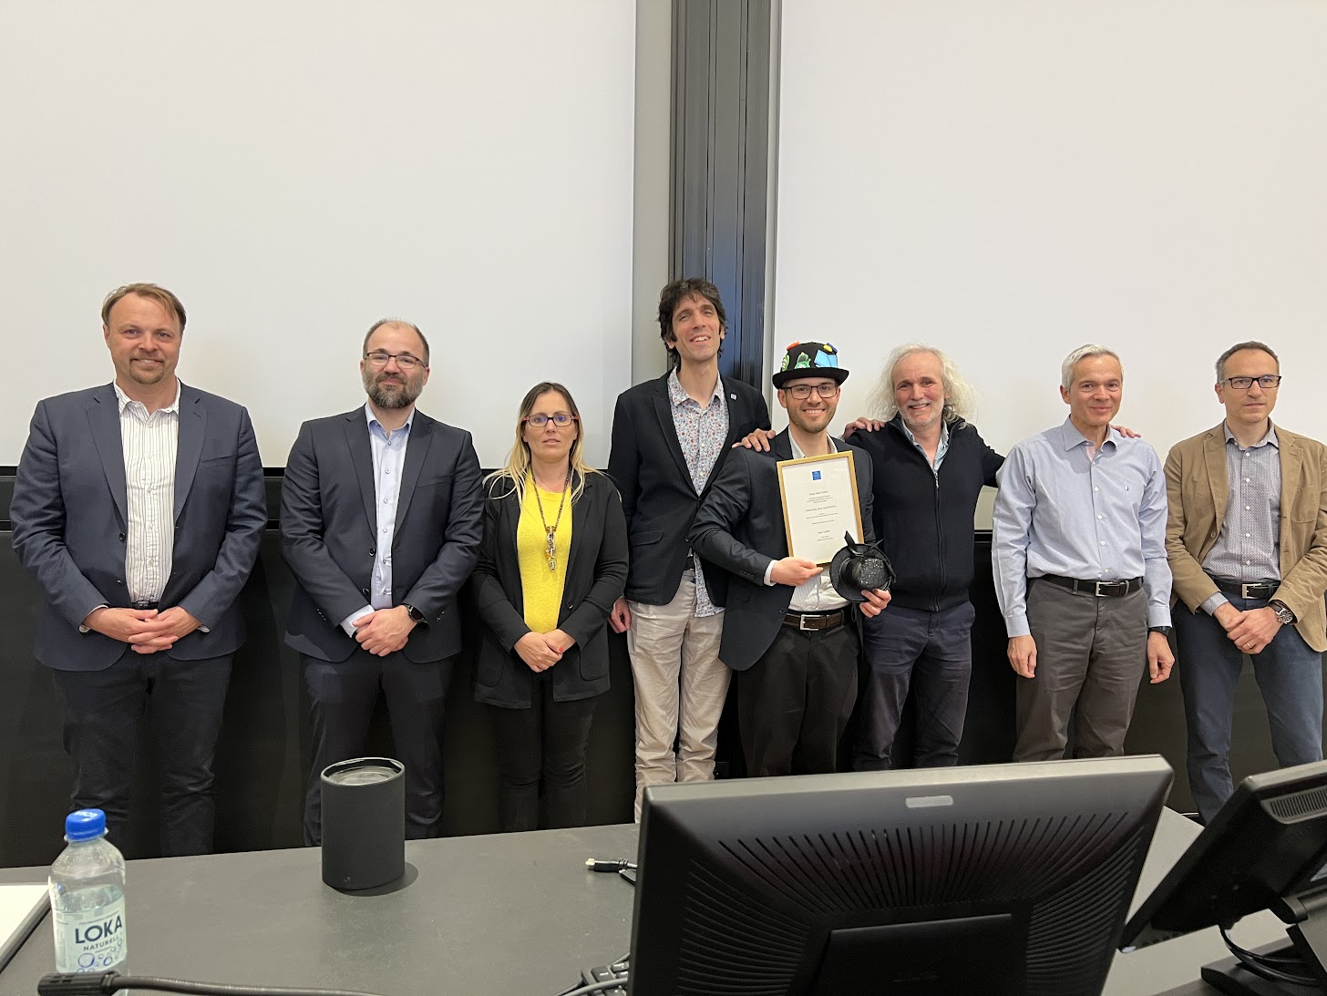
2023 – PhD Graduation at KTH

Slide 23
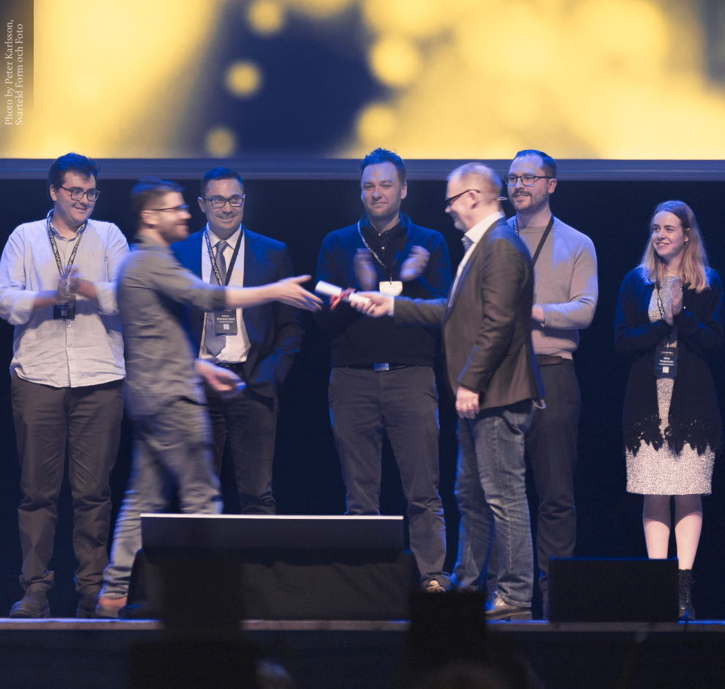
2024 – PhD Graduation Ceremony at WASP Winter Conference

Slide 24
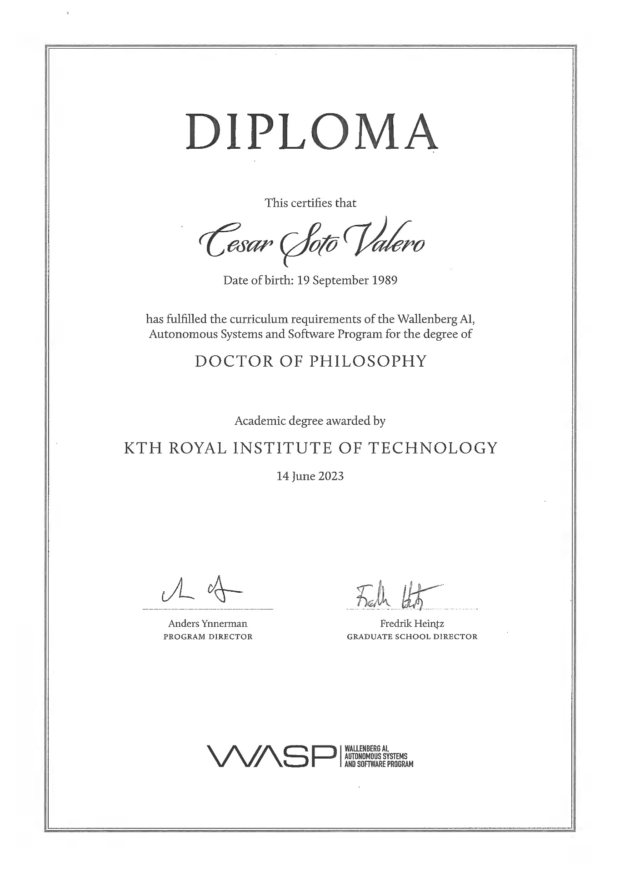

Slide 25
Then…

Slide 26
Move to Industry

Slide 27
Why?

Slide 28
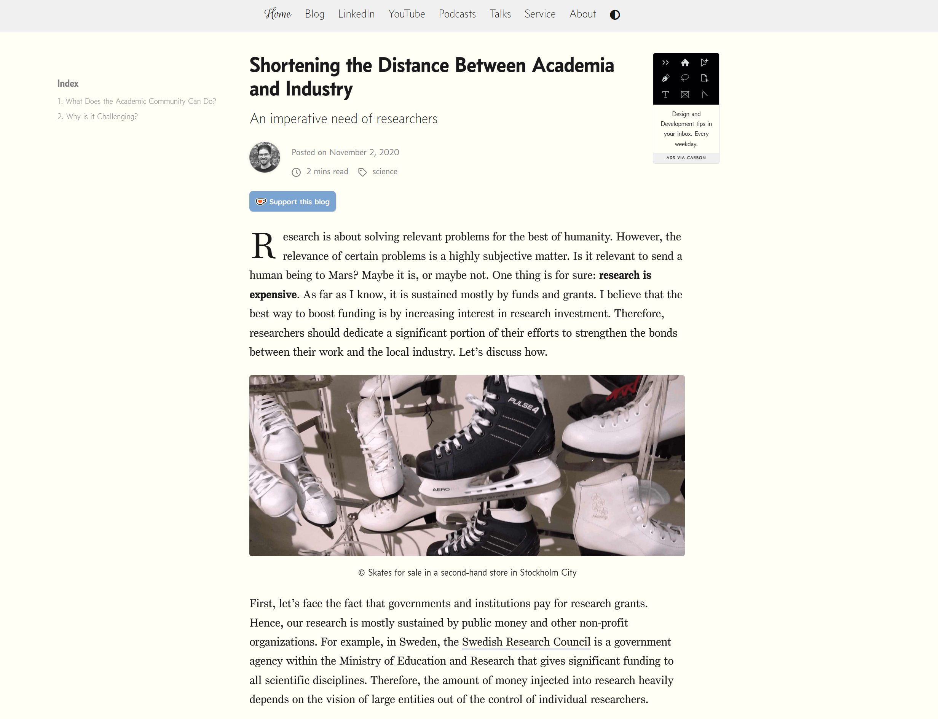

Slide 29
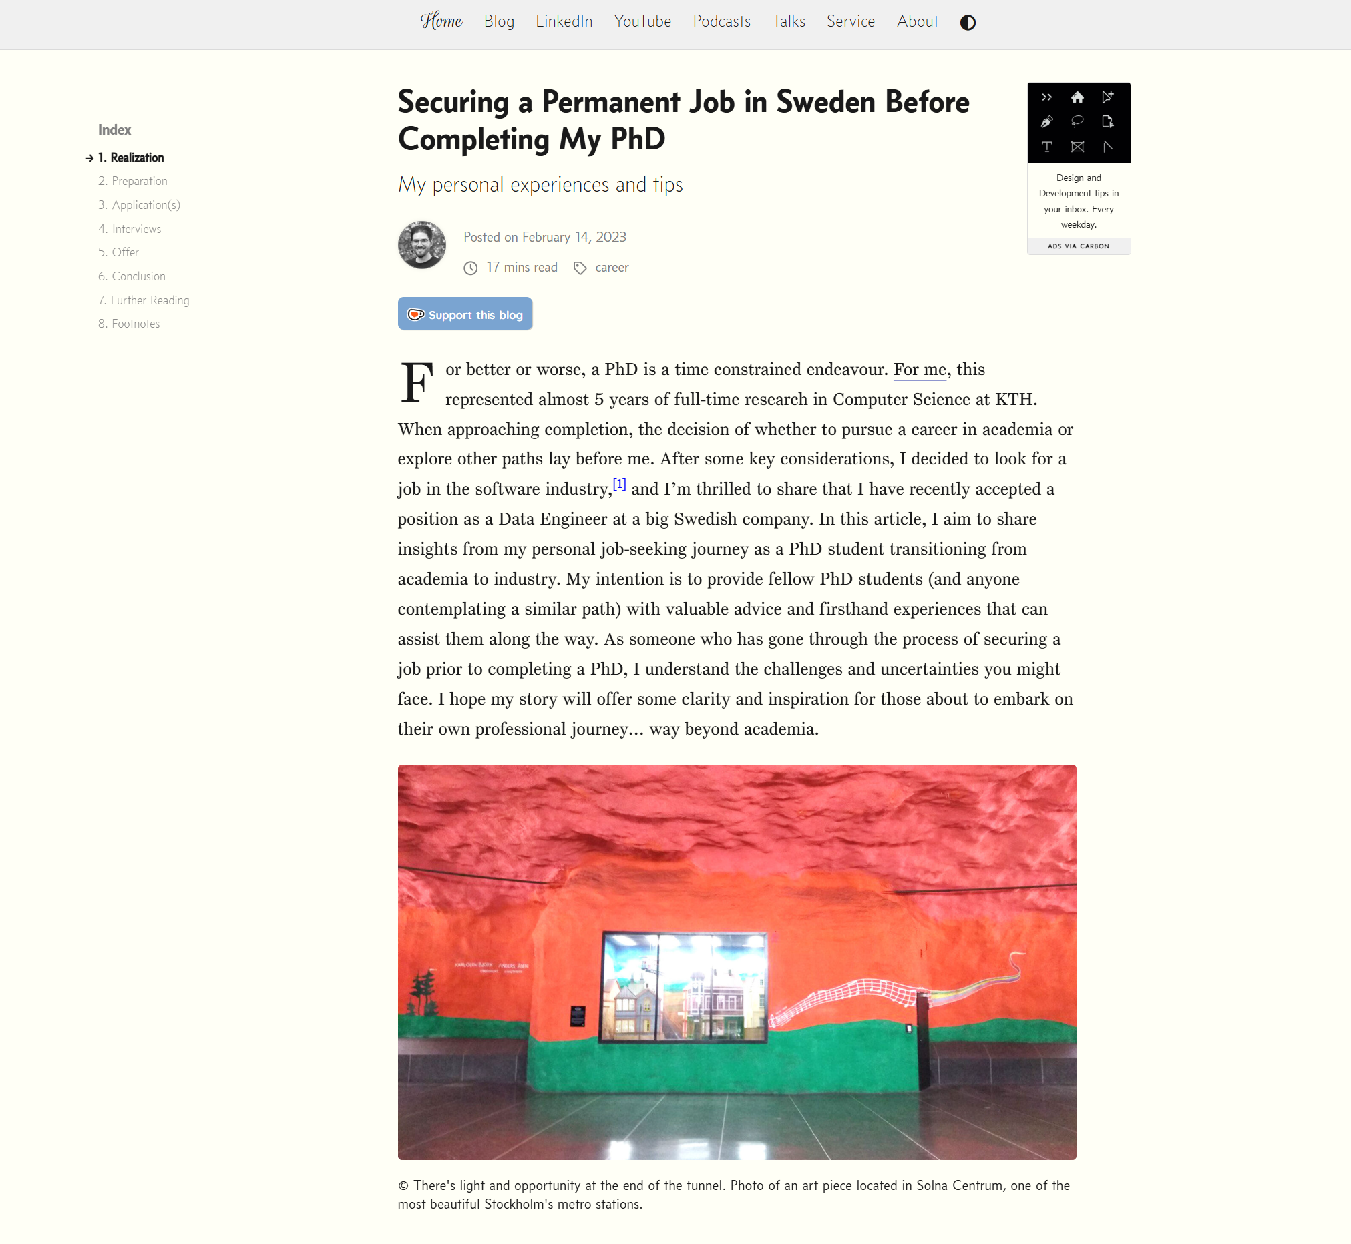

Slide 30
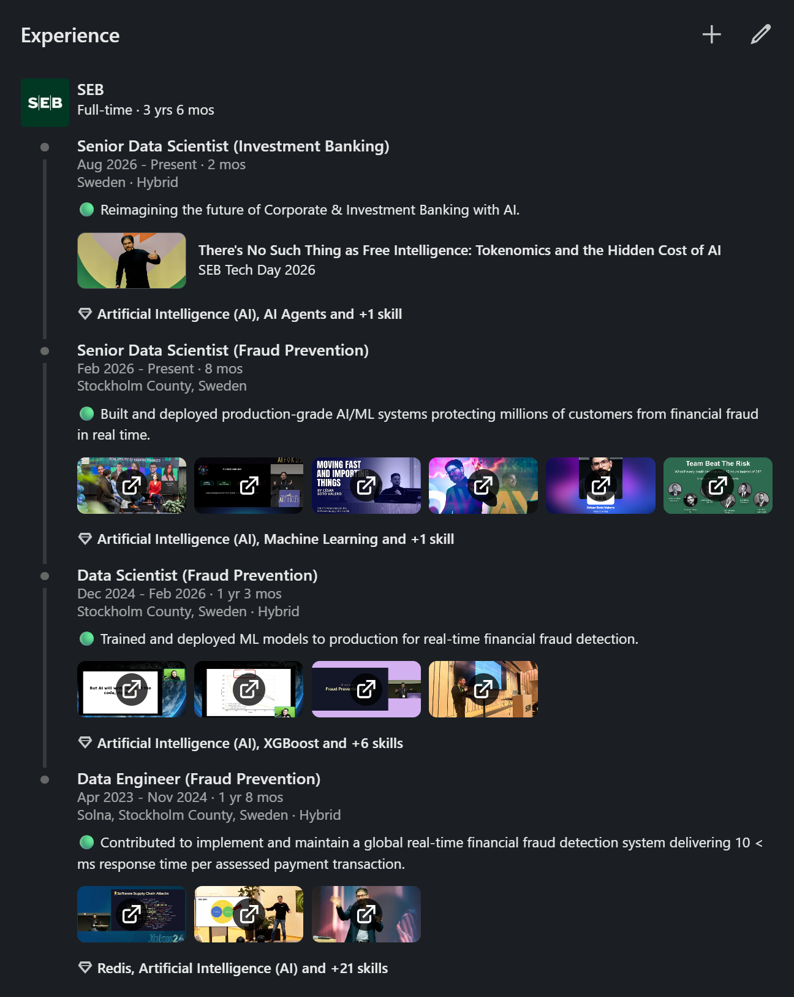
Career

Slide 31
Not The End

Slide 32
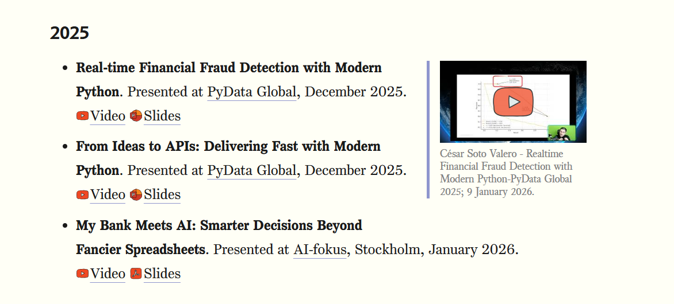
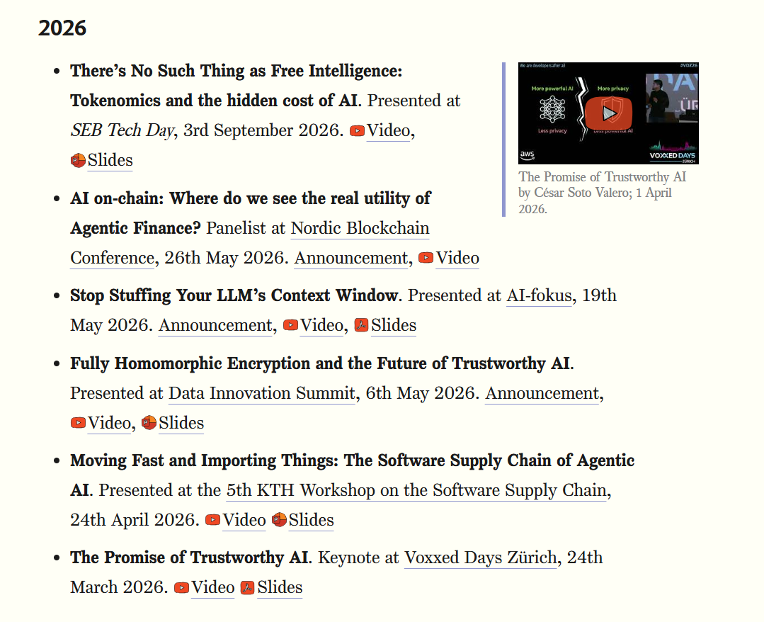
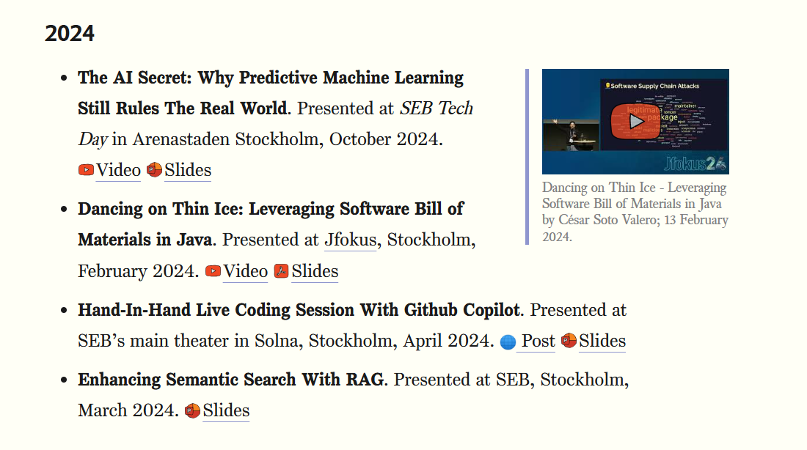
Talks

Slide 33
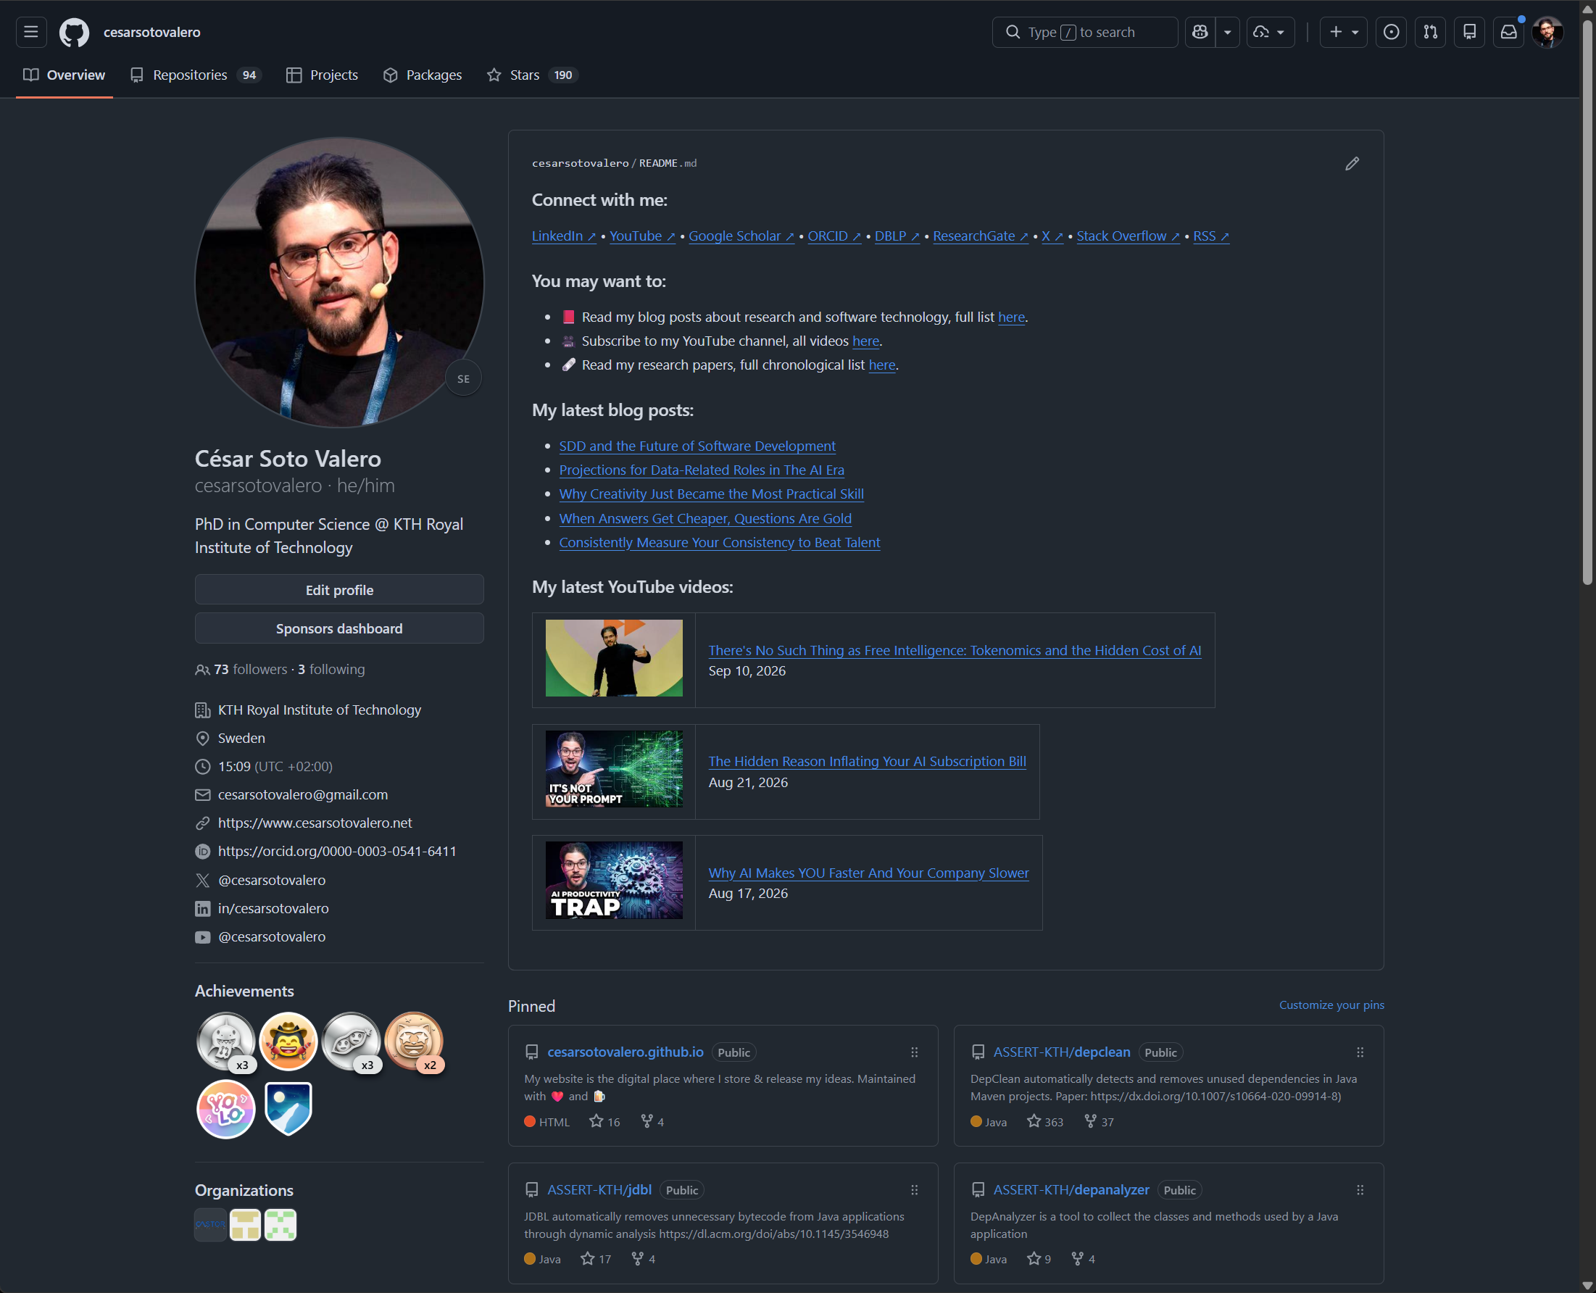
Software

Slide 34
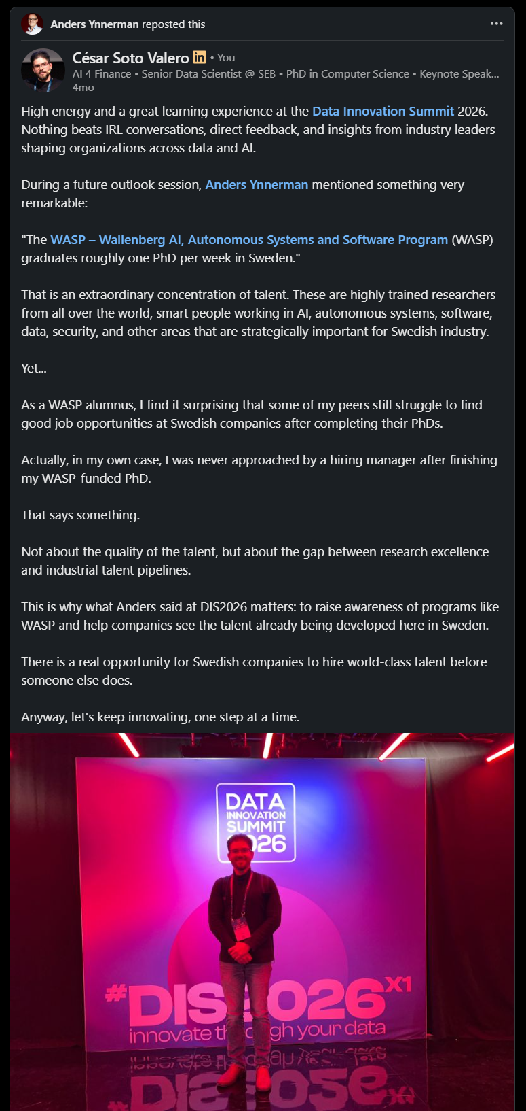
Events

Slide 35
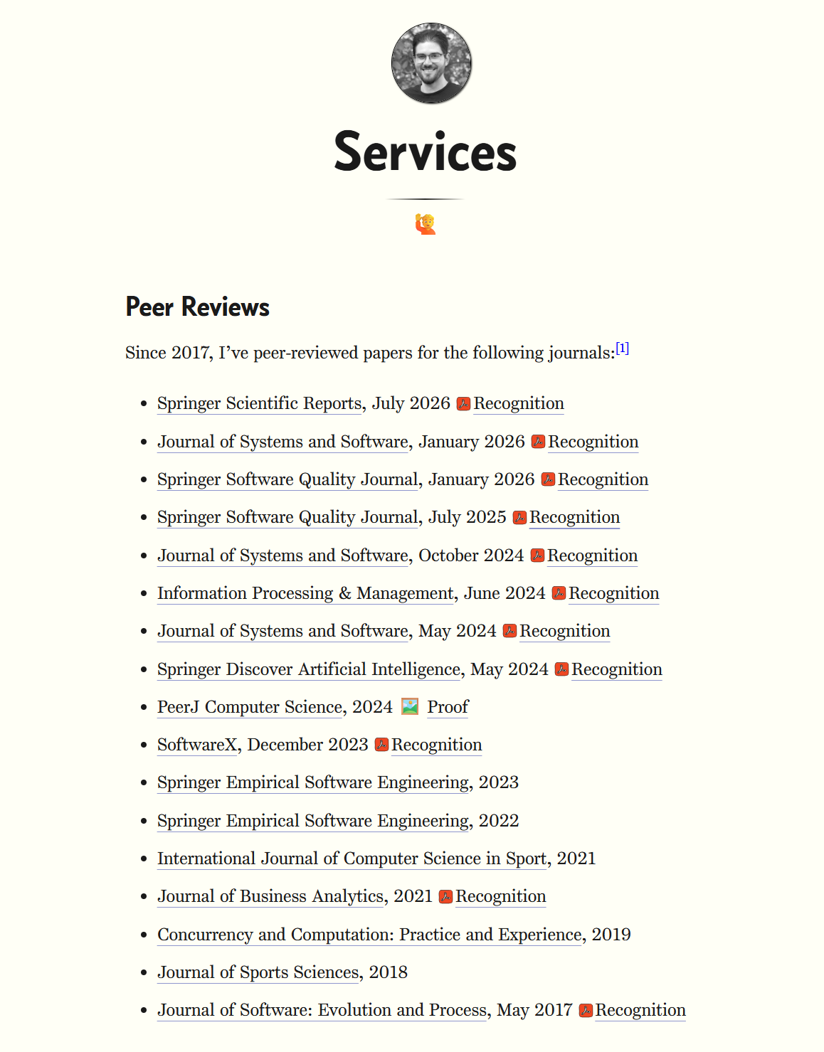
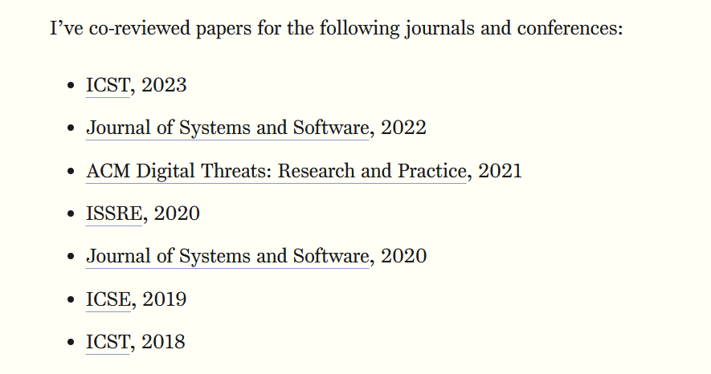
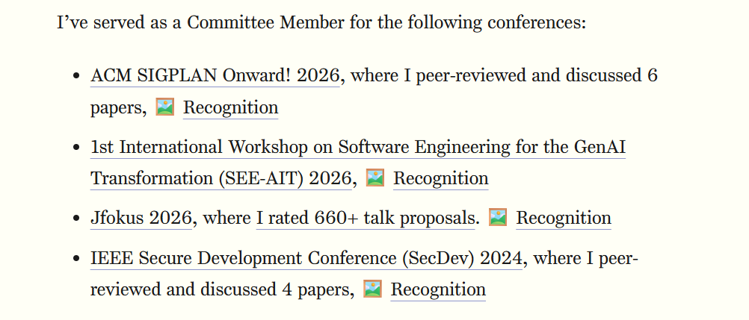

Slide 36
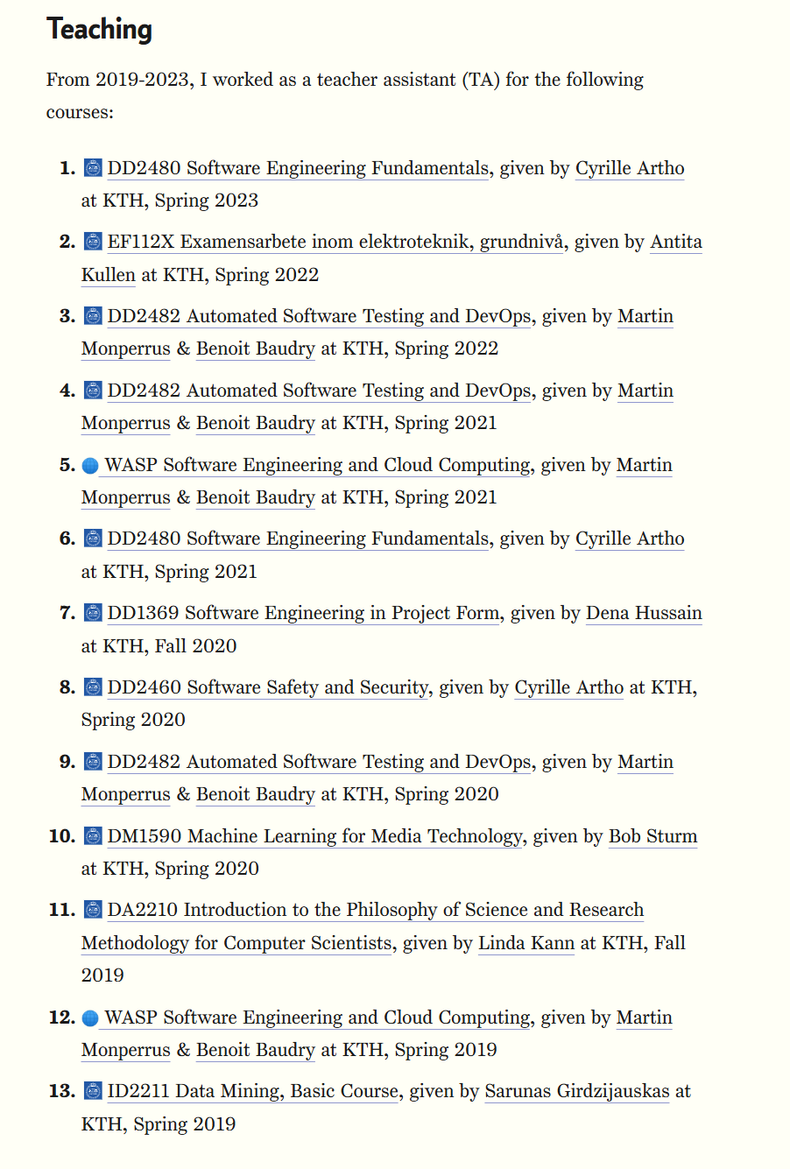
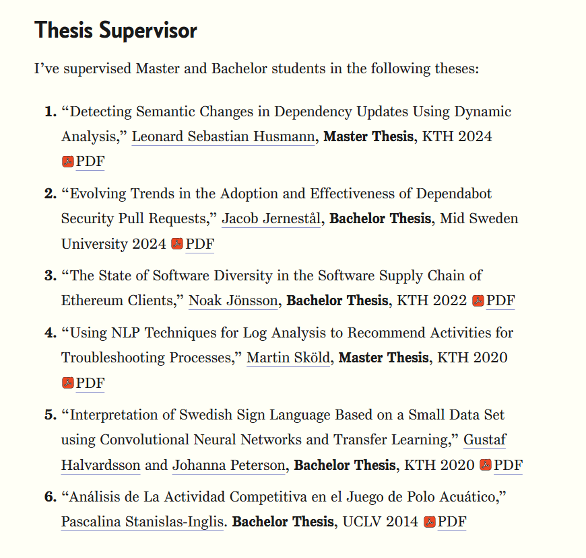

Slide 37
Why Choosing the Industry
Stability
Income
Growth

Slide 38

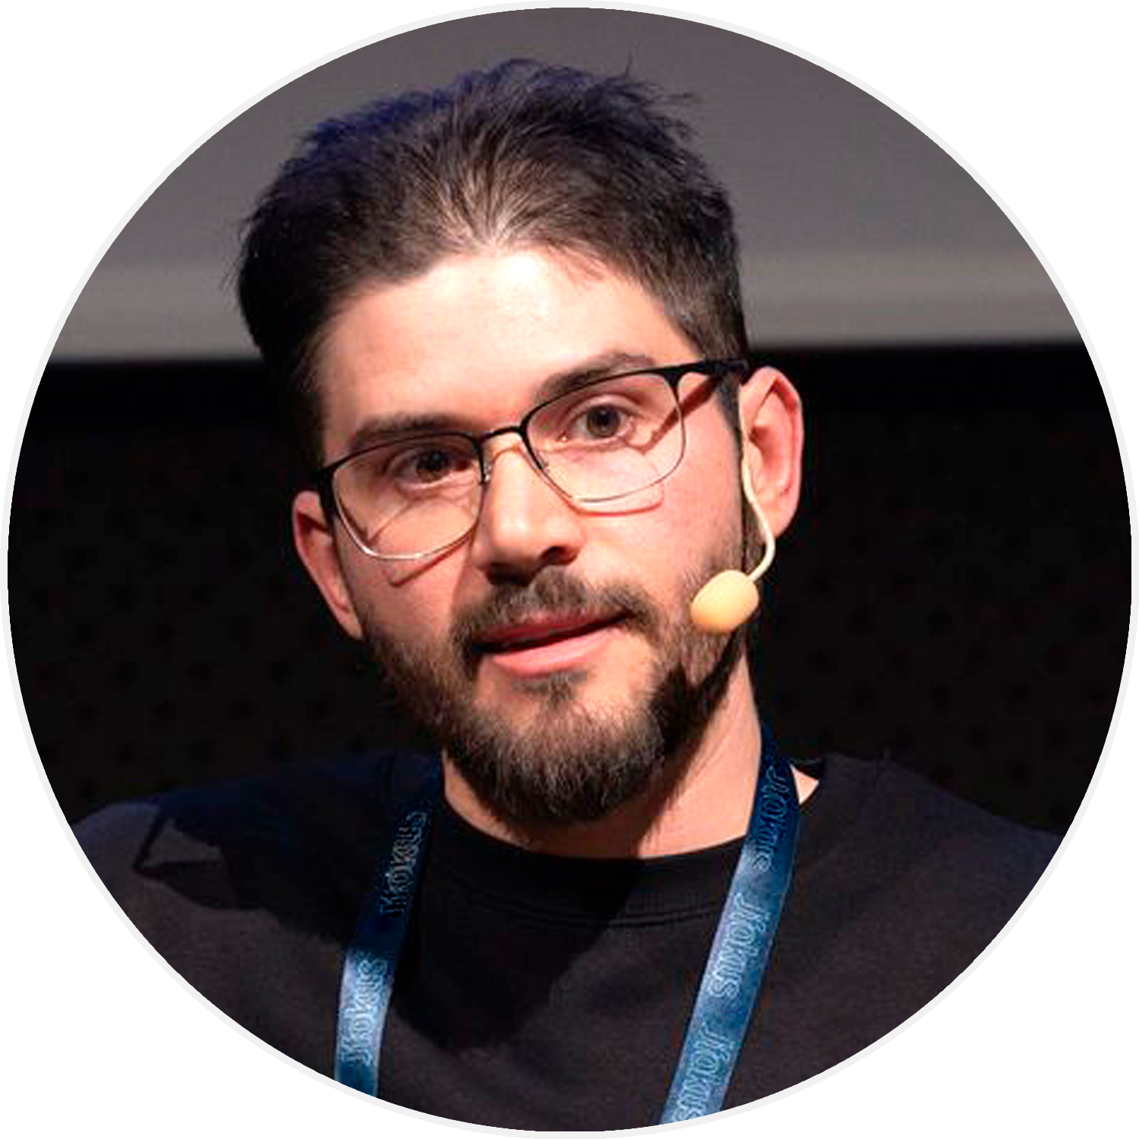
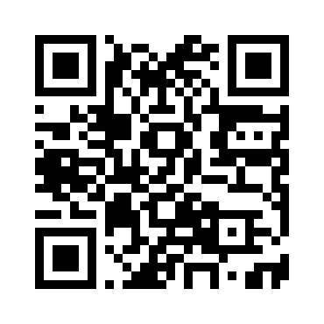
cesarsotovalero.net
Notes:
And for this we have prompt engineering.

