Slide 1
Debloating Java Dependencies
Public Defence of Doctoral Thesis
Candidate: César Soto Valero
Supervisors: Benoit Baudry & Martin Monperrus
KTH Royal Institute of Technology
Notes:
Hello,
This is my presentation of my Doctoral Thesis, which title is “Debloating Java Dependencies”
My name is César Soto Valero.
I’m a PhD student at KTH, supervised by Professors Benoit Baudry and Martin Monperrus.
I’m also a WASP PhD student. WASP is the largest research program in Sweden funded by the Wallenberg Foundation.
And during my PhD I was also part of the Castor Software Research Centre.

Slide 2
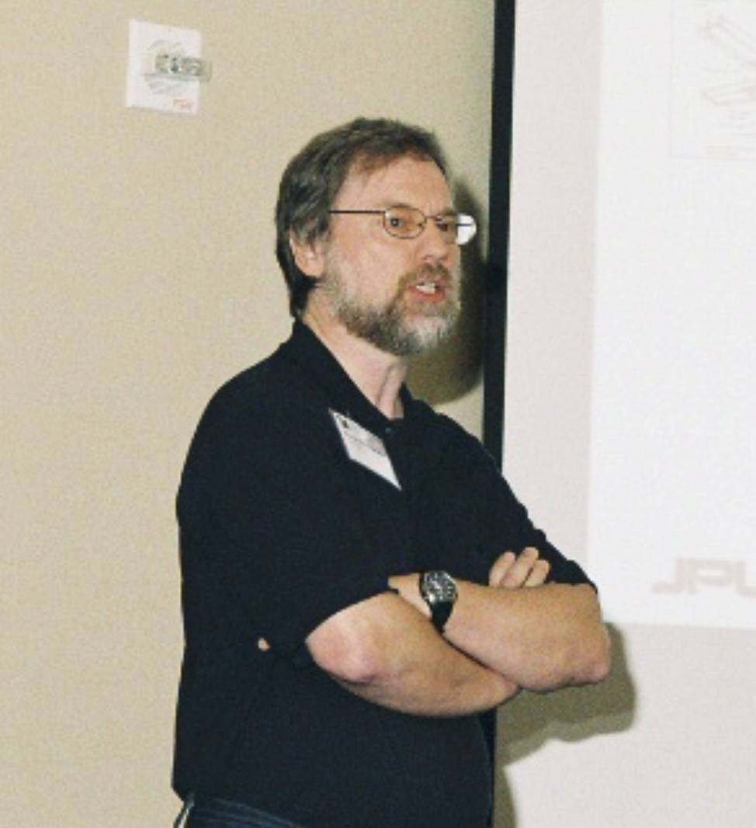
“Software tends to grow over time, whether or not there's a need for it.”
Gerard J. Holzmann. (2015). Code Inflation. IEEE Software, 32 (2).
Source: Wikipedia
2
Notes:
Gerard J. Holzmann, a well known Computer Scientist for his contributions to Formal Methods and Model Checking…
In an influential paper titled “Code Inflantion”, published in 2015 in the IEEE Software magazine.
2

Slide 3
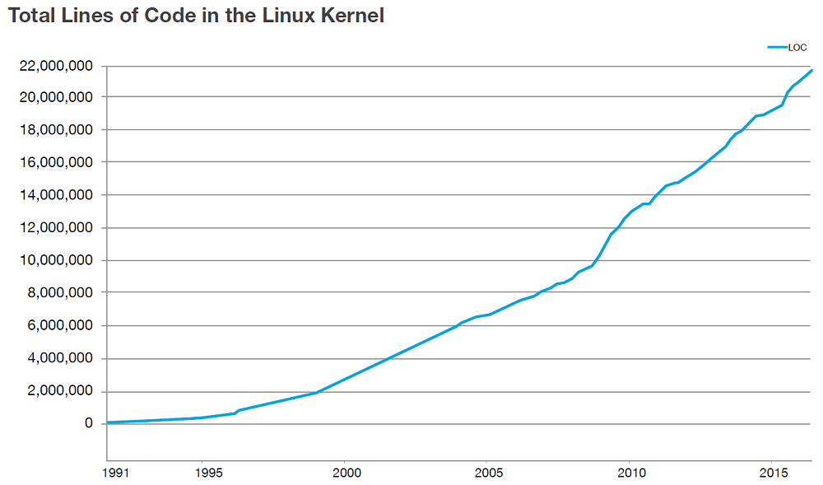
Example
Source: “Linux at 25: Changing the World with Code,” by the Linux Software Foundation
Notes:
For example, the following plot published by the Linux Software Foundation shows that the total number of lines of code in the Linux Kernel keeps on growing over time, and we know that in this code there is code that is unnecessary, in the sense that there is code here, among this 22 million lines of code that it is not needed anymore. And it is there because it was implemented from the beginning of the project, and nowadays it is extremely hard to isolate the code that is not needed and to remove it in a safe way.

Slide 4
Software bloat
“The term software bloat refers to code that is packaged in an application but that is not necessary for building and running the application.”
Maintenance
Security
Performance
Size
Notes:
Software bloat is code that is packaged in an application but is actually not necessary to build and run the application.
The existence of software bloat is a problem because it needlessly wastes developers’ time and resources.
For example, software bloat increases the size of software artifacts, creates maintenance issues, affects performance, and compromises security.
Let’s me show you an example that illustrates the problem of software bloat.

Slide 5
Software debloating
“Software debloating is the process of automatically detecting and removing software bloat across the software development lifecycle.”
5
Notes:
5

Slide 6
Three papers that I love
[USENIX 2019] RAZOR: A Framework for Post-deployment Software Debloating
Relevance
Code reduction for deployed binaries
Evaluated on Firefox & FoxitReader
70% code reduction
6
Notes:
There have been many papers in the last 5 years, and there are 3 that you particularly love
6

Slide 7
Three papers that I love
[USENIX 2019] RAZOR: A Framework for Post-deployment Software Debloating
[CCS 2020] Slimium: Debloating the Chromium Browser with Feature Subsetting
Relevance
Feature subsetting for debloating binary files
Evaluated on Chromium
21% global code reduction
7
Notes:
Prior to these works mos debloating efforts targeted small Linux command line apps,
I low these three papers
7

Slide 8
Three papers that I love
[USENIX 2019] RAZOR: A Framework for Post-deployment Software Debloating
[CCS 2020] Slimium: Debloating the Chromium Browser with Feature Subsetting
[TSE 2021] TRIMMER: An Automated System for Configuration-based Software Debloating
Relevance
Binary specialization with respect to application-specific configuration files
Evaluated on 20 applications
14% code reduction
8
Notes:
Prior to these works mos debloating efforts targeted small Linux command line apps,
I low these three papers
8

Slide 9
Three papers that I love
[USENIX 2019] RAZOR: A Framework for Post-deployment Software Debloating
[CCS 2020] Slimium: Debloating the Chromium Browser with Feature Subsetting
[TSE 2021] TRIMMER: An Automated System for Configuration-based Software Debloating
9
Notes:
9

Slide 10
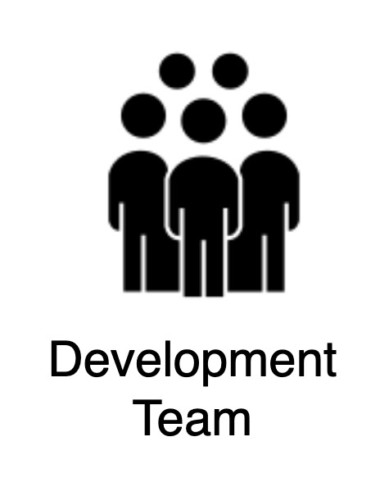
Software Development Lifecycle
Notes:
Software debloating is the process of automatically detecting and removing software bloat across the software development lifecycle.
The first challenge entails a thorough examination of the codebase and the software development lifecycle to pinpoint areas containing unnecessary or redundant code.
The second challenge involves surgically removing the bloated code through code-specific transformation techniques.
Finally, assessing the validity of the debloated artifact requires comprehensive testing and validation to ensure that the removal of bloated code has not introduced new errors or adversely impacted the application’s functionality, performance, or reliability.
By effectively executing these tasks, developers can create leaner, more efficient software, and ensure a better user experience.
10

Slide 11
Software Development Lifecycle
Notes:
11

Slide 12
Software Development Lifecycle
Notes:
12

Slide 13
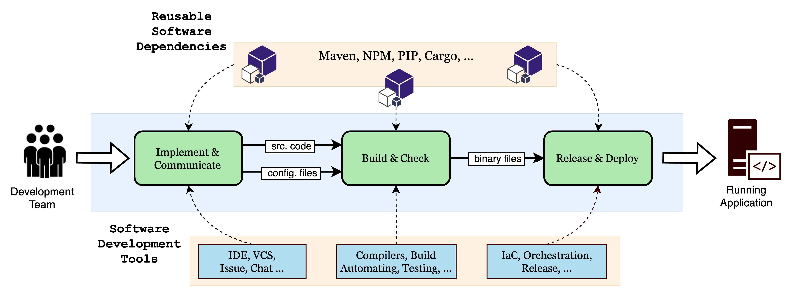
Software Development Lifecycle
Notes:
Software debloating is the process of automatically detecting and removing software bloat across the software development lifecycle.
The first challenge entails a thorough examination of the codebase and the software development lifecycle to pinpoint areas containing unnecessary or redundant code.
The second challenge involves surgically removing the bloated code through code-specific transformation techniques.
Finally, assessing the validity of the debloated artifact requires comprehensive testing and validation to ensure that the removal of bloated code has not introduced new errors or adversely impacted the application’s functionality, performance, or reliability.
By effectively executing these tasks, developers can create leaner, more efficient software, and ensure a better user experience.
13

Slide 14
Problem statements
The increase in the supply of software dependencies leads to dependency bloat in the Java ecosystem
Most of the code shipped with the used dependencies is unused by the dependent software projects
Debloating software libraries could affect the clients that depend on these libraries
14
Notes:
14

Slide 15
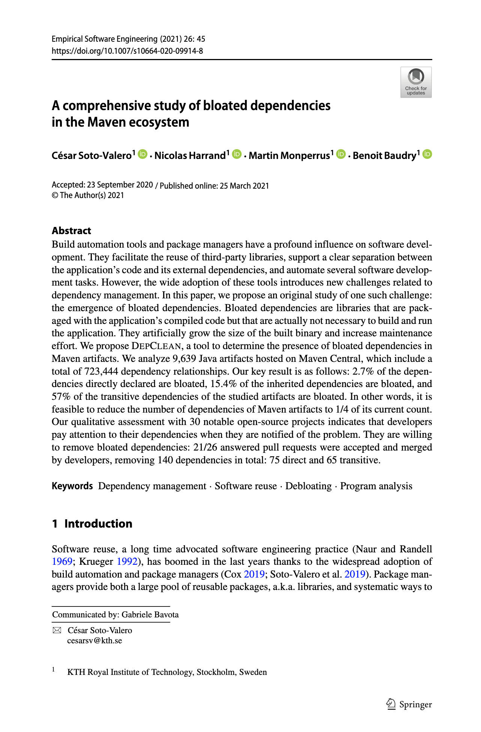
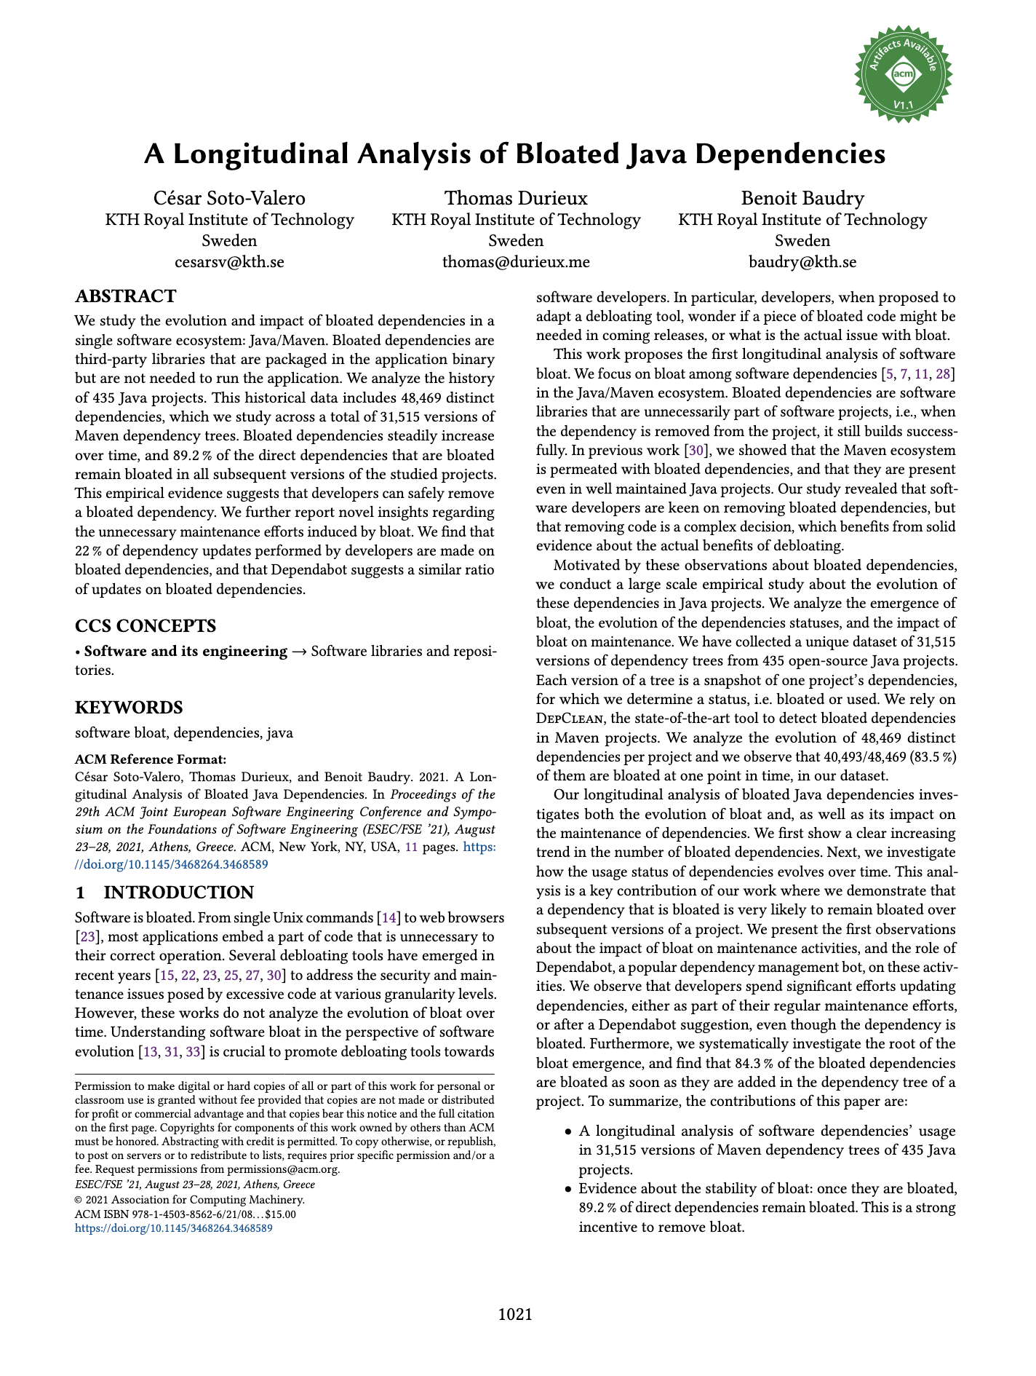
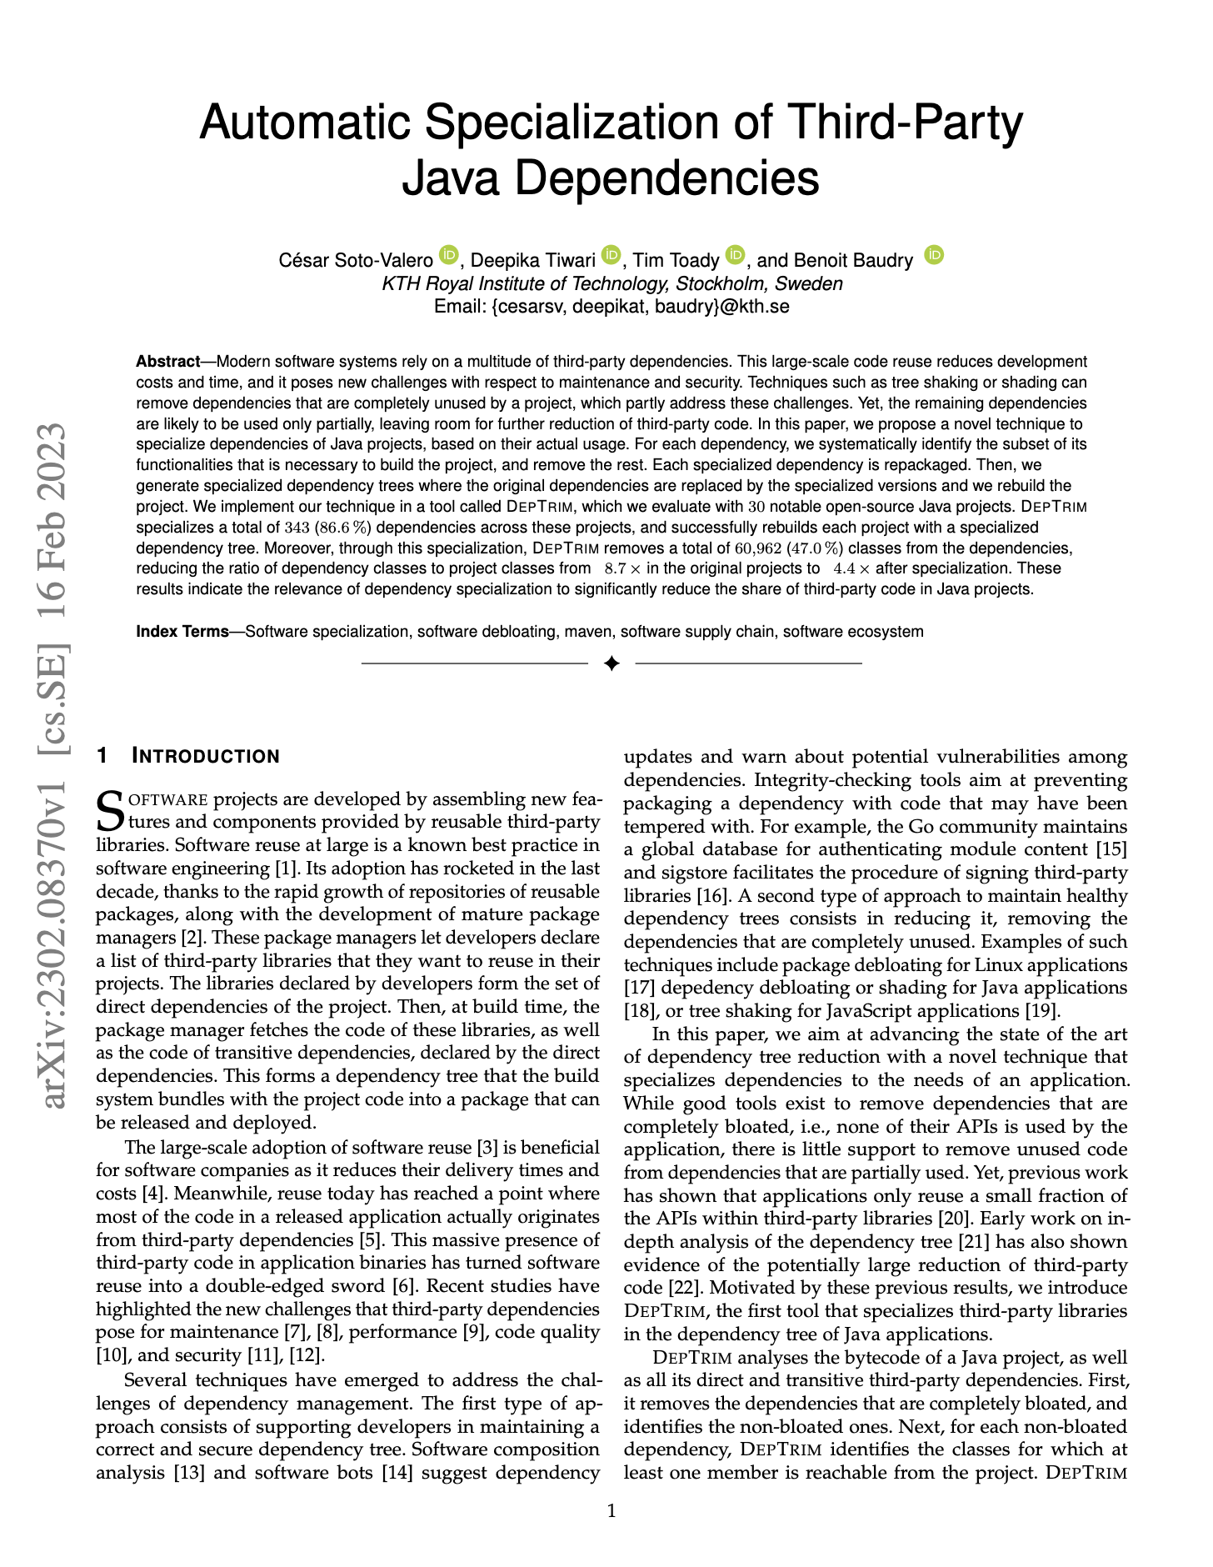
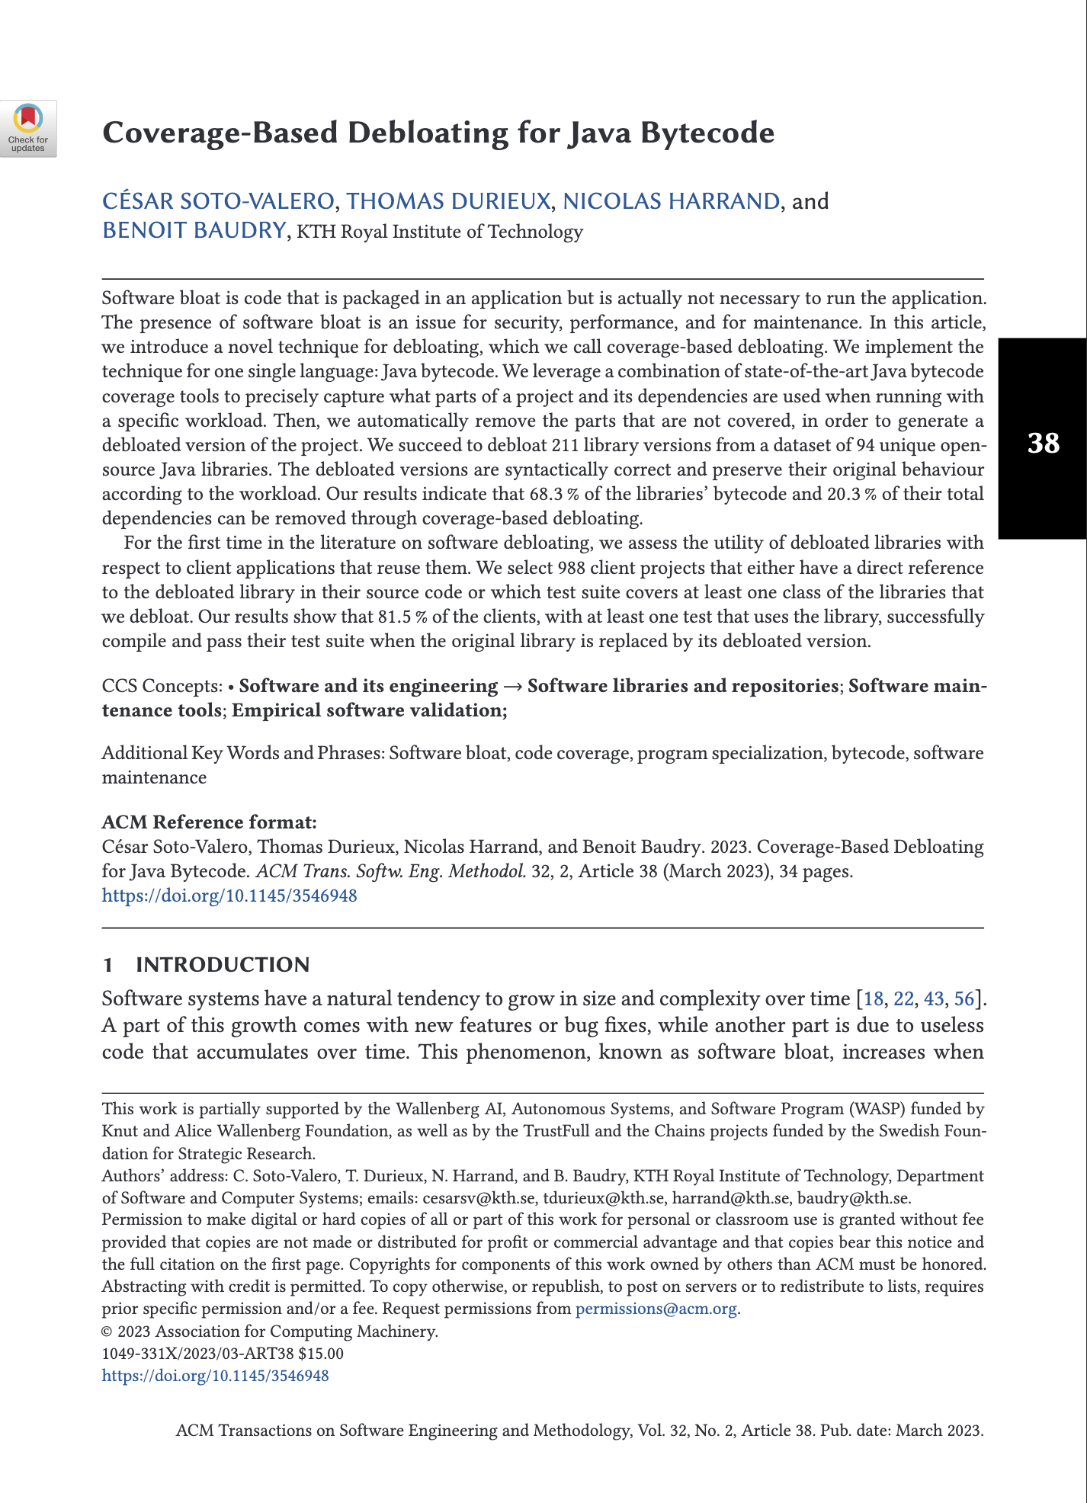
Technical Contributions
Removing bloated dependencies (2 papers)
A Comprehensive Study of Bloated Dependencies in the Maven Ecosystem
A Longitudinal Analysis of Bloated Java Dependencies
Specializing used dependencies (1 paper)
Automatic Specialization of Third-Party Java Dependencies
Debloating with respect to clients (1 paper)
Coverage-Based Debloating for Java Bytecode
15
Notes:
The essence of this thesis is on tackling the code bloat that arises as a result of the increasing complexity in software systems, in one software ecosystem in particular: The Java Maven ecosystem.
In particular, our contributions focus on the fact that current debloating techniques for Java lack the ability to detect and remove code bloat coming from third-party dependencies. To overcome the existing limitations, we propose novel debloating techniques that prioritize minimally invasive changes in the dependency tree of software projects, thereby making it easier for developers to adopt them. Unlike existing debloating methods that focus on producing leaner binaries and enhancing the precision of static and dynamic program analysis for debloating, our contributions are centered on a different aspect. We target the removal of code originating from the software supply chain of third-party libraries, which we have identified as a fundamental source of code bloat. This not only contributes to enhancing the maintainability of the applications, but also reduces the attack surface and improves the projects’ build performance. By leveraging the developers’ familiarity with build systems, we implement debloating techniques that can readily debloat Java applications at build time. the development of MAVEN-based debloating tools has not only demonstrated significant value in addressing this challenge, but also facilitated user adoption.
A debloating approach to help developers identify and remove bloated dependencies in Java projects that build with Maven
A technique that specializes individual dependencies to the specific needs of Java projects
A debloating technique to determine which classes in Java libraries and their dependencies are actually necessary for their clients
While static and dynamic code analysis have shown promising results in identifying unused features [64] and other types of bloat in Java applications, there is still a need to extend their applicability to third-party libraries.
In the context of this work, we investigate the use of debloating techniques to remove the software bloat resulting from the addition of third-party dependencies.
Tackling software bloat within third-party dependencies poses unique challenges, primarily due to the restricted influence that developers possess over the internals of these libraries [55], which complicates the process of identifying and removing unnecessary code without altering the libraries’ binaries.
15

Slide 16
Removing bloated dependencies
16
Notes:
Let’s say that we have a project P.
In the pom.xml we declare three dependencies, A, B, and C. These are direct dependencies of project P.
But the dependency A also has other dependencies, D and E, and dependency C has a depenency F. D, E, and F are called transitive dependencies of project P.
On the other hand, this project P declares the module Q as his parent, and Q declares a direct dependency G. So, in this context G becomes an inherited dependency of project P.
In summary, we can distinguish three types of dependencies in the dependency tree of P: direct dependencies, transitive dependencies, and inherited dependencies.
16

Slide 17
Source code
import com.google.common.base.Joiner; import org.apache.spark.annotation.Private; @Private public class EnumUtil { public static <E extends Enum<E>> E parseIgnoreCase(Class<E> clz, String str) { E[] constants = clz.getEnumConstants(); if (str == null) { return null; } for (E e : constants) { if (e.name().equalsIgnoreCase(str)) { return e; } } throw new IllegalArgumentException( String.format("Illegal type='%s'. Supported type values: %s", str, Joiner.on(", ").join(constants))); } }
17
core/src/main/java/org/apache/spark/util/EnumUtil.java
Notes:
17

Slide 18
Bytecode
// class version 52.0 (52)
// access flags 0x21
public class org/apache/spark/util/EnumUtil {
// compiled from: EnumUtil.java
// access flags 0x9
// signature <E:Ljava/lang/Enum<TE;>;>(Ljava/lang/Class<TE;>;Ljava/lang/String;)TE;
// declaration: E parseIgnoreCase<E extends java.lang.Enum<E>>(java.lang.Class<E>, java.lang.String)
public static parseIgnoreCase(Ljava/lang/Class;Ljava/lang/String;)Ljava/lang/Enum;
. . .
L9
LINENUMBER 35 L9
INVOKESTATIC com/google/common/base/Joiner.on (Ljava/lang/String;)Lcom/google/common/base/Joiner;
ALOAD 2
INVOKEVIRTUAL com/google/common/base/Joiner.join ([Ljava/lang/Object;)Ljava/lang/String;
AASTORE
. . .
18
target/classes/org/apache/spark/util/EnumUtil.class
Notes:
In Java, the compilation of the previous code produces the following bytecode.
18

Slide 19
Bytecode
. . .
// access flags 0x9
public static on(Ljava/lang/String;)Lcom/google/common/base/Joiner;
L0
LINENUMBER 71 L0
NEW com/google/common/base/Joiner
DUP
ALOAD 0
INVOKESPECIAL com/google/common/base/Joiner.<init> (Ljava/lang/String;)V
ARETURN
. . .
// access flags 0x11
// signature (Ljava/lang/Iterable<*>;)Ljava/lang/String;
// declaration: java.lang.String join(java.lang.Iterable<?>)
public final join(Ljava/lang/Iterable;)Ljava/lang/String;
L0
LINENUMBER 230 L0
ALOAD 0
ALOAD 1
INVOKEINTERFACE java/lang/Iterable.iterator ()Ljava/util/Iterator; (itf)
INVOKEVIRTUAL com/google/common/base/Joiner.join (Ljava/util/Iterator;)Ljava/lang/String;
ARETURN
. . .
19
Notes:
19

Slide 20
Project
931,207 LoC
50,709 methods
3,578 classes
https://github.com/apache/spark
20
Notes:
20

Slide 21
Project
529 dependencies
https://github.com/apache/spark
21
Notes:
21

Slide 22
Dependency tree
P
22
Notes:
Let’s say that we have a project P.
In the pom.xml we declare three dependencies, A, B, and C. These are direct dependencies of project P.
But the dependency A also has other dependencies, D and E, and dependency C has a depenency F. D, E, and F are called transitive dependencies of project P.
On the other hand, this project P declares the module Q as his parent, and Q declares a direct dependency G. So, in this context G becomes an inherited dependency of project P.
In summary, we can distinguish three types of dependencies in the dependency tree of P: direct dependencies, transitive dependencies, and inherited dependencies.
22

Slide 23
Dependency tree
pom.xml
P
<dependency> <groupId>org.A</groupId> <artifactId>A</artifactId> </dependency>
<dependency> <groupId>org.B</groupId> <artifactId>B</artifactId> </dependency>
<dependency> <groupId>org.C</groupId> <artifactId>C</artifactId> </dependency>
A
B
C
23
Notes:
Let’s say that we have a project P.
In the pom.xml we declare three dependencies, A, B, and C. These are direct dependencies of project P.
But the dependency A also has other dependencies, D and E, and dependency C has a depenency F. D, E, and F are called transitive dependencies of project P.
On the other hand, this project P declares the module Q as his parent, and Q declares a direct dependency G. So, in this context G becomes an inherited dependency of project P.
In summary, we can distinguish three types of dependencies in the dependency tree of P: direct dependencies, transitive dependencies, and inherited dependencies.
23

Slide 24
Dependency tree
P
A
B
C
D
E
F
24
Notes:
Let’s say that we have a project P.
In the pom.xml we declare three dependencies, A, B, and C. These are direct dependencies of project P.
But the dependency A also has other dependencies, D and E, and dependency C has a depenency F. D, E, and F are called transitive dependencies of project P.
On the other hand, this project P declares the module Q as his parent, and Q declares a direct dependency G. So, in this context G becomes an inherited dependency of project P.
In summary, we can distinguish three types of dependencies in the dependency tree of P: direct dependencies, transitive dependencies, and inherited dependencies.
24

Slide 25
Dependency tree
<parent> <groupId>org.Q</groupId> <artifactId>Q</artifactId> </parent>
pom.xml
Q
P
G
A
B
C
D
E
F
25
Notes:
Let’s say that we have a project P.
In the pom.xml we declare three dependencies, A, B, and C. These are direct dependencies of project P.
But the dependency A also has other dependencies, D and E, and dependency C has a depenency F. D, E, and F are called transitive dependencies of project P.
On the other hand, this project P declares the module Q as his parent, and Q declares a direct dependency G. So, in this context G becomes an inherited dependency of project P.
In summary, we can distinguish three types of dependencies in the dependency tree of P: direct dependencies, transitive dependencies, and inherited dependencies.
25

Slide 26
Dependency tree
pom.xml
Q
Inherited dependency
P
G
Direct dependencies
A
B
C
Transitive dependencies
D
E
F
26
Notes:
Let’s say that we have a project P.
In the pom.xml we declare three dependencies, A, B, and C. These are direct dependencies of project P.
But the dependency A also has other dependencies, D and E, and dependency C has a depenency F. D, E, and F are called transitive dependencies of project P.
On the other hand, this project P declares the module Q as his parent, and Q declares a direct dependency G. So, in this context G becomes an inherited dependency of project P.
In summary, we can distinguish three types of dependencies in the dependency tree of P: direct dependencies, transitive dependencies, and inherited dependencies.
26

Slide 27
Static bytecode analysis
Detect bloated dependencies
Q
P
G
A
B
C
D
E
F
27
Notes:
27

Slide 28
Debloating direct dependencies
Remove bloated dependencies
Q
P
G
A
B
C
- <dependency> - <groupId>org.B</groupId> - <artifactId>B</artifactId> - </dependency>
- <dependency> - <groupId>org.C</groupId> - <artifactId>C</artifactId> - </dependency>
D
E
F
28
Notes:
So, coming back to our example.
DepClean starts by looking at the part of the code in P that calls third-party dependencies.
In this example, there are two sets in P, one of them uses a subset of the dependency A, and the other uses a subset of the dependency F.
And, as we can see, the project P doesn’t use the direct dependencies B and C, so we can remove these dependencies from P.
- To do so, we just need to remove a couple of entries in the dependencies declaration of the pom file of P.
28

Slide 29
Debloating transitive dependencies
Remove bloated dependencies
Q
P
G
A
<dependency> <groupId>org.A</groupId> <artifactId>A</artifactId>
+ <exclusions> + <exclusion> + <groupId>org.E</groupId> + <artifactId>E</artifactId> + </exclusion> + </exclusions> </dependency>
D
E
F
29
Notes:
Now, we can see that the part of A that is used by P, calls some instructions of the dependency D.
But it doesn’t call any API member of E.
So, in the context of the project P, which is the one that we are analyzing, the transitive dependency D is used, while the transitive dependency E is bloated.
Notice that maybe A uses E. However, in the context of the project P, E is not used because it doesn’t exist any bytecode call to E in the part of A that is used by P.
- This way, E can be safely excluded from A in the pom, which means that it will no longer be part of the dependency tree of P
29

Slide 30
Debloating inherited dependencies
Remove bloated dependencies
Q
P
G
A
- <parent> - <groupId>org.Q</groupId> - <artifactId>Q</artifactId> - </parent>
D
F
30
Notes:
Now, we can see that the part of A that is used by P, calls some instructions of the dependency D.
But it doesn’t call any API member of E.
So, in the context of the project P, which is the one that we are analyzing, the transitive dependency D is used, while the transitive dependency E is bloated.
Notice that maybe A uses E. However, in the context of the project P, E is not used because it doesn’t exist any bytecode call to E in the part of A that is used by P.
- This way, E can be safely excluded from A in the pom, which means that it will no longer be part of the dependency tree of P
30

Slide 31
Debloating inherited dependencies
Remove bloated dependencies
P
A
D
F
31
Notes:
Now, we can see that the part of A that is used by P, calls some instructions of the dependency D.
But it doesn’t call any API member of E.
So, in the context of the project P, which is the one that we are analyzing, the transitive dependency D is used, while the transitive dependency E is bloated.
Notice that maybe A uses E. However, in the context of the project P, E is not used because it doesn’t exist any bytecode call to E in the part of A that is used by P.
- This way, E can be safely excluded from A in the pom, which means that it will no longer be part of the dependency tree of P
31

Slide 32
Debloated dependency tree
P
A
F
D
32
Notes:
And the debloat result of using DepClean is an smaller dependency tree
32

Slide 33
Challenges
Detecting the bloat
Removing the bloat
Assessing the behavior of the debloated artifact
Notes:
Static bytecode analysis across the whole dependency tree (thousands of lines of code)
Modifying the configuration file, such that when we build with the new configuration file, then the project builds
33

Slide 34
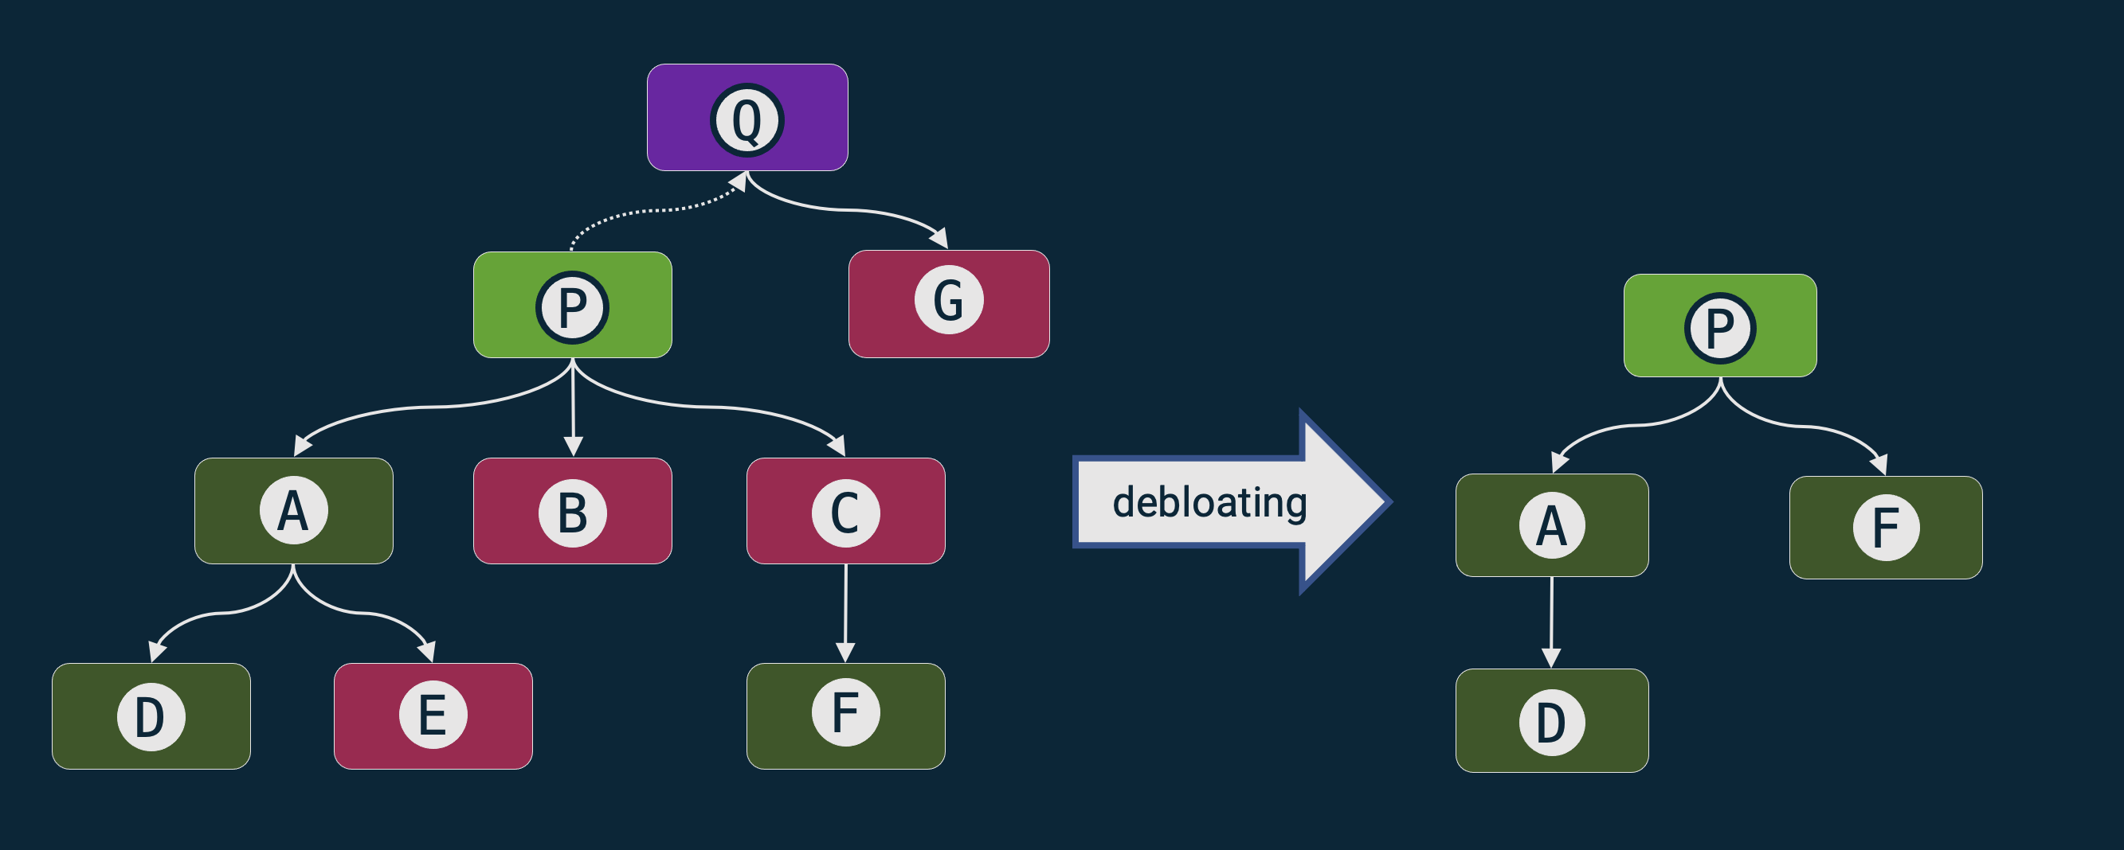
DepClean
Detect and report bloated dependencies
in the context of an artifact
on the whole dependency tree
Automatic generation of a debloated pom.xml file
Open source (https://github.com/castor-software/depclean)
34
Notes:
To do so, we developed DepClean.
- It detects and reports bloated dependencies to developers.
- DepClean works in the context of a Maven artifact, so, given an artifact, it analyzes its whole dependency tree and produces a report with information about the usage status of each dependency. These are two unique features of DepClean. There is a Maven plugin called the maven-dependency-analyzer that provides a report about the status of usage status of dependencies, but it doesn’t analyze transitive dependencies in the context of our project and doesn’t distinguish between transitive and inherited dependencies.
-Another important feature of DepClean is that it produces an alternative pom.xml file with all the bloated dependencies removed. So, developers can use this pom file directly in their projects.
-And DepClean is open source and publicly available on GitHub.
34

Slide 35
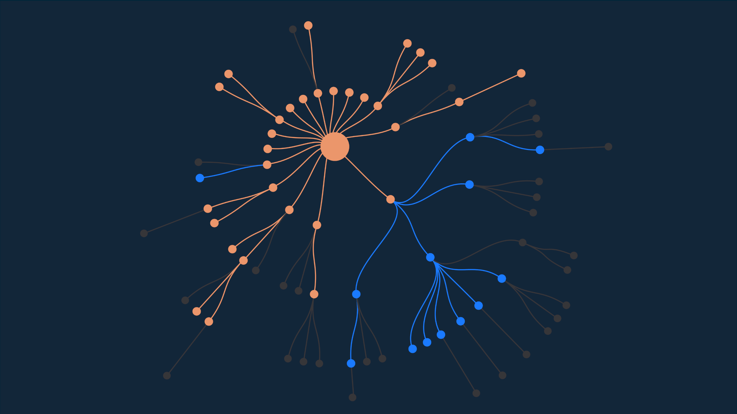
Example: debloated Spoon library
debloating
 | JAR Size | #Classes
Before | 16.2 Mb | 7 425
After | 12.7 Mb | 5 593
Reduction | 28% | 25%
DepClean removes
13 bloated dependencies
https://github.com/INRIA/spoon/pull/3167
35
Notes:
So basically, we can use DepClean to transform this dependency tree.
We debloat it, remove all the unused dependencies, and obtain a much smaller version of it. And it is important to say that process doesn’t affect the build of Spoon. It will compile, the tests will be executed, and all the rest of the Maven phases will work as normal.
-Which is more important, the removal of these bloated dependencies has a very positive impact on the size and the number of classes of the library. The jar-with-dependencies of the Spoon is reduced, from 16.2MB to 12.7MB, which represents a significant reduction in size on disk of 27.6%, and a 24.7% of reduction in the number of classes.
This is the impact of using DepClean on Spoon, but, what about the whole Maven ecosystem?
35

Slide 36
RQ: How much dependency bloat
exists out there?
36
Notes:
Having DepClean in our toolset, one question arises immediately.
How much dependency bloat exists out there, in the wild? In the whole Maven ecosystem.
36

Slide 37
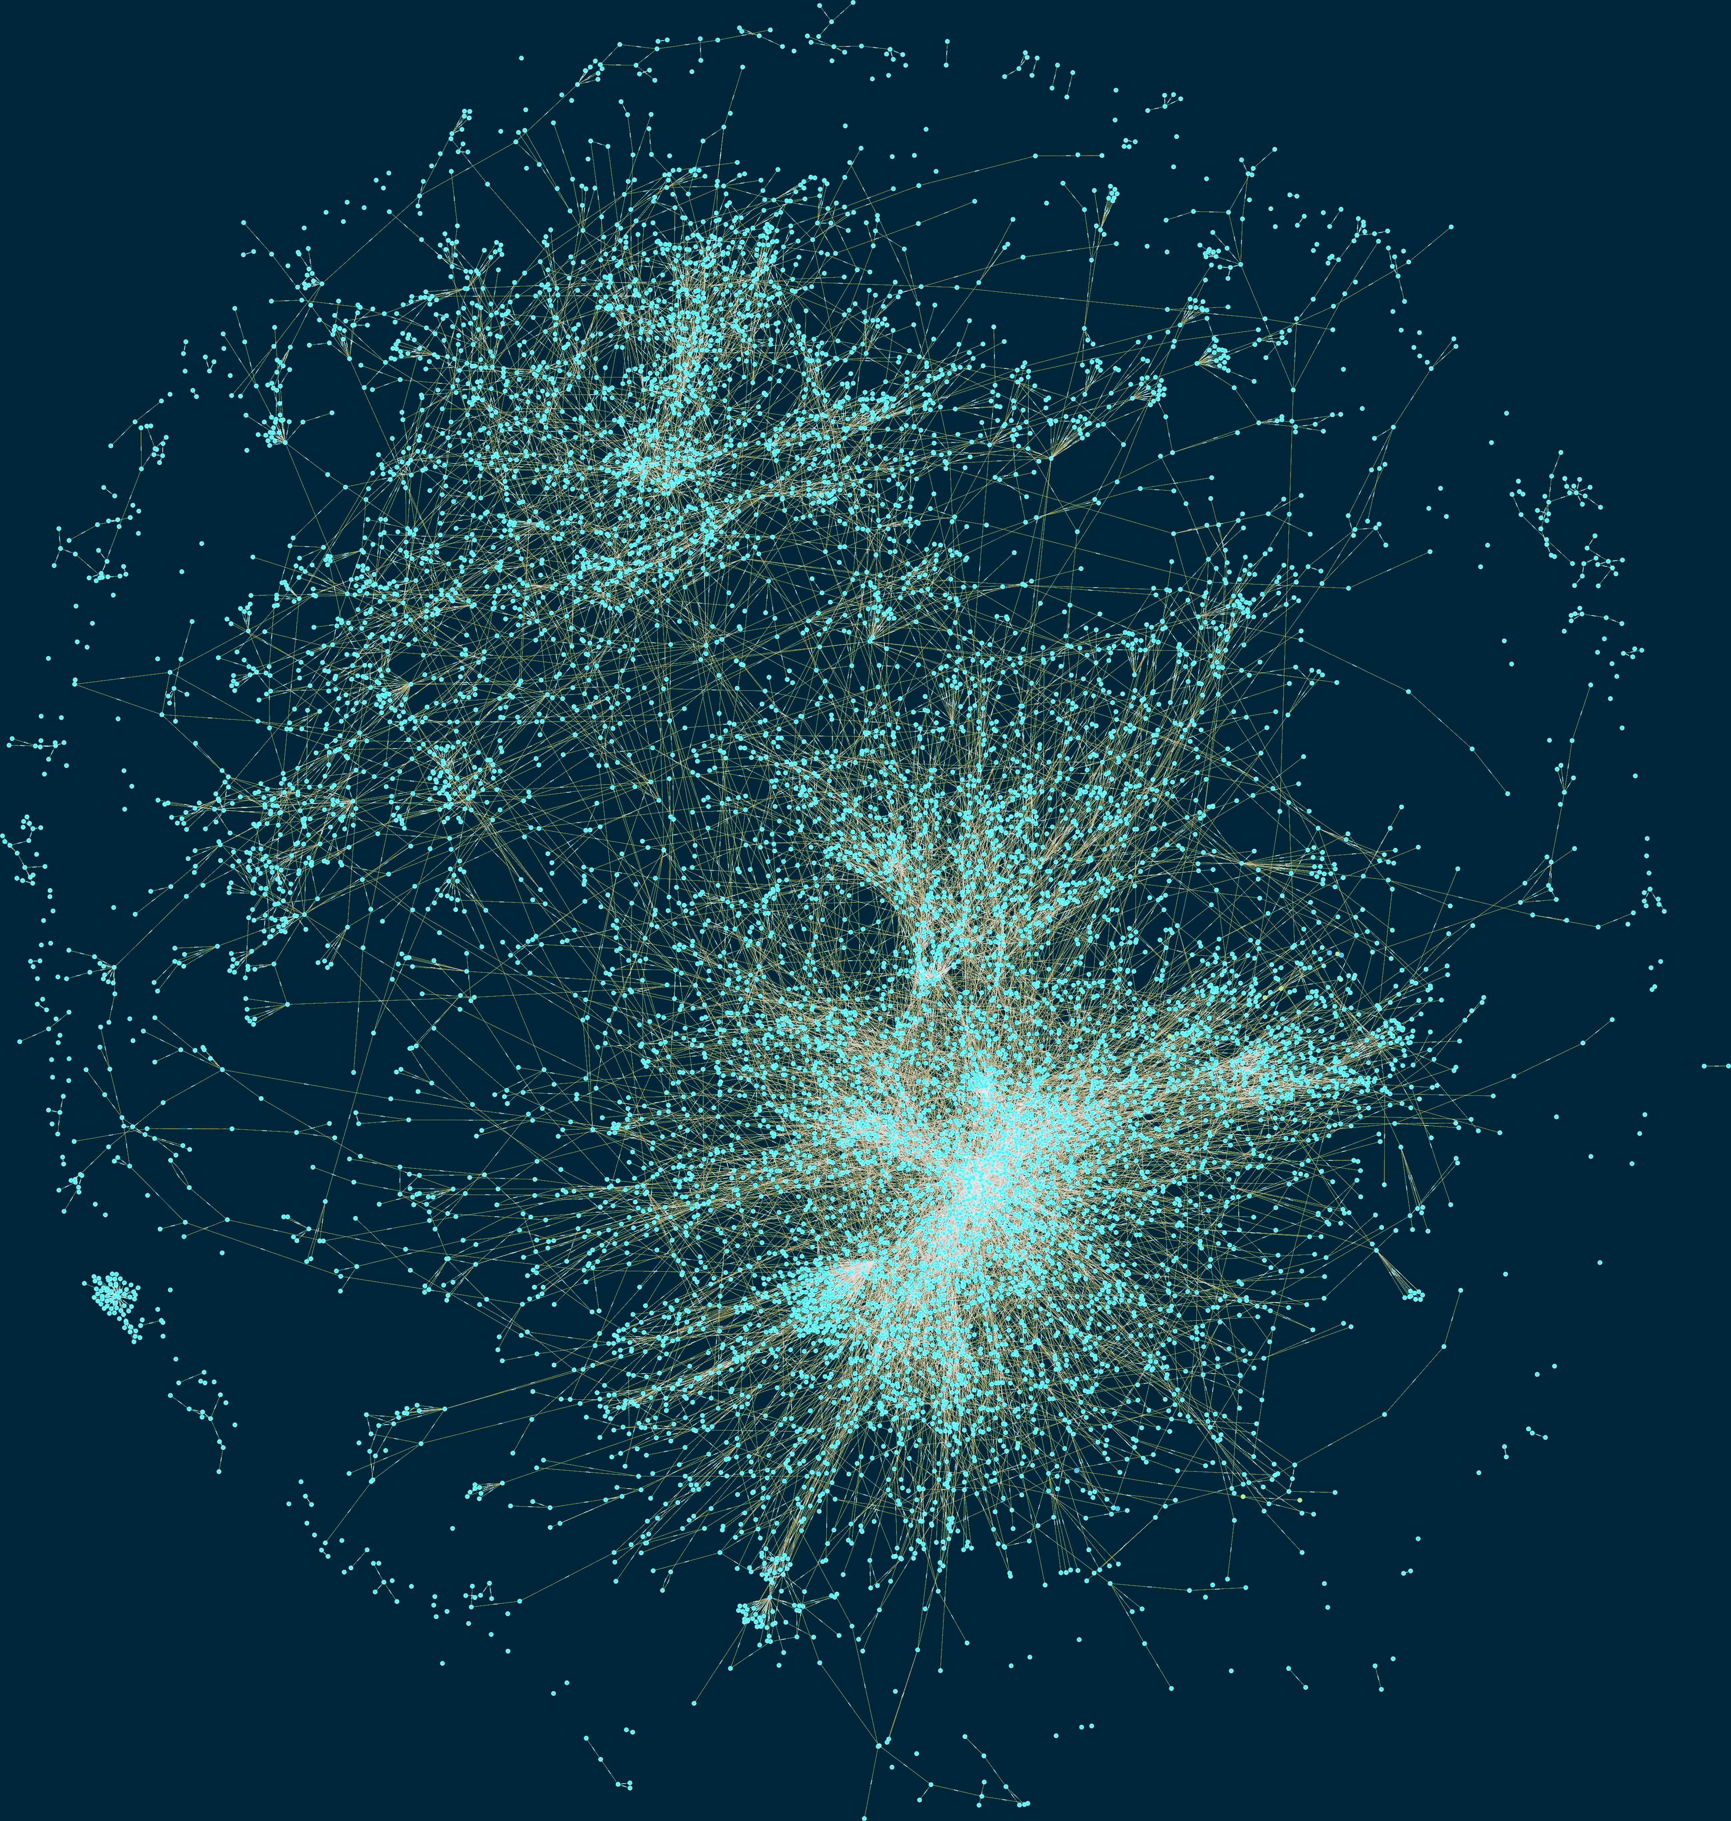
Empirical study (data collection)
9K artifacts
Diverse
Reused
Complex
723K dependency relationships
45K direct (6%)
180K inherited (25%)
498K transitive (69%)
3.6M artifacts in 2019.
37
Notes:
Based on this graph we selected a set of 9 thousand Maven artifacts as study subjects.
This selection took into account several criteria, such as:
Diversity: They belong to different maven projects
Reused: The subjects are used by at least one artifact through a direct dependency declaration
Comple: They contain class files, and have at least one direct dependency with compile scope
The selected 9 thousand Maven artifacts contain a total of 723 dependency relationships,
Of which 6% are direct
25% are inherited
And 69% are transitive
37

Slide 38
Result
9K artifacts and 723K dependencies
2.7% of direct dependencies are bloated
15% of inherited dependencies are bloated
57% of transitive dependencies are bloated
38
Notes:
This bar chart summarizes the results obtained.
Each bar represents the percentage of dependencies of each type (direct, inherited, and transitive) that are bloated, in blue, or used, in orange.
-The key results, from this figure, is that 2.7% of direct dependencies are bloated. This is surprising because those are dependencies explicitly declared in the pom of the Maven project, that are not necessary to build the project.
-15.1% of the inherited dependencies are bloated. This means that there is a lot of dependency bloat that is caused by the Maven inheritance mechanism, in which basically all the dependencies of a parent module are inherited by its children.
-On the other hand, 57% of the transitive dependencies are bloated. These are dependencies that are induced by direct dependencies, as a result of the Maven dependency resolution mechanism, but, they are not necessary, and therefore it is bloat
38

Slide 39
Takeway
Dependency bloat is a pervasive phenomenon affecting 75% of dependency relationships
39
Notes:
Do developers care about it?
39

Slide 40
RQ: Do developers care about bloated dependencies?
40
Notes:
Do developers care about it?
40

Slide 41
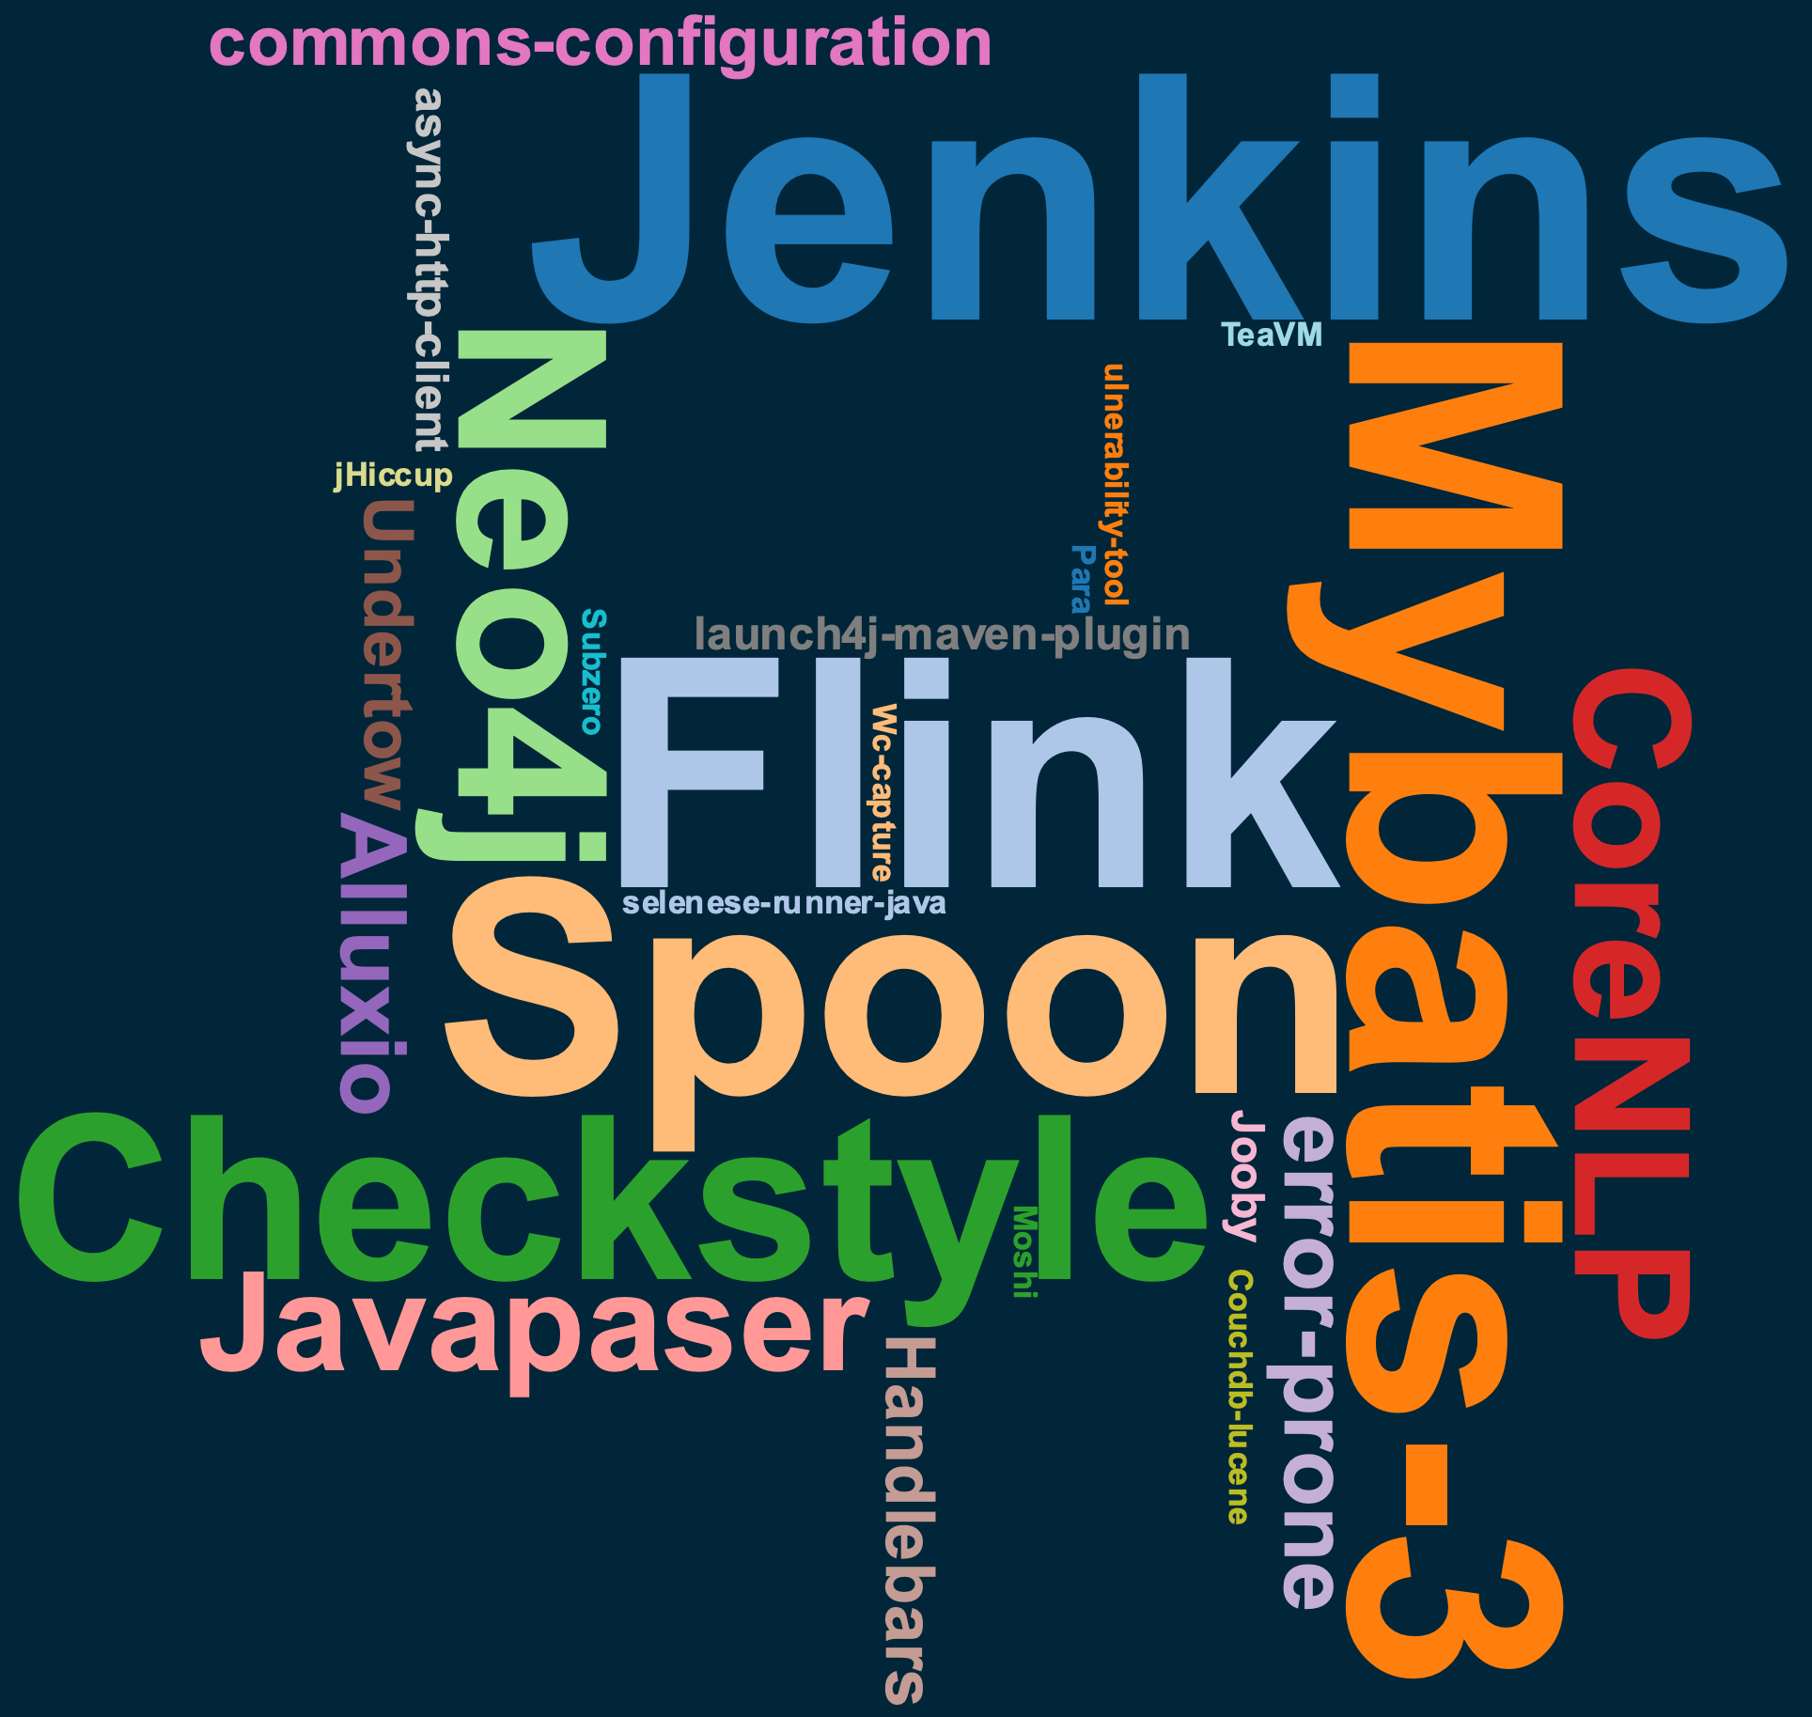
User study
30 software projects
Open source
Active
Popular
Build succesfuly with Maven
Contain dependencies
41
Notes:
To answer this question, we performed a user study.
-We selected 30 projects and used DepClean to detect bloated dependencies.
-For the selection of these projects, we follow several criteria, such as
-They must be open source
-Active on GitHub
-Popular, with at least 100 starts
-They build with Maven and contain dependencies
-This word cloud shows the selected projects. Most of them are well known by the Java community, such as Jenkins, Flink, Neo4j, Checkstyle
41

Slide 42
Result
30 pull requests in 30 notable open-source projects
Removed 140 bloated dependencies in 21 projects thanks to DepClean
42
Notes:
In total, 140 dependencies were removed in 21 projects.
This result indicates that removing bloated dependencies is important for developers.
They are ready to take action, and also that if we submit more pull request proposing the removal of bloated dependencies, they are likely to be accepted by developers.
42

Slide 43
Takeway
Developers are willing to remove bloated dependencies from their projects
43
Notes:
Do developers care about it?
43

Slide 44
RQ: Why consider debloating?
44
Notes:
Do developers care about it?
44

Slide 45
Developers’ comments
jenkins-core
“Past experiences removing unused dependencies have consistently shown that some code will have depended on that inclusion and will be broken by it.”
https://github.com/jenkinsci/jenkins/pull/4378
45
Notes:
With respect to the bloated dependencies in jenkins-core. Developers were reluctant to remove them:
They said that past experiences removing unused dependencies have broken some clients.
They agree that these dependencies are not used, but they don’t want to remove them for compatibility reasons.
What we can learn from this case is that bloated dependencies should be removed as soon as they appear. Because otherwise some clients may depend on them and it will be more difficult to take action without breaking the clients
45

Slide 46
Longitudinal study
435 projects
31515 dependency tree versions
Q: Do bloated dependencies stay bloated across time?
Q: Do developers maintain dependencies that are bloated?
46
Notes:
Let’s a example of a project that we analyze.
DepClean found bloated dependencies in the core module of Jenkins
One bloated direct, and two transitive
It also found a direct dependency bloated in the cli module of Jenkins
So, we submitted a pull request proposing the removal of these dependendencies.
46

Slide 47
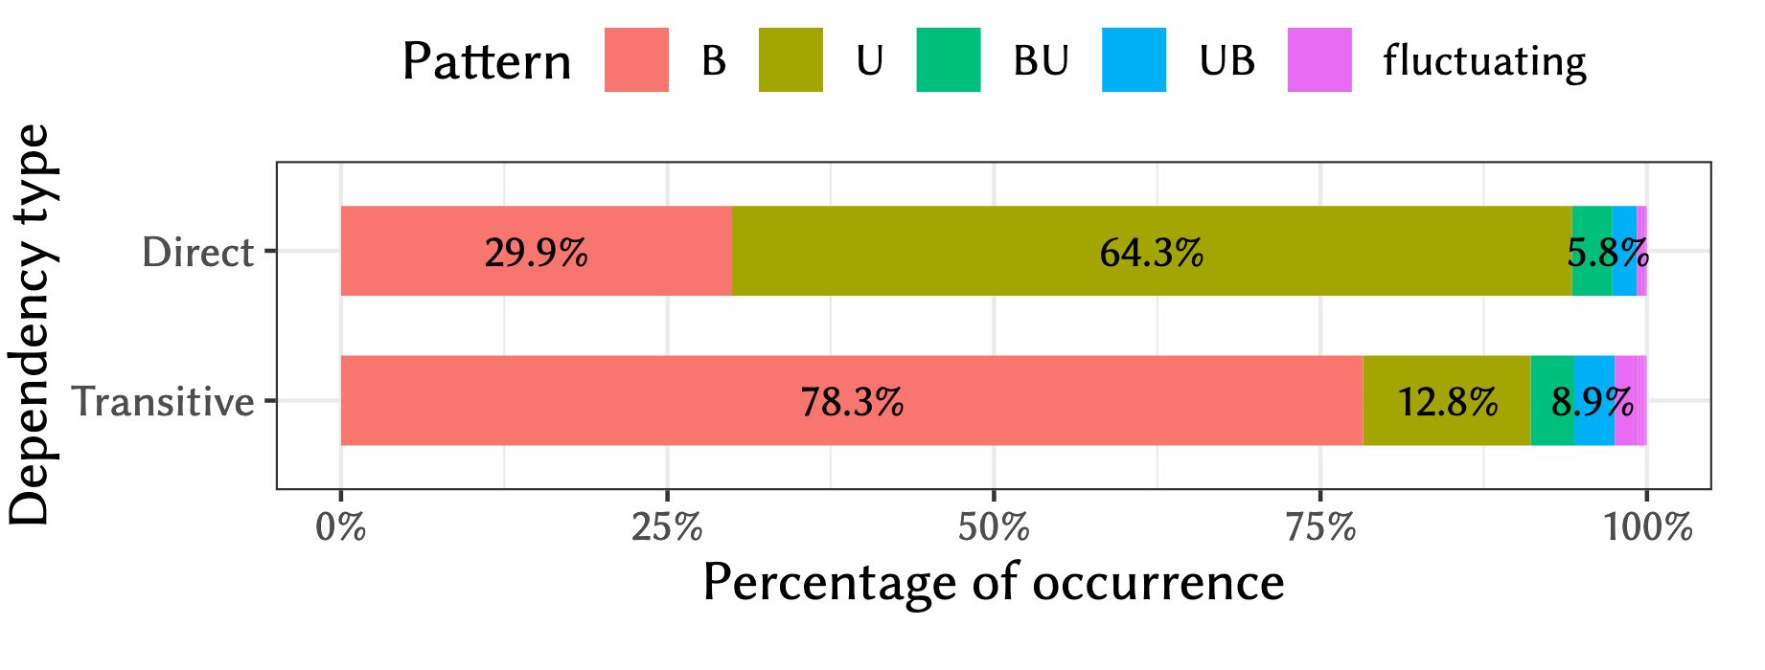
Result
Q: Do bloated dependencies stay bloated across time?
47
Notes:
We compute the percentage of occurrence of each pattern with respect to the total.
We found that 64.3% of the direct dependencies are always used in the projects, whereas 29.9% of them are always bloated.
This means that most direct dependencies never change their status through the evolution of the software projects.
On the other hand, 78.3% of the transitive dependencies are bloated from the start, whereas 12.8% are always used.
This means that transitive dependencies also do not change their usage status over time.
47

Slide 48
Result
89% of bloated direct, and 93% of the transitive bloated dependencies remain bloated in all subsequent versions of the studied projects
48
Notes:
89.2 % of bloated direct, and 93.3 % of the transitive bloated dependencies remain bloated in all subsequent versions of the studied projects.
This empirical evidence suggests that developers can safely take a debloating action when detecting bloated dependencies.
48

Slide 49
Takeway
Bloated dependencies remain
bloated over time
49
Notes:
Do developers care about it?
49

Slide 50
Longitudinal study
Q: Do developers maintain dependencies that are bloated?
50
Notes:
To answer our third research question, we investigate whether or not developers maintain dependencies that are bloated.
We filter all the commits in our dataset that constitute dependency updates.
The figure shows an example of one of such commits.
In this case, a developer manually updates the dependency of Apache commons-io from version 2.6 to version 2.7.
50

Slide 51
Result
Q: Do developers maintain dependencies that are bloated?
51
Notes:
This plot presents the number of dependency updates on used and bloated dependencies made by developers.
As we can see, developers invest 22% of their dependency update efforts on bloated dependencies.
51

Slide 52
Takeway
Developers maintain dependencies that are bloated
52
Notes:
Do developers care about it?
52

Slide 53
Conclusion
53
Notes:
Let’s say that we have a project P.
In the pom.xml we declare three dependencies, A, B, and C. These are direct dependencies of project P.
But the dependency A also has other dependencies, D and E, and dependency C has a depenency F. D, E, and F are called transitive dependencies of project P.
On the other hand, this project P declares the module Q as his parent, and Q declares a direct dependency G. So, in this context G becomes an inherited dependency of project P.
In summary, we can distinguish three types of dependencies in the dependency tree of P: direct dependencies, transitive dependencies, and inherited dependencies.
53

Slide 54
Conclusion
Maven dependencies are bloated as a consequence of
the chain of transitive dependencies
the heritage mechanism of multi-module projects
the limited engineering of configuration files (pom.xml)
Software developers care about bloated dependencies
Debloating dependencies is recommended because empirical evidence suggests that bloated dependencies remain bloated over time
54
Notes:
Let’s a example of a project that we analyze.
DepClean found bloated dependencies in the core module of Jenkins
One bloated direct, and two transitive
It also found a direct dependency bloated in the cli module of Jenkins
So, we submitted a pull request proposing the removal of these dependendencies.
54

Slide 55
Lessons learned
Debloating Java dependencies is a relevant problem
Automatically debloating a large number of real-world applications presents a greater challenge than debloating a few hand-picked projects
Guaranteeing the safety of the debloating procedure is difficult for dynamic languages
55
Notes:
Let’s a example of a project that we analyze.
DepClean found bloated dependencies in the core module of Jenkins
One bloated direct, and two transitive
It also found a direct dependency bloated in the cli module of Jenkins
So, we submitted a pull request proposing the removal of these dependendencies.
55

Slide 56
Other contributions
Blog (cesarsotovalero.net/blog)
Living review on software debloating
Service (cesarsotovalero.net/service)
Thesis supervision, teaching, and reviewer
Dissemination & societal impact (cesarsotovalero.net/talks)
WASP network
Events & talks
Academic collaborations
Outreach to developers
cesarsv@kth.se
Notes:
Let’s a example of a project that we analyze.
DepClean found bloated dependencies in the core module of Jenkins
One bloated direct, and two transitive
It also found a direct dependency bloated in the cli module of Jenkins
So, we submitted a pull request proposing the removal of these dependendencies.
56

Slide 57
Future work
57
Notes:
Let’s say that we have a project P.
In the pom.xml we declare three dependencies, A, B, and C. These are direct dependencies of project P.
But the dependency A also has other dependencies, D and E, and dependency C has a depenency F. D, E, and F are called transitive dependencies of project P.
On the other hand, this project P declares the module Q as his parent, and Q declares a direct dependency G. So, in this context G becomes an inherited dependency of project P.
In summary, we can distinguish three types of dependencies in the dependency tree of P: direct dependencies, transitive dependencies, and inherited dependencies.
57

Slide 58
Future work
To use debloating to specialize and diversify the software supply chain of third-party dependencies
Variants
P
D₁
Original
P
debloating
P
D
D₂
P
D₃
58
Notes:
58

Slide 59
Publications
A Comprehensive Study of Bloated Dependencies in the Maven Ecosystem. EMSE, 2021.
César Soto-Valero, Nicolas Harrand, Martin Monperrus, and Benoit Baudry
A Longitudinal Analysis of Bloated Java Dependencies. ESEC/FSE, 2021.
César Soto-Valero, Thomas Durieux, and Benoit Baudry
Coverage-Based Debloating for Java Bytecode. TOSEM, 2022.
César Soto-Valero, Thomas Durieux, Nicolas Harrand, and Benoit Baudry
The Emergence of Software Diversity in Maven Central. MSR, 2019.
César Soto-Valero, Amine Benelallam, Nicolas Harrand, Olivier Barais, and Benoit Baudry
The Multibillion Dollar Software Supply Chain of Ethereum. IEEE Computer, 2022.
César Soto-Valero, Martin Monperrus, and Benoit Baudry
Automatic Specialization of Third-Party Java Dependencies. TSE (under major revision), 2023.
César Soto-Valero, Deepika Tiwari, Tim Toady, and Benoit Baudry
cesarsv@kth.se
Notes:
Let’s a example of a project that we analyze.
DepClean found bloated dependencies in the core module of Jenkins
One bloated direct, and two transitive
It also found a direct dependency bloated in the cli module of Jenkins
So, we submitted a pull request proposing the removal of these dependendencies.
59

Slide 60
Longitudinal study
Q: Do developers maintain dependencies that are bloated?
60
Notes:
During our analysis, we notice that many of the dependency updates were performed by Dependabot.
This is a software bot very active on GitHub that alerts developers about security issues related to their dependencies.
60

Slide 61
Result
Q: Do developers maintain dependencies that are bloated?
61
Notes:
On the other hand, we observe that Dependabot suggests a similar ratio of updates on bloated dependencies.
This result indicates that Dependabot should improve the suggestions that it makes to developers to detect bloated dependencies and reduce the maintenance effort induced by software bloat.
61

Slide 62
Example
jenkins-core
org.jvnet.hudson:jtidy (direct)
org.jenkins-ci:constant-pool-scanner (transitive)
net.i2p.crypto:eddsa (transitive)
jenkins-cli
commons-codec (direct)
62
Notes:
Let’s a example of a project that we analyze.
DepClean found bloated dependencies in the core module of Jenkins
One bloated direct, and two transitive
It also found a direct dependency bloated in the cli module of Jenkins
So, we submitted a pull request proposing the removal of these dependendencies.
62

Slide 63
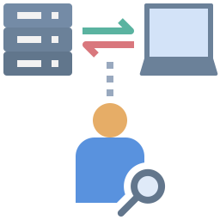
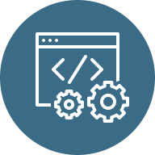
Future work
Debloating applications with respect to usage profiles collected in production environments
Variants
D1
P₁
P₂
D2
P₃
D3
63
Notes:
Let’s a example of a project that we analyze.
DepClean found bloated dependencies in the core module of Jenkins
One bloated direct, and two transitive
It also found a direct dependency bloated in the cli module of Jenkins
So, we submitted a pull request proposing the removal of these dependendencies.
63

Slide 64
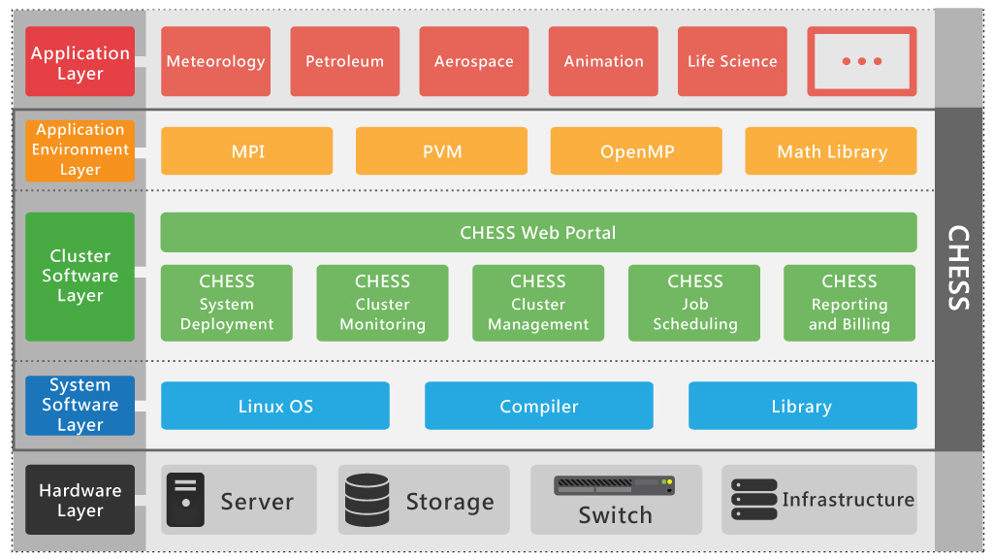
Future work
Extending the debloating techniques to cover other layers of the software stack
Specialized App.
Debloated Env.
Debloated Infrastructure
Slim OS
Dedicated Hardware
debloating
64
Notes:
Let’s a example of a project that we analyze.
DepClean found bloated dependencies in the core module of Jenkins
One bloated direct, and two transitive
It also found a direct dependency bloated in the cli module of Jenkins
So, we submitted a pull request proposing the removal of these dependendencies.
64

Slide 65
Objective
Q
P
G
P
debloating
A
B
C
A
F
D
E
F
D
DepClean reduces the size of the dependency tree by debloating unused dependencies, automatically.
65
Notes:
To sum up, the main objective of DepClean is, for a given Maven project P, to debloat its dependency tree and produce a version of it without bloated dependencies.
65

Slide 66
The Maven ecosystem is big!
We counted 3.6M artifacts in 2019.
66
“The Maven Dependency Graph: a Temporal Graph-based Representation of Maven Central” (published in MSR’19)
Notes:
Well, one thing that we know is that it is big.
Two years ago, we performed an study with the objective of constructing the most precise representation of the dependency relationships between the artifacts in Maven Central.
What you see is part of the Maven Dependency Graph that we built.
- It contained 3.6 million artifacts in 2019.
66

Slide 67
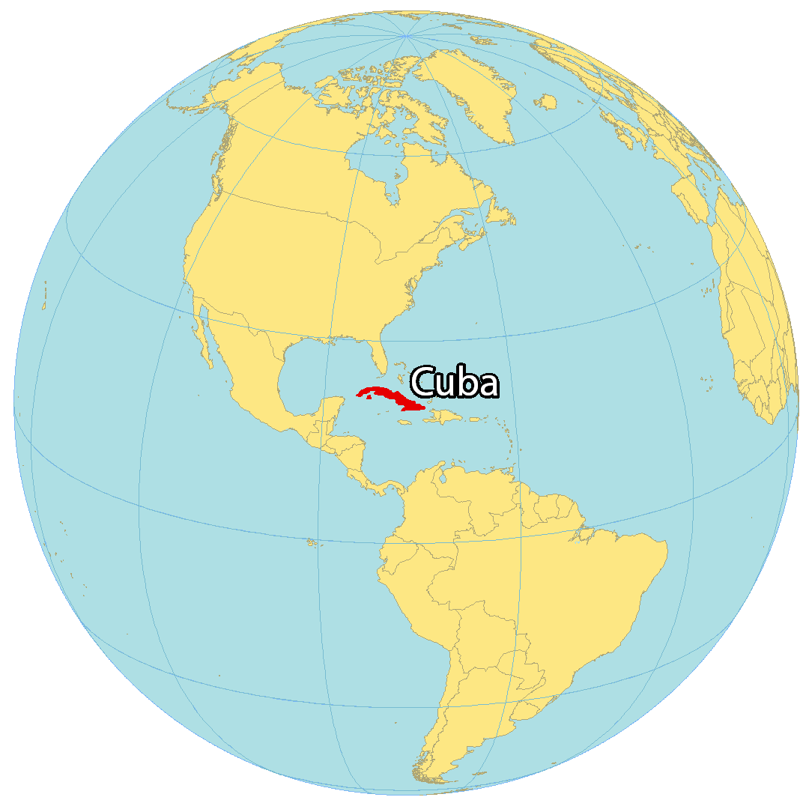
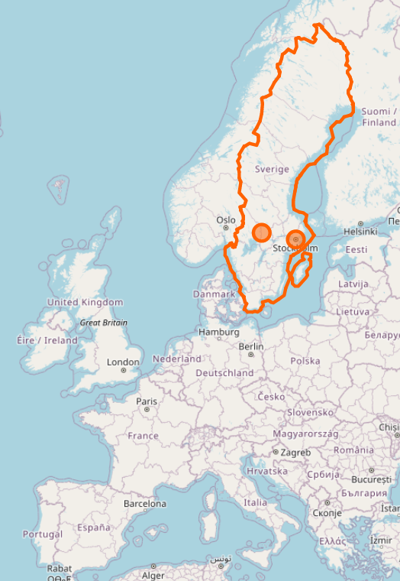
$ whoami
Moved from Cuba to Sweden with:
BSc and MSc in Computer Science
PhD student at KTH since 2018 working on:
Automatic software debloating
Software dependencies
Software diversity
Enthusiastic techy guy ;)
https://www.cesarsotovalero.net

Slide 68
Part #3: Debloating Java bytecode
68
Notes:
68

Slide 69
Source code
import com.google.common.base.Joiner; import org.apache.spark.annotation.Private; @Private public class EnumUtil { public static <E extends Enum<E>> E parseIgnoreCase(Class<E> clz, String str) { E[] constants = clz.getEnumConstants(); if (str == null) { return null; } for (E e : constants) { if (e.name().equalsIgnoreCase(str)) { return e; } } throw new IllegalArgumentException( String.format("Illegal type='%s'. Supported type values: %s", str, Joiner.on(", ").join(constants))); } }
69
core/src/main/java/org/apache/spark/util/EnumUtil.java
Notes:
69

Slide 70
Bytecode
// class version 52.0 (52)
// access flags 0x21
public class org/apache/spark/util/EnumUtil {
// compiled from: EnumUtil.java
// access flags 0x9
// signature <E:Ljava/lang/Enum<TE;>;>(Ljava/lang/Class<TE;>;Ljava/lang/String;)TE;
// declaration: E parseIgnoreCase<E extends java.lang.Enum<E>>(java.lang.Class<E>, java.lang.String)
public static parseIgnoreCase(Ljava/lang/Class;Ljava/lang/String;)Ljava/lang/Enum;
. . .
L9
LINENUMBER 35 L9
INVOKESTATIC com/google/common/base/Joiner.on (Ljava/lang/String;)Lcom/google/common/base/Joiner;
ALOAD 2
INVOKEVIRTUAL com/google/common/base/Joiner.join ([Ljava/lang/Object;)Ljava/lang/String;
AASTORE
. . .
70
target/classes/org/apache/spark/util/EnumUtil.class
Notes:
70

Slide 71
Dynamic analysis
P
A
D
F
Notes:
What you are seeing now is what we can get so far if we use state-of-the-art software debloating techniques that rely on static analysis.

Slide 72
Dynamic analysis
Input
P
A
D
F
Notes:
Now let’s suppose that there is an input that executes the path that goes from P to A, and D.

Slide 73
Dynamic analysis
Input
P
A
D
F
Notes:
This makes part of the other components in P, as well as F unnecessary to satisfy the input.

Slide 74
Dynamic analysis
Input
P
A
D
74
Notes:
So we can remove them.

Slide 75
Dynamic analysis
Input
P
A
D
75
Notes:
So we can remove them.

Slide 76
Dynamic analysis
Input
76
Notes:
And this is what we obtain when using software debloating techniques that rely on dynamic analysis.

Slide 77
Dynamic analysis
77
Notes:
And we collect the used components.

Slide 78
Dynamic analysis
78
Notes:
Package them.

Slide 79
Dynamic analysis
Input
P’
79
Notes:
And then build a single artifact P’ that only contains the necessary parts to successfully execute the application for the given input.

Slide 80
JDBL
P
P’
Relies on code-coverage tools to collect bytecode usage information at runtime
Automatically removes unused methods, classes, and dependencies in Java projects
Open source (https://github.com/castor-software/jdbl)
Notes:
Well, in this work, we have built such a tool that automatically transforms a project P into a debloated version that only contains the parts of P that are necessary to execute certain workload.
Our tool is called JDBL and it relies on existing code-coverage tools to collect bytecode usage information at runtime.
JDBL is capable of removing methods, classes, and dependencies in Java projects that build with Maven.

Slide 81
Debloating with JDBL
Input
Output
Project
1
2
3
JAR
Collect
Remove
Validate
Workload
JDBL
81
Notes:
In essence, JDBL works in three phases.
It receives as input a Java project and a workload that executes some part of the project.
In the first phase, JDBL uses code coverage tools to collect bytecode usage information.
Then, in the second phase, JDBL removes the unnecesary bytecode from the project and its dependencies
Finally, in the third phase, JDBL validates the debloating by executing the project against the same workload.
If the result is as expected, then the project is packaged as a debloated JAR file.

Slide 82
Experiment (debloating libraries)
P = Original library
P’ = Debloated library
P
Build
success?
P’
JAR
exists?
P’
Test suite
pass?
The project build fails
JDBL does not produces a debloated JAR
Debloated artifact does not preserves the behaviour
https://github.com/castor-software/jdbl-experiments
500 single-module Java Maven projects
Commits on the POM files
Notes:
We performed experiments to evaluate JDBL.
For our first experiment, consider a popular Java library P that builds successfully.
Then we debloat P and obtain P’.
We check if JDBL produces a debloated JAR.
If that’s the case, then we check if the JAR preserves the original behaviour using the test suite.
If all the tests pass, then we can say that the debloating was successful.

Slide 83
Result (debloating libraries)
Notes:
We followed this approach and obtained a debloated JAR for 302 libraries, and from these libraries a total of 211 pass all the test.
This represents almost a 70% of the libraries.
This behavioral assessment of coverage-based debloating demonstrates that JDBL preserves a large majority of the libraries’ behavior, which is essential to meet the expectations of their clients.

Slide 84
Result (debloating libraries)
 | Removed*
Methods Classes Dependencies | 59% 60% 20%
*211 debloated libraries
Notes:
We measure the number of methods, classes and dependencies removed in the successfully debloated libraries.
JDBL removes 59% of methods, 60% of classes, and 20% of dependencies in our dataset.
This result confirms the relevance of the coverage-based debloating approach for reducing the unnecessary bytecode of Java projects, while preserving their correctness.

Slide 85
Experiment (impact on clients)
C_{P} = Client of original library P
C_{P’} = Client of debloated library P’
C_{P}
Build success?
C_{P’}
Client compiles?
Test suite pass?
The client build
fails
The client compilation is broken due to the debloated library
The client does not preserves its behaviour
https://github.com/castor-software/jdbl-experiments
Notes:
We also focus on evaluating the impact of debloating on the clients that reuse the debloated libraries.
For a client C that uses the original library P and builds successfully, we replace P by its debloated version P’ in order to investigate if the client still compiles and if the tests suite still passes.
If both are successful then we can say that the client can use the debloated version of the library.

Slide 86
Result (impact on clients)
Notes:
Furthermore, from these clients, 81% of them pass all the tests.
This means that JDBL preserves the behaviour of most of the clients.
We also found that 99.1% of the test failures are due to a missing class or method, which can be easily located and fixed.
This experiment shows that the risks of removing code in software libraries are limited for their clients.

Slide 87
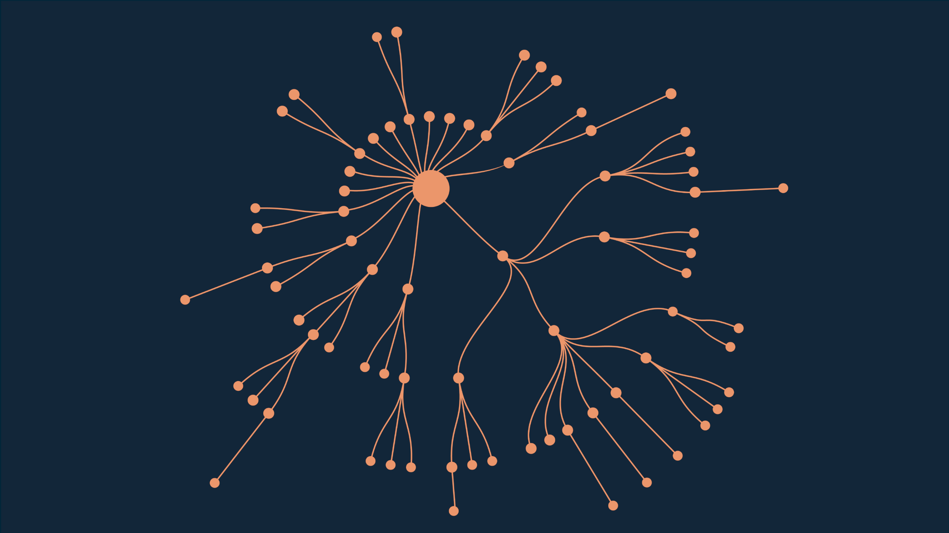
Example: Spoon library
Open source library for code analysis, 75 dependencies
https://github.com/INRIA/spoon
87
Notes:
Let’s see a real example.
This is the dependency tree of Spoon, a library for metaprogramming and source code analysis.
It contains a total of 75 dependencies.
As we can observe, there are both direct and transitive dependencies.
87

Slide 88
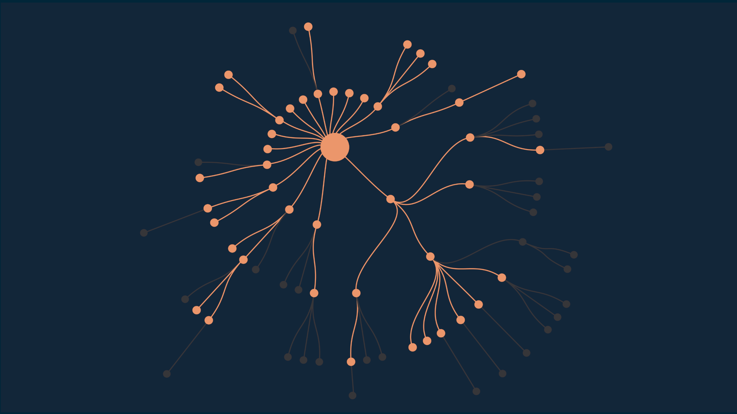
Regular Maven analysis
Maven excludes
31 redundant dependencies
https://github.com/INRIA/spoon
88
Notes:
Maven, as part of its analysis, excludes a total of 31 dependencies from its dependency tree.
These are redundant dependencies, which basically means that they are duplicated versions of the same provider.
88

Slide 89
DepClean novel analysis
DepClean detects
13 bloated dependencies
https://github.com/INRIA/spoon
89
Notes:
After this, DepClean performs its novel dependency analysis.
It detects 13 bloated transitive dependencies in Spoon.
89

